Slide 1
Chapter 1 Introduction to Wireless Communications
Reference: Jorge Olenewa, Guide to Wireless Communications, 3rd edition, ISBN-13: 9781111307318, 2013
© Cengage Learning 2014
Department of Computer Engineering, Faculty of Engineering Prince of Songkla University, Phuket Campus

Slide 2
Objectives
Describe how wireless communications technologies are used today
List various applications of wireless communications technology
Outline the advantages and disadvantages of wireless communications technology
List several types of wireless technologies and their purposes

Slide 3
History of Wireless Networks
Progress of transmission:
fire and smoke used by Indians ==> messenger on horseback ==> telephone line ==> networks
Traditional networks (LAN, MAN, WAN) have provided great convenience:
in office, hotel room, or home
But you cannot utilize the service unless you are physically connected to a LAN or a telephone line.
ALOHANET by University of Hawaii:
7 campuses over 4 islands; star-like structure centered at the Oahu island in 70’s.
Notes:
ALOHANET in 1970s

Slide 4
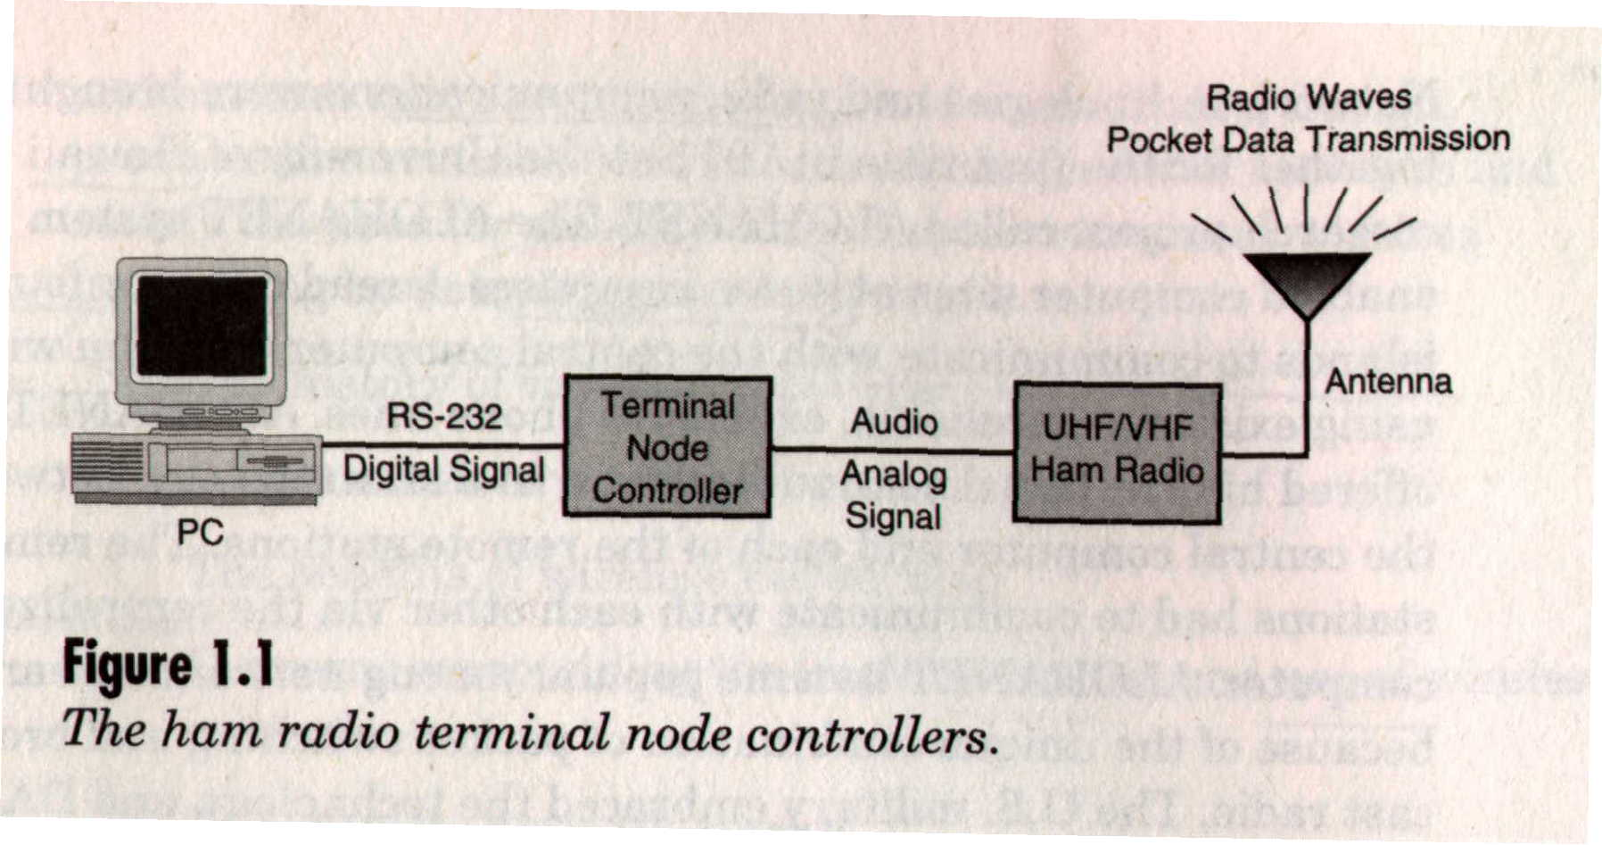
History of Wireless Networks
In 80’s, amateur radio hobbyists built TNC (terminal node controller) to interface “hams” radio equipment and their computers.

Slide 5
Wireless communication
RF spectrum are available because they exist worldwide
using frequencies at will would eventually disable all communication
Regulatory bodies have been formed to keep the RF spectrum organized open for fair use
There are three main regulatory bodies that govern the RF spectrum: ITU-R, FCC, ETSI
Notes:
Reference: https://www.udemy.com/wireless-networking-fundamentals/
FCC stands for Federal Communications Commission and is the supreme regulatory agency in the USA on every communications issues (radio, television, wire, satellite...). The ITU is the International Telecommunication Union and is supposed to be the the international reference on telecommunications. It is a United Nations organization so it´s clear that it may not work how it should be. I think the things work as follows: FCC tolds ITU to propose and then everyone obey ITU. you know.
FCC regualtions are mandatory in US while ITU recommendations are adopted by the countries by their choice
FCC tolds ITU to propose and then everyone obey ITU-R.

Slide 6
Progress of Wireless Communication
In 1985, FCC authorized the use of ISM bands for Industrial, Scientific, and Medical for commercial development.
ISM is very attractive to vendors because NO obtaining FCC license is required.
In 90’s, small-size computers started to appear.
laptop, palmtop, PDA
Wireless LAN products populate

Slide 7
ISM Band defined by ITU-R
Frequency range |  | Bandwidth | Center frequency | Availability
6.765 MHz | 6.795 MHz | 30 kHz | 6.780 MHz | Subject to local acceptance
13.553 MHz | 13.567 MHz | 14 kHz | 13.560 MHz
26.957 MHz | 27.283 MHz | 326 kHz | 27.120 MHz | Worldwide
40.660 MHz | 40.700 MHz | 40 kHz | 40.680 MHz
433.050 MHz | 434.790 MHz | 1.84 MHz | 433.920 MHz | Region 1 only and subject to local acceptance
902.000 MHz | 928.000 MHz | 26 MHz | 915.000 MHz | Region 2 only (with some exceptions)
2.400 GHz | 2.500 GHz | 100 MHz | 2.450 GHz
5.725 GHz | 5.875 GHz | 150 MHz | 5.800 GHz | Worldwide
24.000 GHz | 24.250 GHz | 250 MHz | 24.125 GHz
61.000 GHz | 61.500 GHz | 500 MHz | 61.250 GHz | Subject to local acceptance
122.000 GHz | 123.000 GHz | 1 GHz | 122.500 GHz
244.000 GHz | 246.000 GHz | 2 GHz | 245.000 GHz

Slide 8
How Wireless Technology is Used
Wireless: describes all types of devices and technologies not connected by a wire
Wireless communications: transmission of digital data without the use of wires
Various forms of wireless data communications:
Bluetooth
WirelessHD
WiGig
Satellite
Cellular
Wi-Fi-based wireless LANs
Fixed broadband wireless communications

Slide 9
A Wireless World
Wireless devices
Distance: up to 330 feet (100 meters)
Bandwidth: up to 300 Mbps
Can also include Voice over IP (VoIP)
Wireless network interface card (Wireless NIC)
Sends and receives data over radio waves
Smartphone: Combination mobile phone and personal digital assistant (PDA)
Radio frequency identification (RFID) tags: small chips containing radio transponders

Slide 10
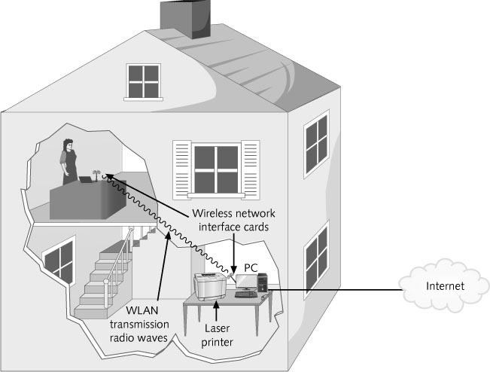
Figure 1-1 Home wireless network (WLAN)

Slide 11
Bluetooth and Other Short-Range Wireless Technologies
Bluetooth
Wireless standard designed for very short ranges
Typically a few inches to 33 feet (10 meters)
Main purpose is to eliminate cables between devices
Bluetooth communicates using small, low-power transceivers called radio modules
Link manager
Special software that helps identify other Bluetooth devices, create a link between them, and send and receive digital data

Slide 12
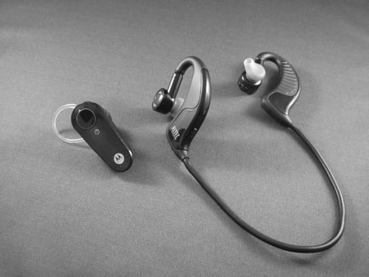
Figure 1-2 Two examples of Bluetooth headsets: mono (left) and stereo (right)

Slide 13
Bluetooth and Other Short-Range Wireless Technologies
Wireless HD and WiGig
Can transfer video and sound at speeds between 7 Gbps and 10 Gbps using Ultra Wide Band (UWB)
Distance: up to 10 meters (only in a room with few or no obstacles)
Greater the distance, the slower the transmission
Piconet
Wireless personal area network (WPAN)
Consists of two or more Bluetooth devices that are exchanging data with each other
Up seven devices can belong to a single WPAN

Slide 14
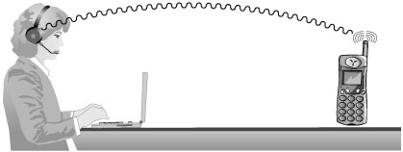
Figure 1-3 Bluetooth network (piconet) or WPAN between
a cordless handset and a headset

Slide 15
Satellite Networks
Used to transmit data over very long distance
Repeater
Located in the satellite itself
“Repeats” the same signal to another location down on the surface
Used to transmit data from one earth station to another
Transmission time can be up to 250 milliseconds

Slide 16
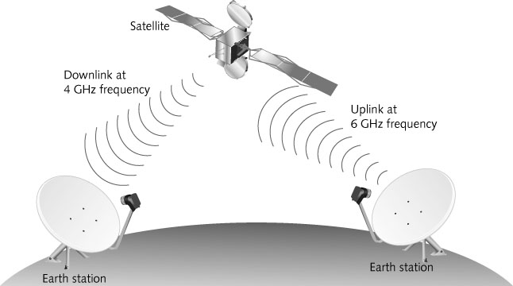
Figure 1-5 Satellite repeating a signal to another Earth station

Slide 17
Cellular Networks
Modern cellular telephone network
Built around the concept of low-power transmitters
With each “cell” handling a number of users
Transmission towers are spread throughout a geographical area
The same radio frequency channels can be reused by another tower
Located a few miles away to avoid interference
Maximizes the use of a limited range of frequency channels

Slide 18
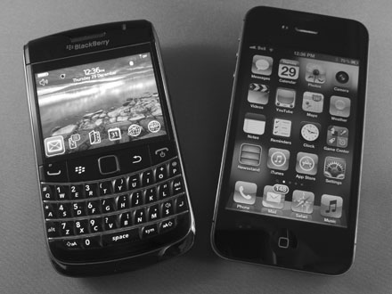
Figure 1-6 Smartphones - Blackberry Bold (left) and Apple iPhone (right)

Slide 19
Cellular Networks
4G (fourth generation) technology
Uses 100% digital transmission for both voice and data
Transmission speed
Over 150 Mbps when stationary
45 Mbps for slow-moving pedestrians
20 Mbps in a fast moving vehicle
3G (third generation) technology
Has a theoretical maximum data transmission rate of up to 21 Mbps
Realistic speeds are between 3 to 11 Mbps

Slide 20
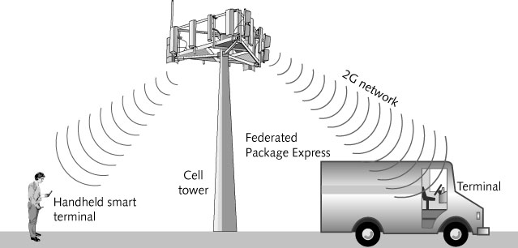
Figure 1-7 Digital cellular network

Slide 21
Wireless Local Area Networks
Wireless Local Area Network (WLAN)
Extension of a wired LAN
Connecting to it through a device called a wireless access point
Access point (AP or wireless AP)
Relays data signals among all of the devices on the wired network
Each computer on the WLAN has a wireless network interface card (NIC)
Has an antenna built into it

Slide 22
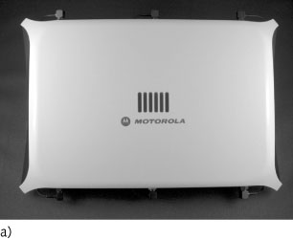
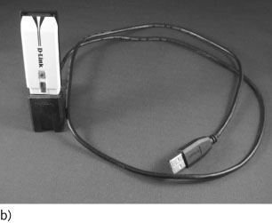
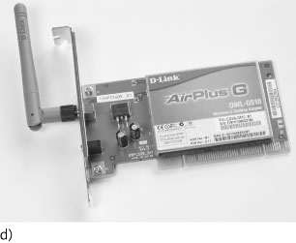
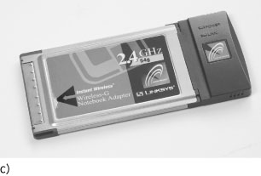
Figure 1-8 Clockwise from top left: a) access point with built-in antennas,
b) USB Wireless NIC, c) PCMCIA, and d) PCI Wireless NICs

Slide 23
Wireless Local Area Networks
Institute of Electrical and Electronic Engineers (IEEE) standards
Established a series WLAN standards
Most recent IEEE 802.11n-2009 (more commonly known as IEEE 802.11n)
Provides for transmission speeds of up to 600 Mbps and covers distances up to 375 feet

Slide 24
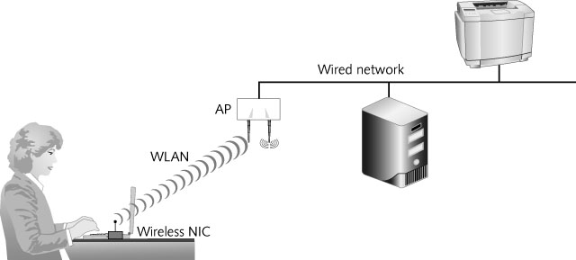
Figure 1-10 Office WLAN

Slide 25
Fixed Broadband Wire
Integrated Services Digital Networks (ISDN)
Transmits at up to 256 Kbps over regular phone lines
T1 lines
Transmit at 1.544 Mbps
Very costly option
Cable modems
Generally only available in residential areas
Digital subscriber lines (DSL)
Use either regular or special telephone lines
Speed is dependent on distance between FPE’s main office and nearest telephone switching office

Slide 26
Fixed Broadband Wireless
Wireless metropolitan area network (WMAN)
Covers a distance of up to 25 miles
Based on the IEEE 802.16 WIMAX Fixed Broadband Wireless standard
Uses radio waves and small custom antennas on the roof of each building in WMAN
Transmission speeds
75 Mbps at distances of up to 4 miles (6.4 km)
17 to 50 Mbps at distances over 6 miles (10 km)
Newer versions of IEEE 802.16m standard will be able to achieve average speeds up to 100 Mbps

Slide 27
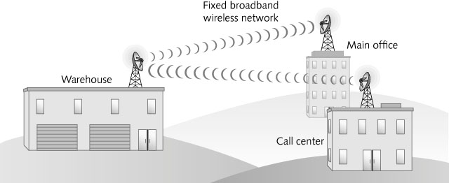
Figure 1-11 IEEE 802.16 wireless metropolitan area network (WMAN)

Slide 28
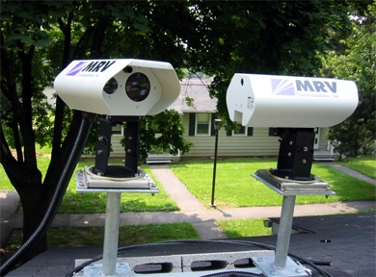
Fixed Broadband Wireless
Free-space optical communication (FSO) is an optical communication technology.
FSO uses light propagating in free space to transmit data for telecommunications or computer networking.
The technology is useful where the physical connections are impractical due to high costs or other considerations.
Photograph courtesy of MRV Communications

Slide 29
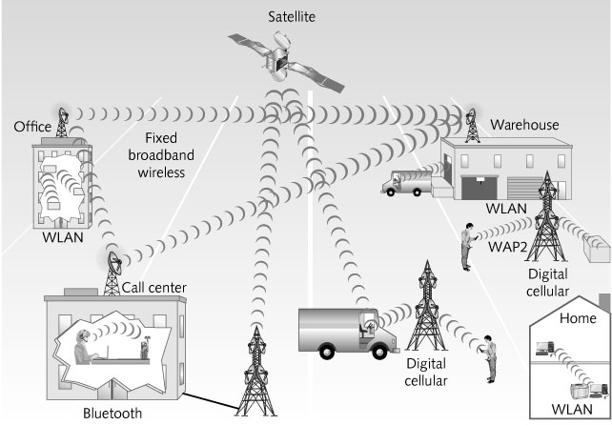
The Wireless Landscape
Wireless communications
Has become a standard means of communication for people in many occupations and circumstances
Figure 1-14 Wireless communications

Slide 30
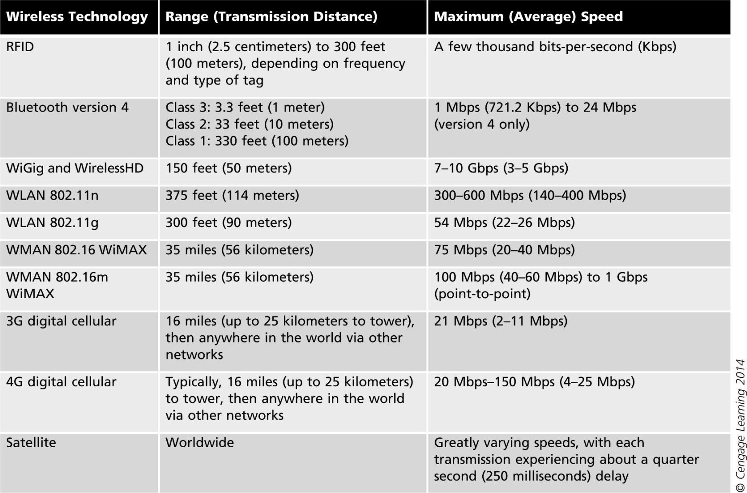
Table 1-1 Wireless data communications technologies

Slide 31
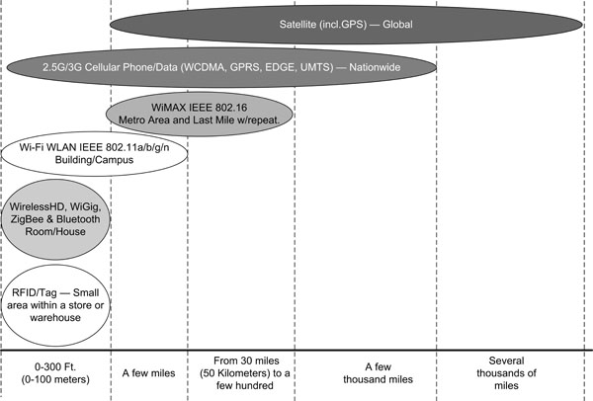
Figure 1-15 Comparing wireless communications technologies

Slide 32
The Wireless Landscape
Speeds of wireless networks vary greatly depending on:
Number of users connected
Amount of data traffic
Amount of interference present at the time
Other factors that will be discussed in later chapters
Job market will increase for:
Wireless engineers
Wireless local area network managers
Wireless technical support personnel

Slide 33
Digital Convergence
Digital convergence
Refers to the power of digital devices to combine voice, video, and text-processing capabilities
As well as to be connected to business and home networks and to the Internet
Same concept applies to the development of VoIP networks
Use the same protocols and media that once only carried data
Wireless technologies are used to fulfill many daily activities

Slide 34
Wireless Applications
Main areas
Education
Home entertainment and Home control systems
Health Care
Government and Military
Office environments
Event management
Travel
Construction and warehouse management
Environmental research
Industrial control

Slide 35
Education
Ideal application for colleges and schools
Instructors can create classroom resources in their home or school office and easily connect to campus network in the classroom
It frees students from having to go to a specific computer lab or the library
To get on the school’s computer network
Wireless technology translates into a cost savings for colleges
Traditional classrooms become computer labs without the expense of additional wiring

Slide 36
Home Entertainment
Wireless communication
Enables people to download, distribute, and control all forms of digital entertainment from anywhere in the house
Examples:
Wireless speakers, media players, game consoles, DVD players, televisions, digital video recorders (DVRs), and multimedia personal computers

Slide 37
Home Control Systems
Manufacturers are creating wireless systems that enable us to:
Control lights, heating, ventilation, air conditioning, drapes, alarms, door locks, and home appliances
Can control from locations throughout the house or even from smartphones or tablets outside the home
Several systems use the ZigBee Alliance communications protocols and the IEEE 802.15.4 standard

Slide 38
Health Care
Administering correct medication in a hospital setting
A major concern for the health care industry
Wireless point-of-care computer systems
Allow medical staff to access and update patient records immediately
Many hospitals use portable devices with barcode scanners or RFID and a wireless connection
Patients may have a barcoded or RFID-enabled armband that can be scanned to access records
System immediately verifies correct medication

Slide 39
Government
Wireless communication
Lets residents, city employees, contractors, and utility staff collect and transmit data to central databases
Examples:
Building inspectors can update permit data while at the construction site
City employees can locate and monitor municipal vehicles
Delivers broadband connectivity to schools, libraries, and government buildings
Provides free Internet access to residents and attracts visitors and businesspeople

Slide 40
Military
Latest devices allow military personnel in the field to:
Use voice and the Internet
Receive and transmit full-motion video
Maneuver remote control survey drones
Use digital battlefield maps
Many other applications

Slide 41
Office Environments
Employees in all lines of work no longer have to be away from the data they need
To help them make decisions
Wireless technologies allow businesses to create an office where the traditional infrastructure doesn’t exist
During office renovations or reorganization
Employees can move to another location and be connected immediately

Slide 42
Event Management
Wireless networks
Help identify a stolen or counterfeit ticket
Can also give a real-time look at traffic flow
Use to determine where staff might be needed
In-progress game statistics are available to any fan in the stadium with a wireless device

Slide 43
Travel
Wireless global positioning systems (GPS)
Tie into emergency roadside assistance services
OnStar roadside assistance is an example
Satellite radio
Transmits over 150 music and talk stations
Airport terminals are offering wireless technologies to passengers
Airplanes themselves are being equipped with wireless data access
City transit systems are also “going wireless”

Slide 44
Construction
Wireless communications
Send information from the job site to the main office
Tardy subcontractor or problems with materials
Alert when maintenance operations need to be performed on equipment
Bulldozers and earth graders are being turned into “smart” equipment
Exact location of dig coordinates can be transmitted to a terminal on the bulldozer
Track engine hours and equipment location

Slide 45
Warehouse Management
Implementing wireless technology is key for many warehouse operations
Warehouse management system (WMS) software
Used to manage all of the activities from receiving through shipping
In the near future
Most of the bar code functions, including inventory counting, will be replaced by RFID tags
Will eliminate the need for printing and affixing labels

Slide 46
Environmental Research
Scientists are now using small, battery- or solar-cell-powered WLAN sensors
In places that were previously difficult to access and monitor
Considered a major breakthrough in many scientific fields
Has helped collect data that used to be very difficult or impossible to collect and record

Slide 47
Industrial Control
Motes
Remote sensors
Can connect to a WLAN
Then collect data and transmit it to a central location
Manufacturing managers can monitor equipment from an office
Problems can be detected instantly
Technicians in a control room can monitor status of every machine or device
Dispatch a technician when necessary

Slide 48
Wireless Advantages and Disadvantages
As with any new technology, wireless communications offers both advantages and disadvantages

Slide 49
Advantages of Wireless Networking
Mobility
Freedom to move about without being tethered by wires
Permits many industries to shift toward an increasingly mobile workforce
Creating “flatter” organizations with fewer management levels between top executives and regular employees
Easier and less expensive installation
Installing network cabling in older buildings can be a difficult, slow, and costly task
Makes it easier for any office to be modified with new cubicles or furniture

Slide 50
Advantages of Wireless Networking
Increased reliability
Network cable failures may be the most common source of network problems
Disaster recovery
In the event of a disaster, managers can quickly relocate the office
Some planners keep laptop computers with wireless NICs and access points in reserve
Future Applications
Every day, a new application for wireless data transmission is thought of or implemented

Slide 51
Disadvantages of Wireless Networking
Radio signal interference
The potential for two signals to interfere exists
Solution: locate source of interference and eliminate it
Security
It is possible for an intruder to be lurking outdoors with a notebook computer and wireless NIC
With the intent of intercepting the signals from a nearby wireless network
Some wireless technologies can provide added levels of security
Network managers can limit access

Slide 52
Disadvantages of Wireless Networking
Health risks
High levels of RF can produce biological damage through heating effects
Wireless devices emit low levels of RF while being used
No clear picture of the biological effects of this type of radiation has been found to date
Science today does not yet permit anyone to draw a definitive conclusion on the safety of wireless mobile devices
Be aware of the possibility and monitor ongoing scientific research

Slide 53
Summary
Wireless communications have become commonplace
Wireless networks and devices are found in all circles of life today
Wireless wide area networks will enable companies of all sizes to interconnect their offices
Without the high cost charged by telephone carriers for their landline connections
WLAN applications are found in a wide variety of industries and organizations

Slide 54
Summary
Remote sensors capable of communicating using wireless technologies
Used in large manufacturing facilities to monitor equipment and for scientific research
Wireless communication advantages
Mobility
Easier and less expensive installation
Increased network reliability
Support for disaster recovery

Slide 55
Summary
Wireless communication disadvantages
Radio signal interference
Security issues
Health risks

Slide 56
Homework
Describe all wireless technologies that you are using in more details?
Technology specification
How do you use them

