Slide 1
Chapter 2 Wireless Data Transmission
Reference: Jorge Olenewa, Guide to Wireless Communications, 3rd edition, ISBN-13: 9781111307318, 2013
© Cengage Learning 2014
Department of Computer Engineering, Faculty of Engineering Prince of Songkla University, Phuket Campus

Slide 2
Objectives
Discuss the two types of wireless transmissions
Explain the properties of a wave, such as amplitude, wavelength, frequency, and phase
Describe the basic concepts and techniques related to the transmission of data by radio waves

Slide 3
Wireless Signals
Data travel in the “air”?
Can data send in the outer space (outside world)?
Wireless data signals travel on electromagnetic waves
Through space at the speed of light
300,000 kilometers per second
Two basic types of waves
Infrared light
Radio waves

Slide 4
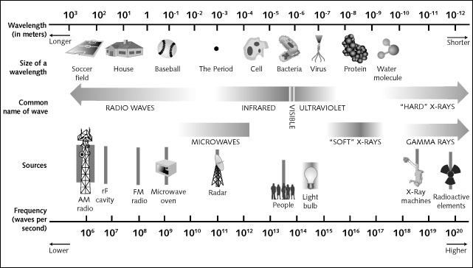
Figure 2-1 Electromagnetic spectrum

Slide 5
Wireless Signals
Two basic types of waves
Infrared Light
Radio Waves

Slide 6
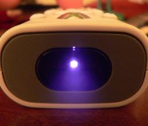
Infrared Light
Infrared (IR) light is electromagnetic radiation with longer wavelengths than those of visible light.
This range of wavelengths corresponds to a frequency range of approximately 430 THz down to 300 GHz.
The existence of infrared radiation was first discovered in 1800 by astronomer William Herschel.

Slide 7
Infrared Light for Communications
It is easy to transmit information with light
Light has two properties: off and on
A 1 in binary code could result in a light quickly flashing on; a 0 could result in the absence of light
Light spectrum
Types of light that travel from the Sun to the Earth
Infrared light
Adjacent to visible light (although invisible)
A much better medium for data transmission
Less susceptible to interference

Slide 8
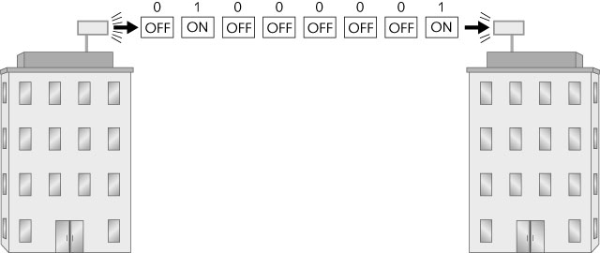
Figure 2-2 Transmitting a message using visible light

Slide 9
Infrared Light for Communications
Infrared wireless systems require:
Emitter that transmits a signal (LED)
Detector that receives the signal
Infrared wireless systems send data by the intensity of the light wave
Detector senses the higher intensity pulse of light
And produces a proportional electrical current
Infrared wireless transmission types
Directed transmission (called line-of-sight or LOS)
Diffused transmission – relies on reflected light

Slide 10
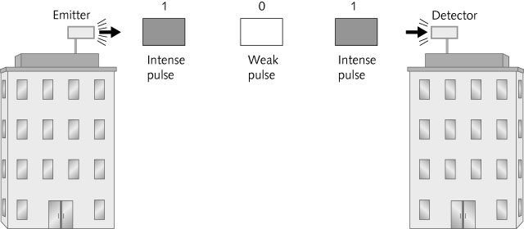
Figure 2-3 Light pulses

Slide 11
Figure 2-4 Directed infrared transmission

Slide 12
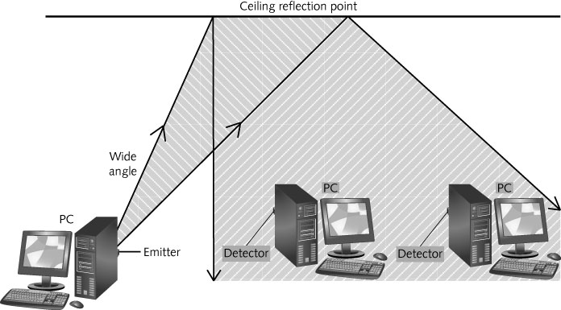
Figure 2-5 Diffused infrared transmission

Slide 13
Infrared Light
Advantages
It does not interfere with other types of communication signals
It is not affected by other signals (except light)
Infrared light does not penetrate walls
Signals are kept inside a room
Limitations
Lack of mobility
Range of coverage
Can cover a range of only 50 feet (15 meters)
Diffused infrared can only be used indoors
Speed of transmission

Slide 14
Infrared Light
Some specialized wireless local area networks are based on the infrared method
Used in situations where radio signals would interfere with other equipment
Light waves cannot penetrate through materials like wood or concrete
Heat rays are absorbed by most objects
Solid objects, dust and humidity can limit the distance that light and infrared waves can travel

Slide 15
Radio Waves
Radio waves are a type of electromagnetic radiation with wavelengths in the electromagnetic spectrum longer than infrared light.
Radio waves have frequencies from 300 GHz to as low as 3 kHz.
Like all other electromagnetic waves, they travel at the speed of light.

Slide 16
Radio Waves
Naturally occurring radio waves are made by lightning, or by astronomical objects.
Artificially generated radio waves are used for fixed and mobile radio communication:
Broadcasting, radar and other navigation systems, communications satellites, computer networks and innumerable other applications.

Slide 17
Radio Waves
Different frequencies of radio waves have different propagation characteristics in the Earth's atmosphere.
Shortwave radio (shortwave frequency) can reflect off the ionosphere and travel around the world, and much shorter wavelengths bend or reflect very little and travel on a line of sight e.g., AM radio.
Longwave radio may cover a part of the Earth very consistently e.g., FM radio.
Notes:
Shortwave radio refers to radio transmissions using shortwave frequencies.!!!

Slide 18
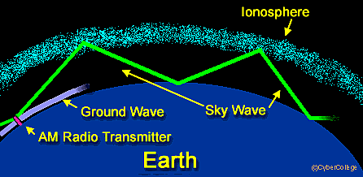
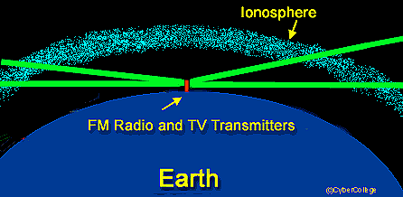
Radio Waves
AM Radio vs. FM Radio
AM: 535 to 1705kHz
FM: 88 to 108 MHz

Slide 19
Radio Waves
Radio waves provide the most common and effective means of wireless communications today
Energy travels through space or air in electromagnetic waves
Antenna
Length of copper wire, or similar material with one end free and the other end connected to a receiver or transmitter
Notes:
Many people use radio wave for communication (majority)
Energy (data) travel in the air in electromagnetic
Radio wave come from: Electric current → wire → Create magnetic field (around wire)
Magnetic field move → Create radio wave (move out)

Slide 20
Radio Waves
Electrical current moves the antenna
At the same frequency as the radio waves
Electromagnetic wave (EM wave) – continuous (analog) combination of magnetism and electrical pressure (voltage) moving away from an antenna
Radio (radiotelephony) waves
When an electric current passes through a wire, it creates a magnetic field
In the space around the wire
As this magnetic field radiates or moves out, it creates radio waves

Slide 21
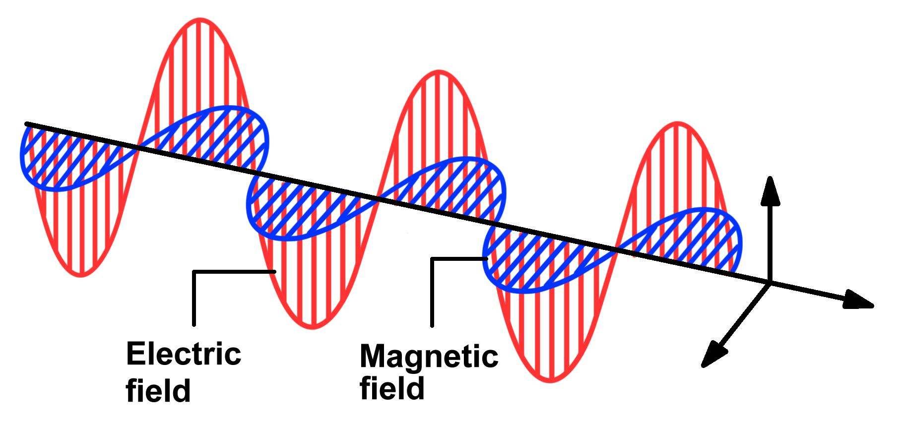
Frequency and Wavelength
A magnetic field and an electrical field around the antenna.
Receiver antenna can pickup transmitted radio signals

Slide 22
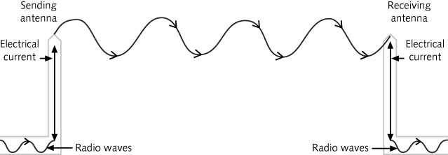
Figure 2-18 Radio antennas transmitting and receiving signals

Slide 23
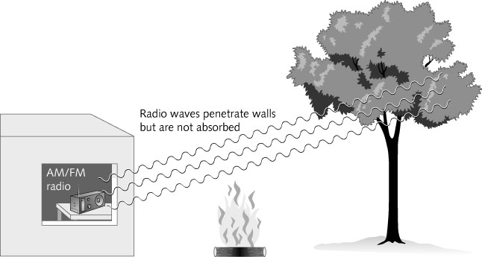
Radio Waves
Advantages of radio waves
Can travel great distances
Can penetrate most solid objects
With the exception of metallic ones
Invisible
Figure 2-9 Radio waves can
penetrate most solid objects

Slide 24
How Radio Data is Transmitted
Radio waves can be used to transmit data
Over long distances
Without the need for wires
Types of data
Analog data
Digital data

Slide 25
Analog and Digital
Analog signal
The intensity of the waves (voltage or amplitude) varies
It is broadcast continuously
Examples:
Audio, video, voice, and light
Figure 2-10 Analog signal

Slide 26
Analog and Digital
Digital signal
Consists of discrete or separate pulses
Has numerous starts and stops throughout the signal stream
Computers operate using digital signals
Analog signal must be converted into a digital format
Before it can be stored and processed or interpreted by a computer

Slide 27
Figure 2-11 Simulating a digital signal with a garden hose
Figure 2-12 Digital signal

Slide 28
Analog and Digital
To transmit a digital signal over an analog medium, a modem is used
Modem (Modulator/Demodulator)
Converts the distinct digital signals from a computer
Encodes them into a continuous analog signal
For transmission over analog phone lines
Modulation
Process of encoding the digital signals (bits) onto an analog wave

Slide 29
Frequency and Wavelength
Wavelength – distance between any point in one wave cycle and the same point in the next wave cycle
Frequency – Rate at which a radio circuit creates the waves
The number of times a cycle occurs within one second
Carrier signal
Sent by radio transmitters
Continuous wave (CW) of constant amplitude (also called voltage) and frequency
An up-and-down wave called an oscillating signal or a sine wave

Slide 30
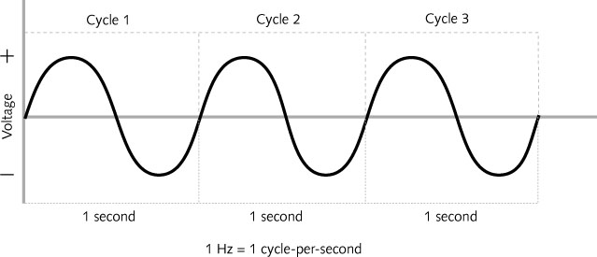
Figure 2-15 Sine wave (analog wave) and frequency

Slide 31
Frequency and Wavelength
A change in voltage does not create a change in frequency
The term Hertz (Hz) is used to measure frequency
A Kilohertz (KHz) is 1,000 Hertz
A Megahertz (MHz) is 1,000,000 Hertz
A Gigahertz (GHz) is 1,000,000,000 Hertz
The wave measured as 710,000 Hz is referred to as 710 KHz

Slide 32
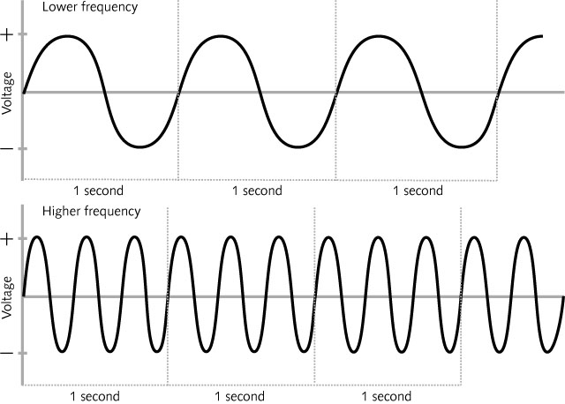
Figure 2-16 Two different frequencies; same amplitude

Slide 33
Transmission Speed
Speed of transmission is usually shown in bits per second (bps)
Baud rate
Another term used in measuring the speed of radio transmission
Number of signal units per second that are required to represent the bits transmitted
Baud is a change in the carrier signal
It is possible to have a change in signal (a baud) represent more than 1 bit

Slide 34
Table 2-2 Bit representation of four signal changes

Slide 35
Transmission Speed
Analog modems transmit at a rate of 4,800 baud
Maximum number of signal changes per second that a phone line can support
Current modems can transmit up to 33,600 bps
Using more complex modulation techniques
Along with compression of the data
When a signal unit can represent:
Two bits, it is known as a dibit
Three bits, it is known as a tribit
Four bits, it is known as a quadbit
Notes:
4800 baudx 7 bit = 33,600 bps

Slide 36
Transmission Speed
Bandwidth
Range of frequencies that can be transmitted by a particular system or medium
Refers to the maximum data transmission capacity
Accurate only when referring to purely digital systems

Slide 37
Analog Modulation
Representation of analog information by an analog signal
Analog modulation types
Amplitude modulation
Frequency modulation
Phase modulation
Amplitude modulation (AM)
Height of a carrier wave is known as the amplitude
Can be measured in volts (electrical pressure)
Height of the carrier wave is changed in accordance with the height of the modulating signal

Slide 38
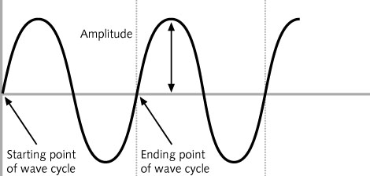
Figure 2-19 Amplitude of a signal

Slide 39
Analog Modulation
Amplitude modulation (AM)
Used by broadcast radio stations
Very susceptible to interference from outside sources
Frequency modulation (FM)
Number of waves that occur in one second undergoes change based on the amplitude of the modulating signal
Often used by broadcast radio stations
Not as susceptible to interference from outside sources
FM carrier has a wider bandwidth
Allows it to carry Hi-Fi as well as stereophonic signals

Slide 40
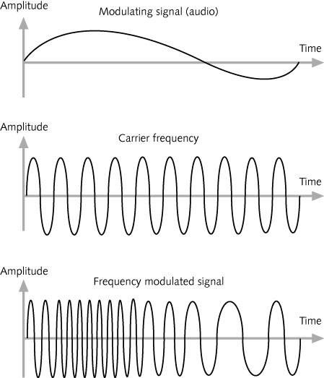
Figure 2-21 Frequency modulation (FM)

Slide 41
Analog Modulation
Phase modulation (PM)
Changes the starting point of the cycle
It is not generally used to represent analog signals
A signal composed of sine waves has a phase associated with it
Phase is measured in degrees
One complete wave cycle covers 360 degrees
A phase change is always measured with reference to some other signal
PM systems almost always use the previous wave cycle as the reference signal

Slide 42
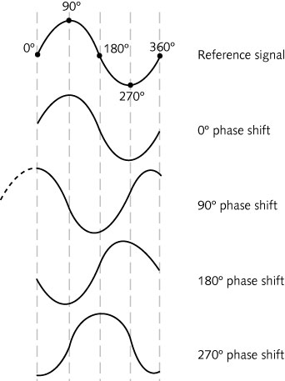
Figure 2-22 Visual representation of phase shift

Slide 43
Digital Modulation
Method of encoding a digital signal onto an analog wave
For transmission over a medium that does not support digital signals
In a digital system, the changes are distinct using binary signals
Which exist in one of two states, a 1 or a 0
For a computer to be able to understand these signals
Each bit must have a fixed duration to represent 1 or 0

Slide 44
Digital Modulation
Advantages
Makes better use of the bandwidth available
Requires less power to transmit
Performs better when the signal experiences interference from other signals
Error-correcting techniques are more compatible with other digital systems
There are three basic types of digital modulations:
Amplitude, frequency, and phase
Users demand more transmission speed
Today there are dozens of different types of modulation

Slide 45
Digital Modulation
Binary signals
Digital data transmissions are typically sent in bursts of bits
Three types of binary signaling techniques can be used:
Return-to-zero (RZ)
Non-return-to-zero (NRZ)
Polar non-return-to-zero (polar NRZ)
Also known as non-return-to-zero-level (NRZ-L)
A variation of NRZ-L is non-return-to-zero, invert-on-ones (NRZ-I)

Slide 46
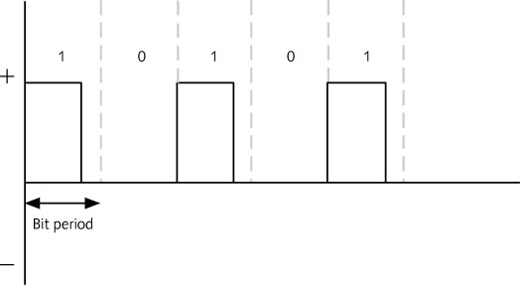
Figure 2-23 Return-to-zero (RZ)

Slide 47
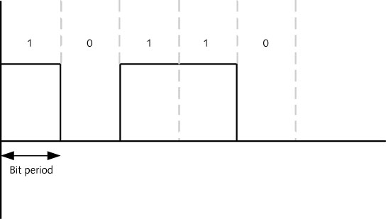
Figure 2-24 Non-return-to-zero (NRZ)

Slide 48
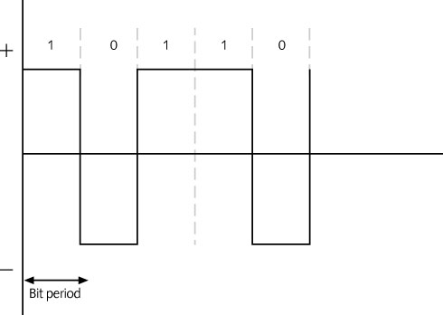
Figure 2-25 Polar non-return-to-zero (non-return-to-zero level or NRZ-L)

Slide 49
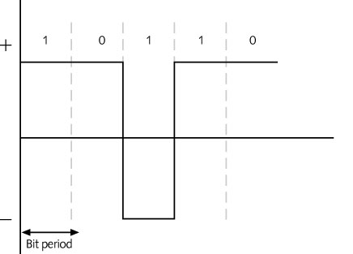
Figure 2-26 Non-return-to-zero, invert-on-ones (NRZ-I)

Slide 50
Digital Modulation
Amplitude Shift Keying (ASK)
Binary modulation technique similar to amplitude modulation
Height of the carrier signal can be changed to represent a 1 bit or a 0 bit
ASK uses NRZ coding
Frequency Shift Keying (FSK)
Binary modulation technique that changes the frequency of the carrier signal
More wave cycles are needed to represent a 1 bit

Slide 51
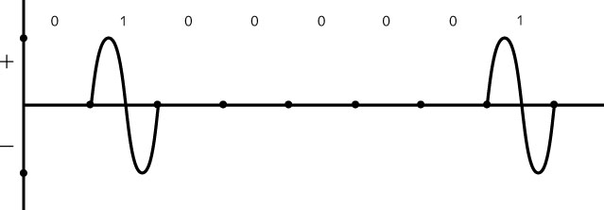
Figure 2-27 Amplitude shift keying (ASK)

Slide 52
Figure 2-28 Frequency shift keying (FSK)

Slide 53
Digital Modulation
Phase Shift Keying (PSK)
Binary modulation technique similar to phase modulation
Transmitter varies the starting point of the wave
PSK signal starts and stops because it is a binary signal
Quadrature amplitude modulation (QAM)
Technique of combining amplitude and phase modulation
Receivers can detect phase changes much more reliably than a frequency or amplitude change
In the presence of electromagnetic noise

Slide 54
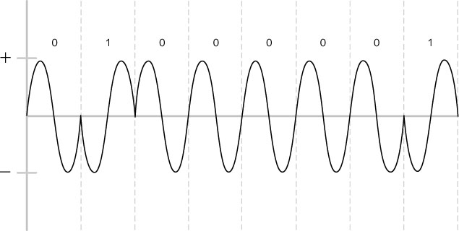
Figure 2-29 Phase shift keying (PSK)

Slide 55
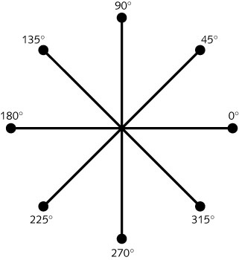
Figure 2-30 Phase modulation angles

Slide 56
Digital Modulation
Binary phase shift keying (BPSK)
Can be used to transmit dibits (four signal changes equals 2 bits per signal change)
Figure 2-32 Transmitting dibits using BPSK
Notes:
Phase is referenced by a previous wave

Slide 57
Spread Spectrum
Narrow-band transmissions
Each signal transmits on one radio frequency
Or a very narrow range of frequencies
Vulnerable to outside interference from another signal
Radio signal transmissions are narrow-band
Spread spectrum transmission
Takes a narrow band signal and spreads it over a broader portion of the radio frequency band
Results in less interference and fewer errors
Two common methods
Frequency hopping and direct sequence

Slide 58
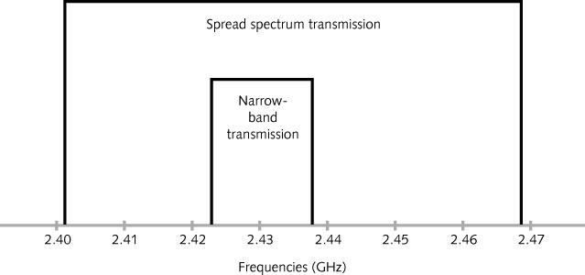
Figure 2-33 Spread spectrum vs. narrow-band transmission

Slide 59
Frequency Hopping Spread Spectrum (FHSS)
Uses a range of frequencies
Changes frequencies several times during transmission
Hopping code
The sequence of changing frequencies
The receiving station must also know the hopping code
Multiple radios can each use a different sequence of frequencies within the same area
And never interfere with each other
If interference is encountered on a frequency
Only a small part of the message is lost

Slide 60
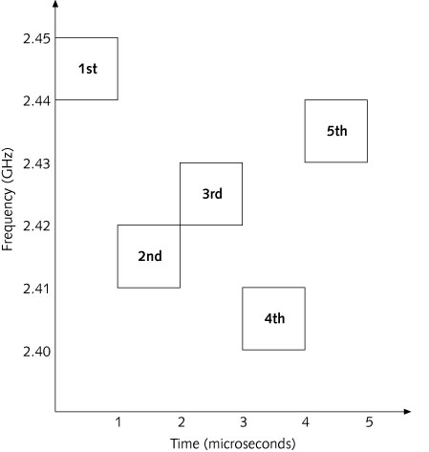
Figure 2-34 Frequency hopping spread spectrum (FHSS) transmission

Slide 61
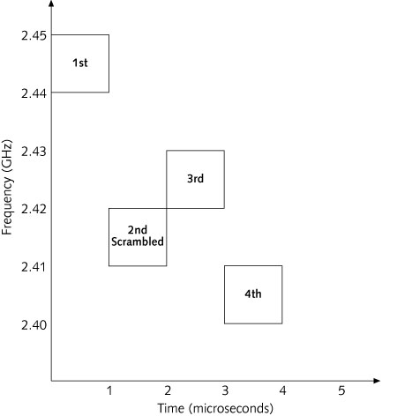
Figure 2-35 FHSS error detection

Slide 62
Frequency Hopping Spread Spectrum (FHSS)
Frequency hopping can reduce the impact of interference from other radio signals
An interfering signal will affect the FHSS signal only when both are transmitting at the same frequency and at the same time
Because FHSS transmits short bursts over a wide range of frequencies, the extent of any interference will be small
The error can be detected through error checking
Message can be easily retransmitted

Slide 63
Direct Sequence Spread Spectrum (DSSS)
Similar as: Word spelling when communicate by telephone (Somchai: Singapore, Oxygen, Man…)
Uses an expanded redundant code to transmit each data bit
And then a modulation technique such as QPSK
A DSSS signal is effectively modulated twice
Barker code (or chipping code)
A particular sequence of 1s and 0s
Ideal for modulating radio waves
As well as for being detected correctly by the receiver
It is also called a pseudo-random code
Before transmission, add the original data bit to the chipping code

Slide 64
Figure 2-36 Encoding before modulation in a DSSS transmission

Slide 65
Direct Sequence Spread Spectrum (DSSS)
DSSS system transmits combinations of multiple chips
11 chips are transmitted at a rate 11 times faster than the data rate
Characteristics
Frequency of the digital component of the signal is much higher than that of the original data (chip rate)
A plot of the frequency spectrum of this signal would look similar to random noise
All of the information contained in the original signal (a 0 or a 1 bit) is still there!

Slide 66
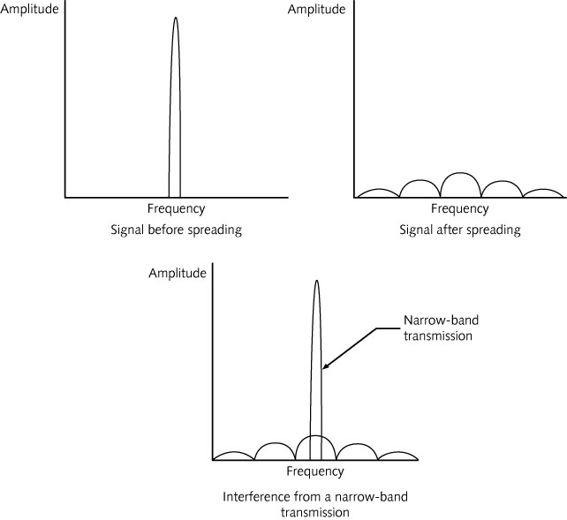
Figure 2-37 Spreading the signal over a wider range of frequencies

Slide 67
Direct Sequence Spread Spectrum (DSSS)
Advantages
DSSS signal appears to an unintended narrow-band receiver to be low-powered noise
Noise can cause some of the chips to change value
Receiver can recover the original data bit
Using statistical techniques and mathematical algorithms
Thus avoiding the need for retransmission
DSSS devices are typically higher-end products
Because they are more expensive to manufacture than FHSS systems

Slide 68
Summary
American Standard Code for Information Interchange (ASCII)
Coding scheme that uses numbers from 0 to 127 to represent symbols
Wireless transmissions do not use wires or any other visible media
Infrared wireless transmission can be either directed or diffused
Radio transmissions use a carrier signal
A continuous wave (CW) of constant amplitude (voltage) and frequency

Slide 69
Summary
Carrier signal can undergo three types of modulation:
Amplitude, frequency, and phase
Digital modulation basic techniques
Amplitude, frequency and phase
Radio signals are by nature a narrow-band type of transmission
Transmit on one radio frequency or a very narrow spectrum of frequencies

Slide 70
Summary
Spread spectrum
Takes a narrow signal and spreads it over a broader portion of the radio frequency band
Spread spectrum common methods
Frequency hopping spread spectrum (FHSS)
Direct sequence spread spectrum (DSSS)

Slide 71
Homework
Prepare to send your name to network
Write your name in English and translate to hexadecimal (e.g., Bob => 42-6F-62)
Using ASCII Table
Convert hexadecimal value of your name to binary
Put group of 8 bits together
Draw a wave form to show a digital signal of your name
Using Amplitude Shift Keying (ASK)
Using Frequency Shift Keying (FSK)
Using Binary Phase Shift Keying (BPSK)

