Slide 1
Chapter 3 Radio frequency communication
Reference: Jorge Olenewa, Guide to Wireless Communications, 3rd edition, ISBN-13: 9781111307318, 2013
© Cengage Learning 2014
Department of Computer Engineering, Faculty of Engineering Prince of Songkla University, Phuket Campus

Slide 2
Objectives
List the components of a radio system
Describe the factors that affect the design of a radio system
Discuss why standards are beneficial and list the major telecommunications standards organizations
Explain the radio frequency spectrum

Slide 3
Components of a Radio System
Components include:
Filters
Mixers
Amplifiers
Antennas

Slide 4
Filters
Filter: removes unwanted RF signals
RF filter
Either passes or rejects a signal based on frequency
Types of filters
Low-pass filter: maximum frequency is set and all signals below that value are allowed
High-pass filter: minimum frequency is set and all signals above that level are allowed
Bandpass filter: sets a range called a passband and signals that fall within the passband are allowed

Slide 5
Figure 3-2 Low-pass filter
Figure 3-3 High-pass filter
Figure 3-4 Bandpass filter

Slide 6
Filters
Filters are also found in transmitters
Used to eliminate some unwanted frequencies called harmonic oscillations
Result from the process of modulating the signal before transmission
Intermediate frequency (IF) signal
Resulting output from the modulation process
IF signal is filtered through a bandpass filter
To remove any undesired high- or low-frequency signals

Slide 7
Figure 3-5 Filter function in a radio transmitter

Slide 8
Mixers
Mixers: combine two radio frequency inputs to create a single output
Output is in the range of the highest sum and the lowest difference of the two frequencies
Sum and differences are known as the sidebands of the frequency carrier
Shield transmitted signal from “stray” signals
Used to convert an input frequency to a specific desired output frequency

Slide 9
Figure 3-6 Mixer symbol
Figure 3-7 Mixer output

Slide 10
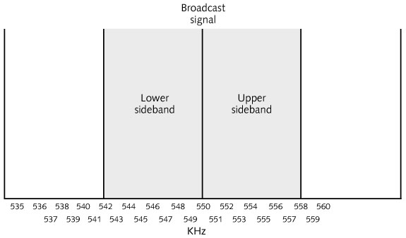
Figure 3-8 AM radio sidebands

Slide 11
Amplifiers
Amplifiers: increase the amplitude of an RF signal
RF signals tend to lose intensity (amplitude)
When they move through circuits, air, or space
Amplifier is an active device
Must be supplied with electricity
Uses this electricity to increase a signal’s intensity or strength
Then output an exact copy of the input signal with a higher amplitude

Slide 12
Antennas
Antennas: transmit or receive an RF signal
Antennas will be discussed in greater detail in Chapter 4
Figure 3-11 Antenna symbol

Slide 13
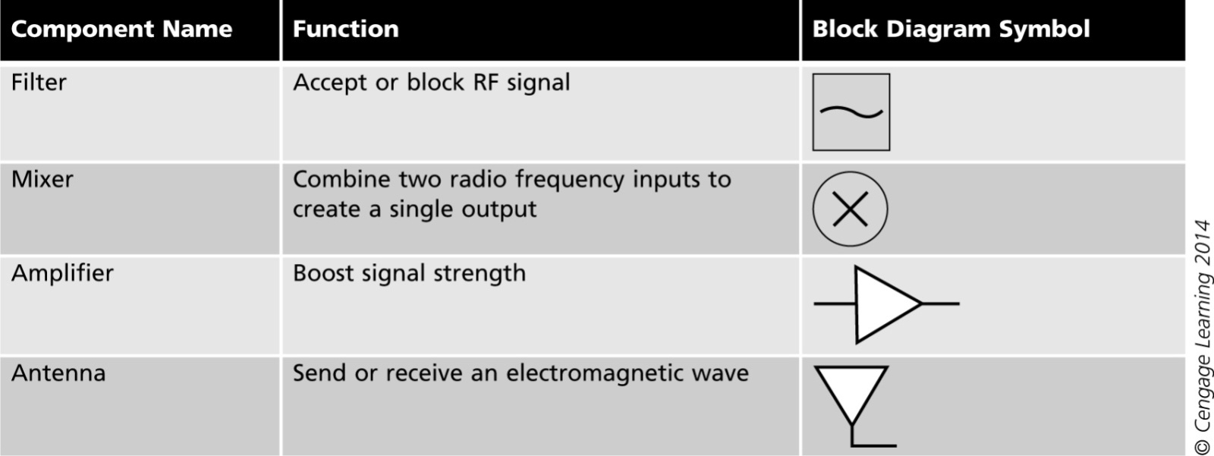
Radio system components
Table 3-1 Radio system components and their symbols

Slide 14
Design of a Radio System
Designers of radio communications systems
Need to consider how the systems will be used
Signal broadcasting
E.g., size and location of antenna, coverage area
Other considerations:
Multiple user access
Transmission direction
Switching and Signal strength

Slide 15
Multiple Access
Only a limited number of frequencies are available for radio transmission
Conserving the use of frequencies is important
Conserving a frequency
Share a frequency among multiple users
Methods that allow multiple access
Frequency Division Multiple Access (FDMA)
Time Division Multiple Access (TDMA)
Code Division Multiple Access (CDMA)

Slide 16
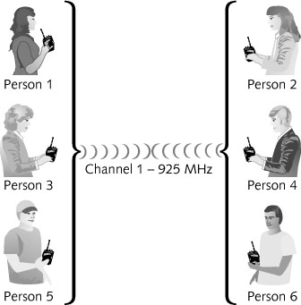
Figure 3-12 Multiple access

Slide 17
Multiple Access
Frequency Division Multiple Access (FDMA)
Divides the bandwidth of a channel into several smaller frequencies bands
Most often used with analog transmissions
Cable television is transmitted using FDMA
Drawback of FDMA: Crosstalk
Causes interference on the other frequency and may disrupt the transmission

Slide 18
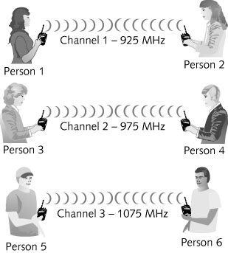
Figure 3-13 Frequency Division Multiple Access (FDMA)

Slide 19
Multiple Access
Time Division Multiple Access (TDMA)
Divides the transmission time into several slots
Each user is assigned the entire frequency for the transmission
For a fraction of time on a fixed, rotating basis
Advantages
Uses the bandwidth more efficiently
Allows both data and voice transmissions to be mixed using the same frequency

Slide 20
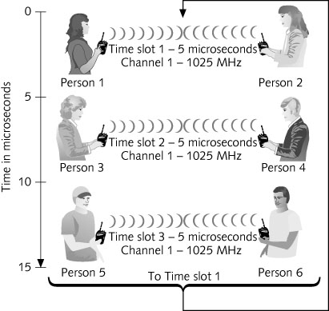
Figure 3-14 Time Division Multiple Access (TDMA)

Slide 21
Multiple Access
Code Division Multiple Access (CDMA)
Used primarily for cellular telephone communications
Uses direct sequence spread spectrum (DSSS)
With a unique digital spreading code (PN code)
Before transmission occurs
High-rate PN code is combined with the data to be sent
Spreads the signal over a wide frequency band
The longer the code is, the more users will be able to share the same channel
Number of chips in the code
Determines the amount of spreading or bandwidth

Slide 22
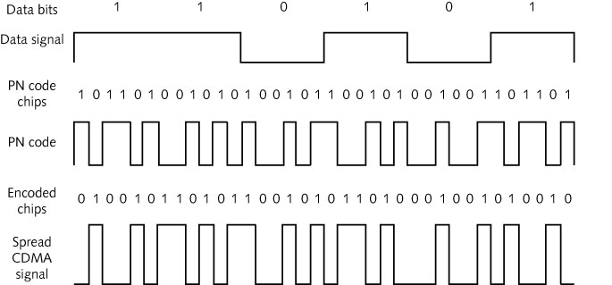
Multiple Access
Figure 3-15 CDMA spreading of a data signal by a PN code

Slide 23
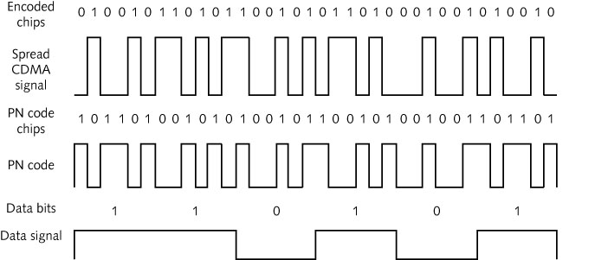
Multiple Access
Code Division Multiple Access (cont’d)
Spreading process is reversed at the receiver
Code is de-spread to extract the original data bit transmitted
Figure 3-16 De-spreading a CDMA signal to recover the data bits

Slide 24
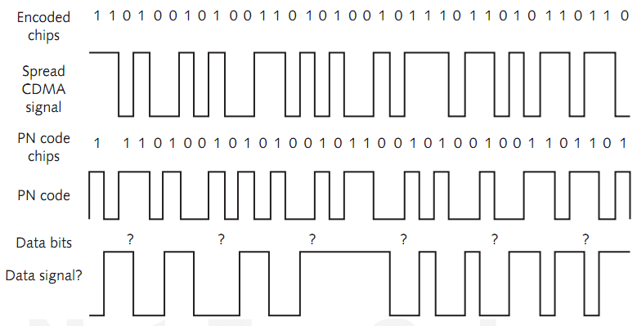
Multiple Access
Figure 3-17 Attempting to de-spread another receiver’s CDMA signal

Slide 25
Multiple Access
PN Code as a language
A room with 20 people, 10 simultaneous 1-1 conversation
All pairs are talking at the same time with different languages
Ignore noise level issue in the room
Other 9 conversations don’t bother them since none of the listeners understands any other languages

Slide 26
Multiple Access
Code Division Multiple Access (cont’d)
Advantages
Can carry up to three times the amount of data as TDMA
Transmissions are much harder to eavesdrop on
A would-be eavesdropper must also know the exact chip in which the transmission starts

Slide 27
Transmission Direction
Simplex transmission
Occurs in only one direction
Rarely used in wireless communication today
Except for broadcast radio and television
Half-duplex transmission
Sends data in both directions
But only one way at a time
Used in consumer devices such as citizens band (CB) radios or walkie-talkies
User must hold down the “talk” button while speaking

Slide 28
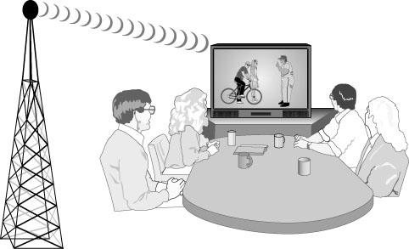
Figure 3-18 Simplex transmission

Slide 29
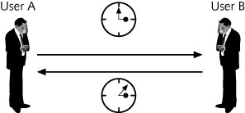
Figure 3-19 Half-duplex transmission

Slide 30
Transmission Direction
Full-duplex transmission
Allows data to flow in both directions simultaneously
Example: A telephone system
If the same antenna is used for wireless transmission and reception
A filter can be used to handle full-duplex transmissions
Full-duplex wireless communications equipment
Sends and receives on different frequencies

Slide 31
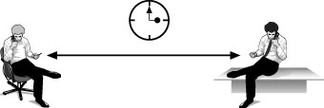
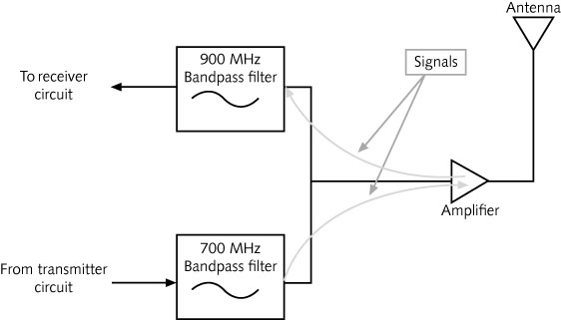
Figure 3-20 Full-duplex transmission
Figure 3-21 Using a single antenna in full-duplex RF communications

Slide 32
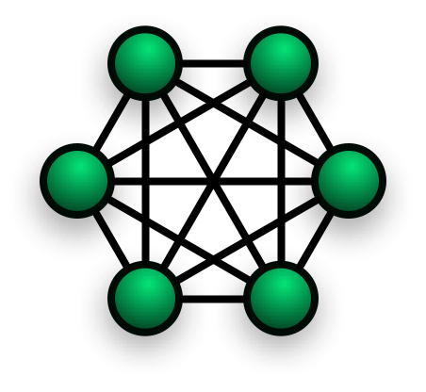
Switching
Why we need switching?
3 telephones require 2 cables to connect to all the others.
Thus, total = 3 needed cables.
6 telephones require 5 cables to connect to all the others.
Thus, total = 15 needed cables.
Mesh network:
n(n-1)/2 (n = number of devices)

Slide 33
Switching
Involves moving the signal from one wire or frequency to another
Circuit switching
Type of switching used by telephone systems
A dedicated and direct physical connection is made between the caller and the recipient
Direct connection lasts until the end of the call
Packet switching
Used by data networks
Data transmissions are broken into packets
Each packet is sent independently

Slide 34
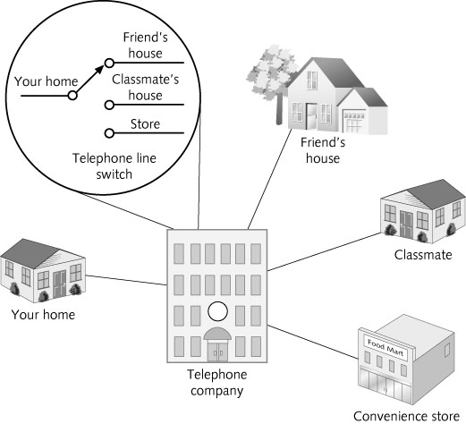
Figure 3-22 Telephone call switching

Slide 35
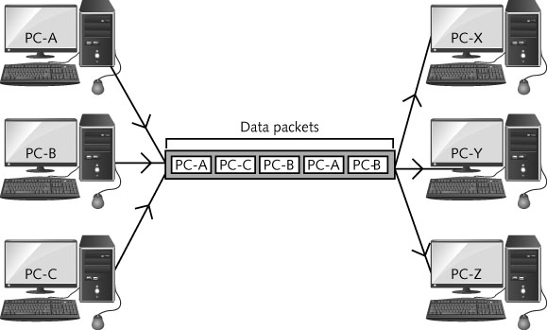
Figure 3-23 Packet switching

Slide 36
Switching
Packet switching advantages
Allows better utilization of the network
Allows multiple computers to share the same line or frequency
If a transmission error occurs
It usually affects only one or a few packets
Only packets affected must be resent, not entire message

Slide 37
Signal Strength
Strength of the signal in a radio system
Must be sufficient for the signal to reach its destination
With enough amplitude to be picked up by the antenna
And for the information to be extracted from it
Electromagnetic interference (EMI)
Affects radio signal strength
Also called noise
Signal-to-noise ratio (SNR)
Compares signal strength with background noise
When strength of a signal is well above the noise, interference can be filtered out

Slide 38
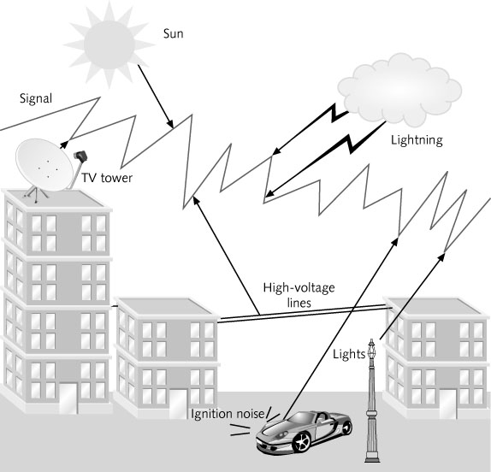
Figure 3-24 Sources of EMI or noise (interference)

Slide 39
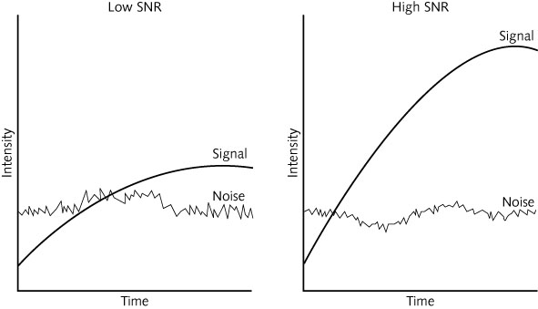
Figure 3-25 Signal-to-noise ratio (SNR)

Slide 40
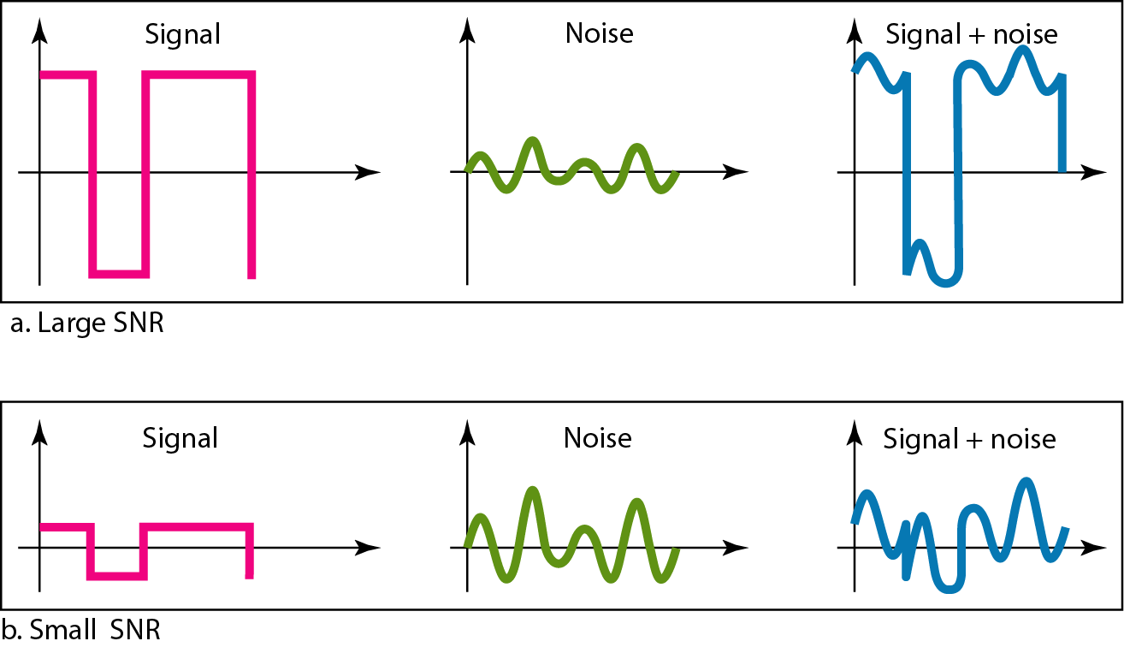

Slide 41
Signal Strength
The power of a signal is 10 mW and the power of the noise is 1 μW; what are the values of SNR and SNR_{dB} ?
Solution
The values of SNR and SNR_{dB} can be calculated as follows:

Slide 42
Signal Strength
To reduce the interference of noise
Boost the strength of the signal
Use of filters on the receiving end
Attenuation
A loss of signal strength
Multipath distortion
As a radio signal is transmitted, the electromagnetic waves spread out
Waves travel different paths between transmitter and receiver
Arrive at different times and out of phase

Slide 43
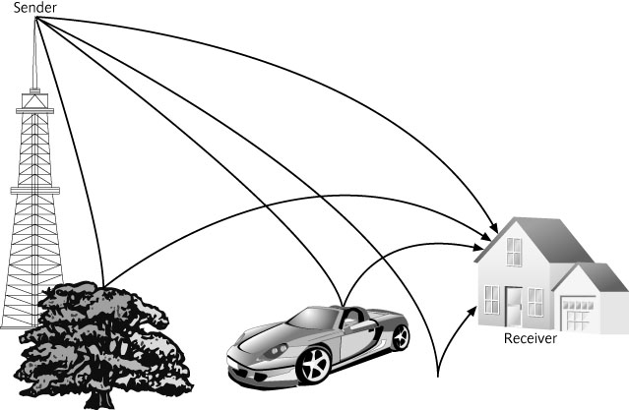
Figure 3-26 Multipath interference or distortion

Slide 44
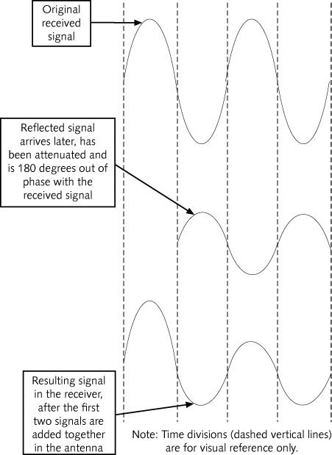
Figure 3-27 Effect of multipath distortion in a signal

Slide 45
Signal Strength
Directional antenna
Used to minimize multipath distortion
Radiates electromagnetic waves in one direction only
Other methods to reduce multipath distortion
Use an amplifier in front of receiver to increase SNR
Transmit the same signal on separate frequencies

Slide 46
Understanding Standards
Standards for telecommunications have been in place almost since the beginning of the industry
Standards have played an important role in the rapid growth of the industry

Slide 47
The Need For Standards
Standards
Commonly accepted technical specifications
Telecommunications requires standards exist for the design, implementation, and operation of the equipment
A lack of standards between devices would prevent communications from taking place

Slide 48
Advantages and Disadvantages of Standards
Advantages
Guarantee device interoperability
Create competition
Competition results in lower costs for consumers and improvements in products
Competition also results in lower costs for manufacturers
Help consumers protect their investment in equipment
Disadvantages
Can be a threat to industries in large countries
More overhead cost of products
Although standards are intended to create unity
They can have the opposite effect
Political reasons to reject the standard and create its own
Notes:
Threat => large countries has more overhead cost of products
Opposite effect => political to reject some standard => industry political

Slide 49
Types of Standards
De Facto Standards
Not official standards
Common practices that industry follows
E.g., M$ Windows has become the de facto standard for PC
De jure Standards
Also called official standards
E.g., Request For Comments (RFC)
Controlled by an organization or body
Published to members (individuals, companies)
Process for creating standards can be very involved
Notes:
De facto: e.g., M$ Windows has become the de facto standard for PC
De jure: RFC => published members (individual, company) who interested in the field => review, comment and revise before final draft (vote)

Slide 50
Types of Standards
Why Consortia?
De jure standard takes too long time to complete
E.g., WLAN took 7 years while products are released long before the standard
Consortia
Industry-sponsored organizations that promote a specific technology
Not open to everyone, instead, specific high-profile companies create and serve on consortia
E.g., W3C: M$, Netscape, Sun and IBM
HTML, CSS, DOM
Notes:
De jure is too long (e.g, WLAN = 7 yrs) , product is released long before the standard => Consortia: industry-sponsored

Slide 51
Telecommunications Standards Organizations
United States Standards Groups
American National Standards Institute (ANSI)
Telecommunications Industries Association (TIA)
Internet Engineering Task Force (IETF)
Internet Architecture Board (IAB)
Internet Society (ISOC)
Institute of Electrical and Electronics Engineers (IEEE)

Slide 52
Telecommunications Standards Organizations
Multinational Standards Groups
European Telecommunications Standards Institute (ETSI)
International Standards Groups
International Telecommunications Union (ITU)
International Organization for Standardization (ISO)

Slide 53
Regulatory Agencies
Enforcing telecommunications regulations is important
E.g., Nobody buys cellular phones that refuses transmission standards
Regulations must be enforced by an outside agency
Ensure all participants adhere to the prescribed standards
Federal Communications Commission (FCC)
Primary regulatory agency for telecommunications in the United States
Responsibilities
Processes applications for licenses and other filings
Analyzes complaints and conducts investigations
Regulates radio and television broadcast stations
Notes:
FCC and other country agencies continually monitor transmissions to ensure that no one is using a frequency without a license or is transmitting with more power than their license allows.

Slide 54
Radio Frequency Spectrum
Radio frequency spectrum
Entire range of all radio frequencies that exist
Range extends from 10 KHz to over 30 GHz
Spectrum is divided into 450 different sections (bands)
Radio frequencies of common devices include:
Garage door openers, alarm systems: 40 MHz
Baby monitors: 49 MHz
Radio-controlled airplanes: 72 MHz
Radio-controlled cars: 75 MHz
Wildlife tracking collars: 215 MHz–220 MHz
Global positioning system: 1.227 GHz and 1.575 GHz

Slide 55
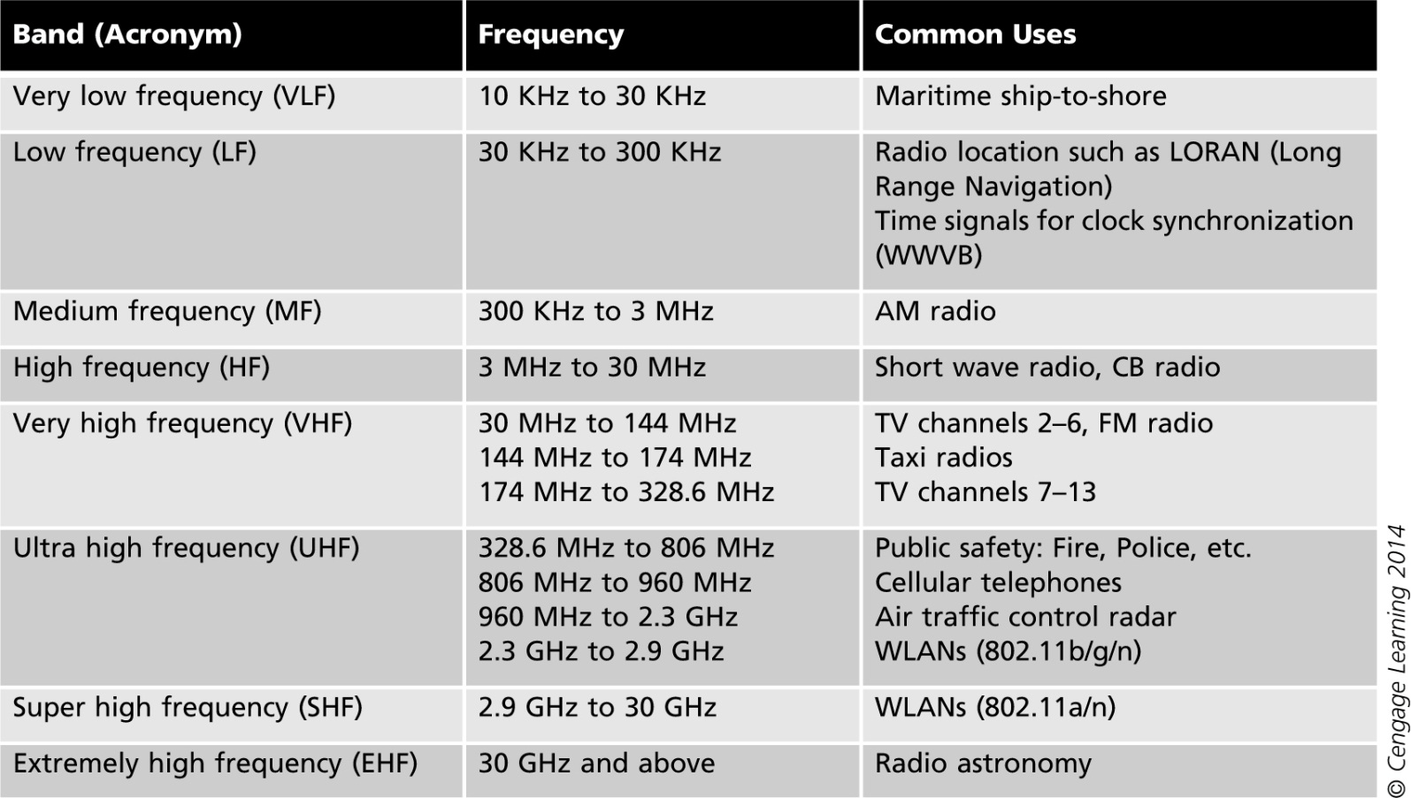
Table 3-3 Radio frequency bands

Slide 56
Radio Frequency Spectrum
International spectrum allocations are established by the ITU
License exempt spectrum
Unregulated bands
Radio spectra available without charge to any users without a license
Devices from different vendors may attempt to use the same frequency (disadvantage)

Slide 57
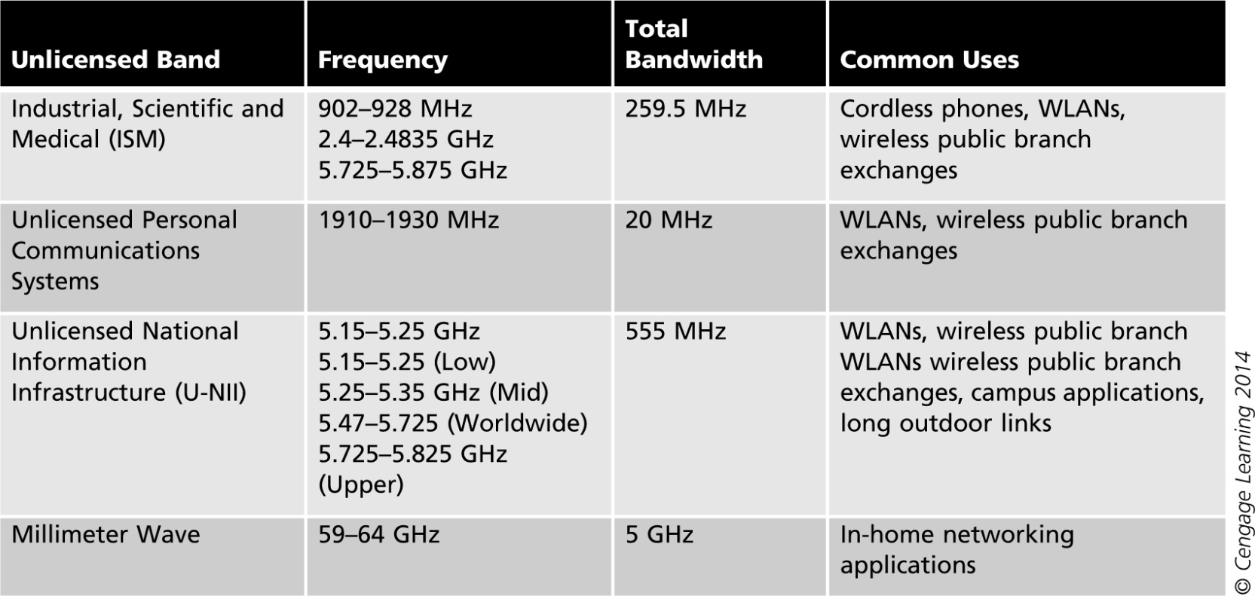
Table 3-4 Unregulated bands

Slide 58
Summary
Radio frequency system hardware components
Filters, mixers, amplifiers, and antennas
Filter is used either to accept or block a radio frequency signal
Mixer combines two inputs to create a single output
Amplifier increases a signal’s intensity or strength
Multiple access methods
FDMA
TDMA
CDMA

Slide 59
Summary
Types of data flow
Simplex
Half-duplex
Full-duplex
Switching involves moving the signal from one wire or frequency to another
Electromagnetic interference (EMI) is sometimes called noise
Signal-to-noise ratio (SNR)
Measure of signal strength relative to background noise

Slide 60
Summary
Standards for telecommunications
In place almost since the beginning of the industry
Radio frequency spectrum
The entire range of all radio frequencies that exist

Slide 61
Homework (CDMA)
Prepare to send your name to network
Write your name in English and translate to hexadecimal (e.g., Bob => 42-6F-62)
Using ASCII Table
Convert hexadecimal value of your name to binary
Put group of 8 bits together (choose only 1 character (8 bits))
Draw a wave form to show a digital signal of your name using CDMA
Choose PN Code (Chipping code) to be any code by yourself
PN Code must not the same in this example and has noise resistance
Demonstrate ‘Encode’ and ‘Decode’ original data

