Slide 1
Chapter 4 HOW antennas work
Reference: Jorge Olenewa, Guide to Wireless Communications, 3rd edition, ISBN-13: 9781111307318, 2013
© Cengage Learning 2014
Department of Computer Engineering, Faculty of Engineering Prince of Songkla University, Phuket Campus

Slide 2
Objectives
Define decibels, gain, and loss
Explain the purpose of an antenna
List the different antenna types, shapes and sizes as well as their applications
Explain RF signal strength and direction
Describe how antennas work

Slide 3
Gain and Loss
Understanding RF signal transmission involves:
The strength or the power with which the transmitter is sending the signal
The amount of reduction in signal strength caused by cables, connectors, and other components
The transmission medium (atmosphere or free-space)
The minimum strength of the signal required by the receiver to be able to properly recover the data sent by the transmitter

Slide 4
Gain and Loss
Amplifier boosts the power of a signal
The effect is called a gain
Cables and connectors offer a resistance to the flow of electricity
They tend to decrease the power of a signal (loss)
Signal power changes logarithmically
Not in a linear fashion
Gain and loss are relative concepts
Need to know the power level of the signal at two different points

Slide 5
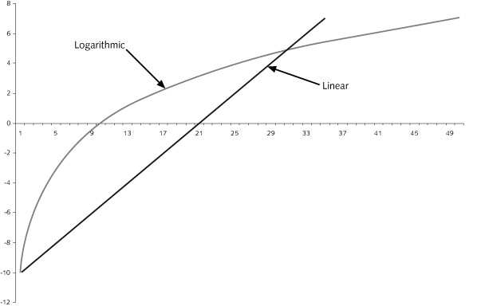
Figure 4-1 Linear vs. logarithmic

Slide 6
Decibel
Decibel (dB)
Ratio between two signal levels
Makes it much simpler to express and calculate power gain or loss
Tens and threes of RF mathematics
A gain of 3 dB (+3 dB) means the signal is two times bigger (twice the power)
A gain of 10 dB (+10 dB) means the signal is 10 times bigger (10 times the power)
The same applies for loss

Slide 7
Decibel
Power (dB) = 10 log P₂/P₁
where P₂ and P₁ are the power in watts
If P₂/ P₁ = 1 in watt, P_{dB} = 10 log 1 dB = 0 dB
If P_{dB} = 3, P₂/ P₁ = 2
If P_{dB} = 10, P₂/ P₁ = 10 (10 = 10 log 10¹⁰)
3 = 10 log P₂/P₁ log P₂/P₁ = 0.3 P₂/P₁ = 10^{0.3} = 2

Slide 8
Decibel
Wireless device has output of 200 mW. It is connected to a cable with a 9 dB gain and a 6 dB loss. What is the effective device output power?
Gain in the cable = 9 dB
Loss in the cable = 6 dB
The net gain = 9 dB - 6dB = 3dB.
Notes:
Effective Isotropic Radiate Power (EIRP) ใช้กำหนดว่า สุทธิ์แล้วสามารถส่งได้ไกลแค่ไหนที่ไม่ชนกับ ตัวส่งตัวอื่น ที่ความถี่ช่วงเดียวกัน
Active Gain = Transmitter amplifier (+dB) :
Passive Gain = Antenna focus (+dB)
Loss = Loss in cable, connector (-dB)
EIRP => Total dB = Effective Isotropic Radiated Power (output power: net gain)
For Unlicensed band (not mean uncontrol)
Max transmitter output power = 1 watt (for unlicensed, not mean uncontrol)
Max EIRP power = 4 watt

Slide 9
Decibel
Every 3dB gain doubles the milliwatts.
As according to the popular "rule of 3's". Whenever losing or gaining by a factor of 3 dB, just divide or multiply by 2.
As device output power is 200 mw and we need to multiply it by a factor of 2 according to rule of 3
Output power = 400mW

Slide 10
Decibel
Absolute power level of a signal is supplied by a transmitter, the strength of the output is +36 dBm. What is the output power in watts?
The absolute power signal is calculated as follow:
36 dBm = 10 dBm + 10 dBm + 10 dBm + 3 dBm + 3 dBm
Since 0 dBm = 1 mW
10 dBm => 10 mW (multiplied by 10)
x 2 of 10 dBm => 10mW x 10² = 1000 mW = 1 W
x 2 of 3 dBm => 1 W x 2 x 2 = 4 W
The output power in watts = 4 W.

Slide 11
Decibel
dBm
Relative way to indicate an absolute power level in the linear Watt scale
1 mW = 0 dBm
Isotropic radiator
Theoretically perfect sphere that radiates energy equally in all directions
Not possible to build a real isotropic radiator since it needs a power source or signal cable connected to it at some point on the surface.
Provides a reference point for representing the gain of an antenna
A unit for the antenna gain compared to an isotropic radiator gain
Usually expressed in dB isotropic (dBi)
The sun is the closest to an isotropic radiator
Notes:
dBi => compare perfect sphere all directions radiator
dBd => compare dipole antenna (= 2.15 dBi)
Antenna 2 dBd = 2 dBi + 2.15 dBi = 4.15 dBi

Slide 12
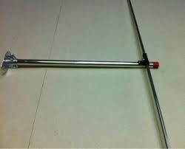
Decibel
For microwave and higher frequency antennas
Gain is usually expressed in dB dipole (dBd)
dBd is referred to a reference dipole antenna
Dipole
The smallest, simplest, most practical type of antenna that can be made
But that also exhibits the least amount of gain
Has a fixed gain over that of an isotropic radiator of 2.15 dB
dipole antenna

Slide 13
Table 4-1 Decibel values and references

Slide 14
Antenna Characteristics
Characteristics of antennas
Types
Sizes
Shapes
Notes:
Antenna
Length of copper wire, or similar material with one end free and the other end connected to a receiver or transmitter

Slide 15
Antenna Types
Passive antennas
The most common type
Constructed of a piece of metal, wire, or similar conductive material
Does not amplify the signal in any way
Directional gain
Passive antennas radiate the RF energy supplied by the transmitter in one direction
Exhibits an effective gain that is similar to amplification of the signal

Slide 16
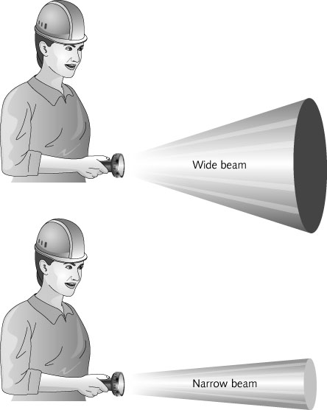
Comparison RF signal as the light
Shapes of passive antennas radiate the RF energy in one direction called directional gain
Wide area
Far distance
Figure 4-2 Directional gain

Slide 17
Antenna Types
Active antennas
Passive antennas with an amplifier built-in
Amplifier is connected directly to the piece of metal that forms the antenna itself
Most active antennas have only one electrical connection
RF signal and the power for the amplifier are supplied on the same conductor

Slide 18
Antenna Sizes and Shapes
Size and shape of an antenna depend on:
Frequency on which the antenna will transmit and receive
Direction of the radiated electromagnetic wave
Power with which the antenna must transmit
Antenna size is proportional to the wavelength it is designed to transmit or receive
Require larger antennas
Lower frequency signals
Higher gain

Slide 19
Antenna Sizes and Shapes
Omnidirectional antennas
Used to transmit and receive signals from all directions with relatively equal intensity
Longer omnidirectional antennas usually have a higher gain

Slide 20
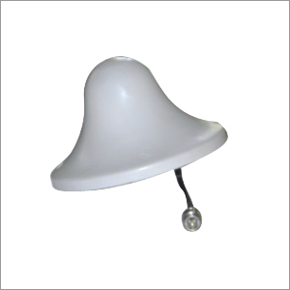
omnidirectional antenna
High-gain omnidirectional antenna

Slide 21
Antenna Sizes and Shapes
Directional antennas
Transmit a signal in one direction only
Yagi antenna emits a wider, less focused RF beam
Parabolic dish antenna emits a narrow, more concentrated beam of RF energy

Slide 22
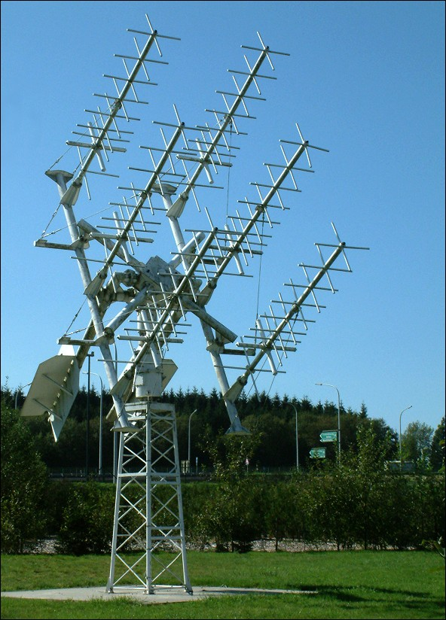
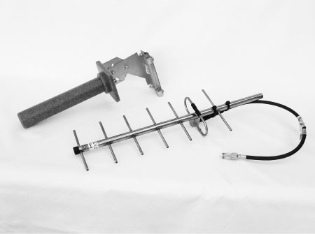
Figure 4-5 Yagi antennas
Notes:
Director element – รับสัญญาณคลื่นแม่เหล็กไฟฟ้า ชนกับ director element แรก ก็จะเหนี่ยวนำ คลื่นไฟฟ้า element ถัด ๆ (และเกิดสนามแม่เหล็กด้วย) ไป ให้ เกิดคลื่นไฟฟ้า ไปถึง Driven-dipole ยิ่งมี Director element มากยิ่ง รับสัญญาณได้ดีขึ้น ตัว Director element เป็นเสาบาง ๆ ไม่ต่อกับแผ่นวงจร คลื่นวิทยุ
Driven dipole – ต่อกับ วรจรวิทยุ แปลงจากสัญญาณไฟฟ้า เป็นข้อมูล TV
Reflector – สะท้อนคลื่นที่รับเข้ามา (เก็บตกสัญญาณที่เลยออกไป) ให้กับ Driven dipole
https://pantip.com/topic/33235199

Slide 23
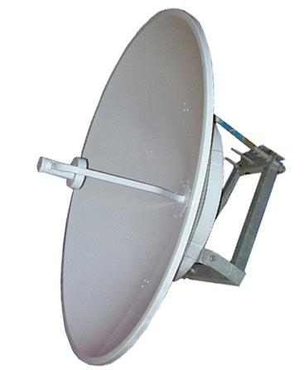
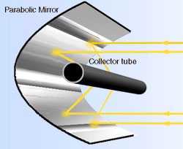
antenna
Reflector
Parabolic dish antenna

Slide 24
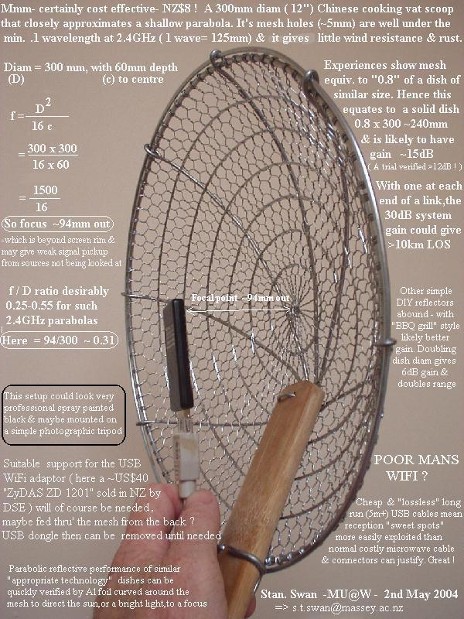
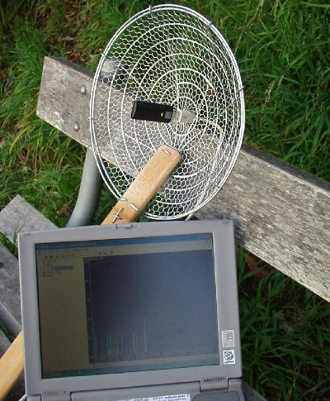
DIY Parabolic antenna
http://www.usbwifi.orconhosting.net.nz/usbscoop.jpg

Slide 25
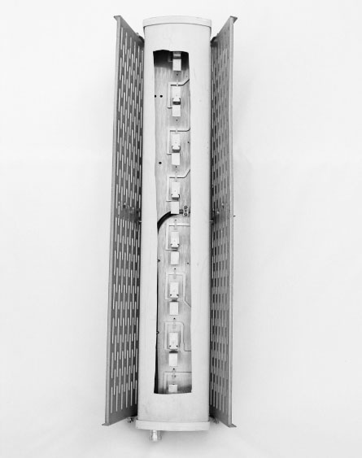
Antenna Sizes and Shapes
Patch antennas
Some are designed for installation on building walls
To send an RF signal in one direction away from the structure
One common application for patch antennas is in cellular telephony
Figure 4-7 Cellular antenna with cutout to show internal construction

Slide 26
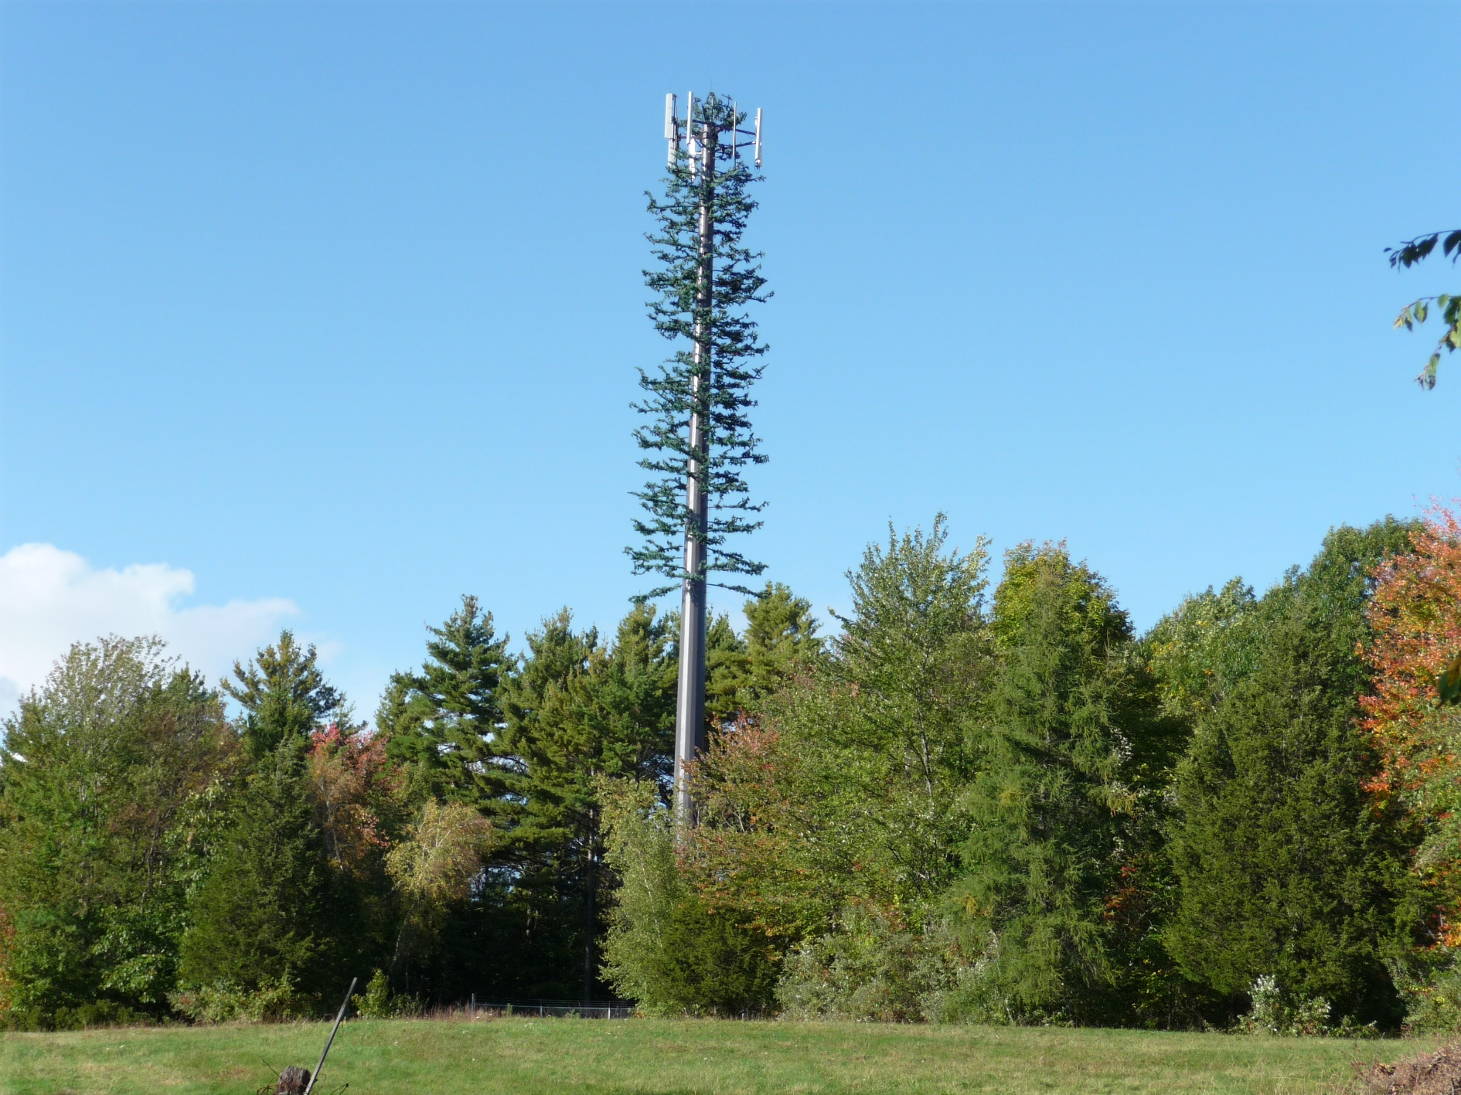
from: https://upload.wikimedia.org/wikipedia/commons/b/b3/Cell_phone_tower_disguised_2008.jpg

Slide 27
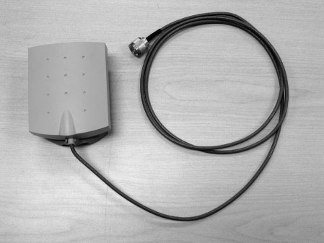
Figure 4-8 Indoor patch antenna

Slide 28
Signal Strength and Direction
Distance between the transmitter and receiver
Determines the strength of the signal
Transmitters produce a finite amount of RF energy
For most applications, active antennas can be extremely expensive
Omnidirectional antenna divides strength of signal in a 360-degree circle around the antenna
Free space loss
RF waves tend to spread away from the source of the signal (the antenna)
Free space loss calculator tools can be found on Internet

Slide 29
Antenna Performance
Antenna performance
A measure of how efficiently an antenna can radiate an RF signal
Design, installation, size, and type of antenna can affect its performance

Slide 30
Radiation Patterns
Antenna pattern
Graphic developed by measuring the signal radiating from the antenna
Indicates the direction, width, and shape of the RF signal beam coming from the antenna
Antennas emit signals in two dimensions
Horizontally and vertically
Antenna specifications almost always include the vertical beam angle that a particular antenna emits
Notes:
Radiation pattern ของเสาอากาศ ใช้เพื่อ แสดงความแรงของคลื่นวิทยุในทิศทางต่าง ๆ โดยรอบสายอากาศ ที่ระยะห่างคงที่จากสายอากาศ

Slide 31
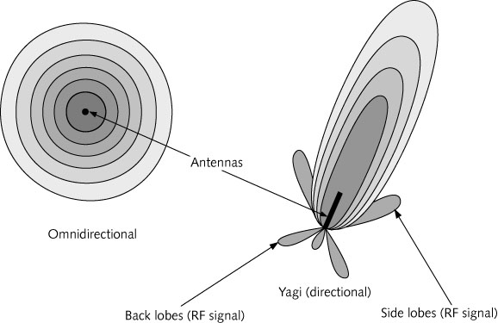
Figure 4-9 Antenna patterns viewed from above
Notes:
Omini
แผ่กระจายเท่ากันทุกทิศทาง
Yagi
minor lobe – พูคลื่นเล็ก (side lobes, back lobe)
Main lobe – พูคลื่นหลัก เป็นพูคลื่นที่มีความแรงมากที่สุด

Slide 32
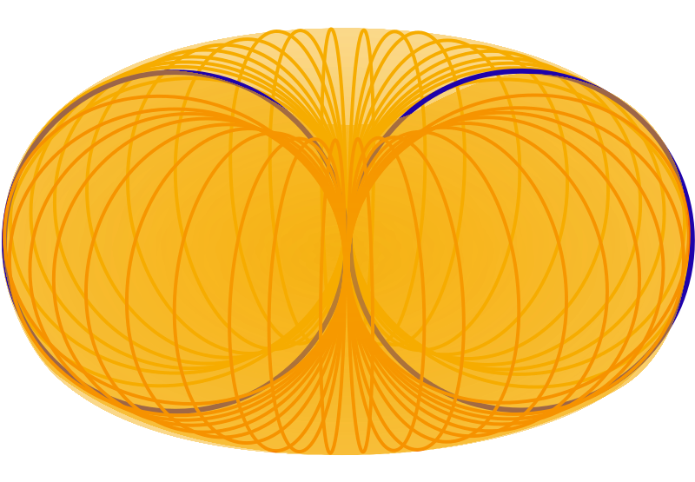
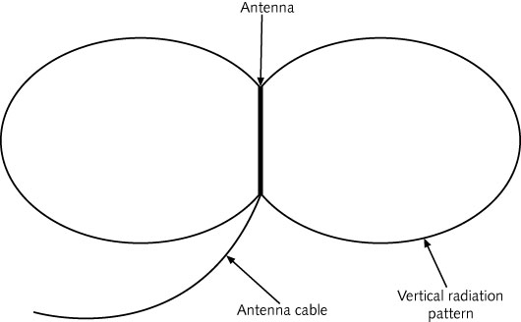
Figure 4-10 Vertical antenna pattern (side view of omnidirectional antenna pattern)

Slide 33
Antenna Polarization
Antenna polarization: orientation of the wave leaving the antenna
Vertical polarization
Sine waves travel up and down when leaving antenna
Horizontal polarization
Sine waves travel from side to side on a horizontal plane
Most efficient signal transmission and reception is experienced when both antennas are equally polarized
Notes:
Antenna polarization => it oscillates either horizontally or vertically

Slide 34
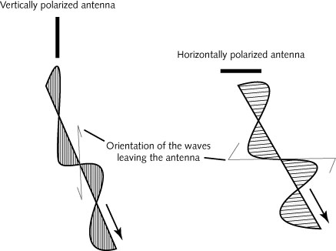
Figure 4-11 Antenna polarization

Slide 35
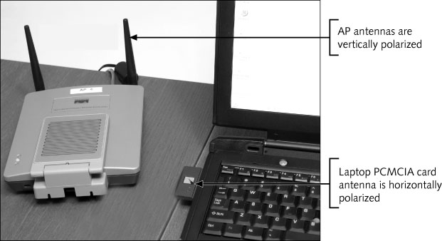
Figure 4-12 Mixed vertical and horizontal antenna polarizations

Slide 36
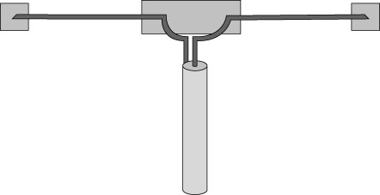
Monopole and dipole antennas
Monopole antenna
Basically a length of wire or metal
Straight piece of wire or metal, with no reflecting or ground element
One-dimensional antennas
Dipoles are commonly built as two monopoles
Mounted together at the base
A monopole antenna is less efficient than a dipole
Figure 4-13 Common dipole antenna

Slide 37
Smart Antennas
Used primarily in mobile or cellular telephony
“Learn” where the mobile receiver is
Can track and focus RF energy in specific direction
Classes of smart antennas
A switched beam antenna
Uses several narrow beam antennas pointing in different directions
Adaptive or phased array antennas
Divided into a matrix of radiating elements
Has the effect of sending the energy beam in a particular direction (generally called “beam forming”)
Used extensively in ultramodern radar systems.

Slide 38
Figure 4-15 Directional antenna vs. smart antenna

Slide 39
Antenna System Implementation
Proper installation of antennas requires knowing the user’s requirements
Challenges
Physical obstacles
Other regulatory restrictions

Slide 40
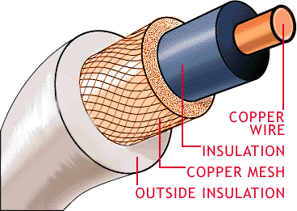
Antenna Cables
Most antennas are connected to the transmitter or receiver using coaxial cable
Impedance
Represented by the letter “Z” and measured in ohms
Cable’s impedance must match that of the transmitter circuit as well as that of the antenna
Removable high-gain antenna may use a non-standard connector in order to protect the mismatch of transmitter EIRP assigned by FCC
You must consider the signal loss caused by the connector and by the cable itself
Notes:
Antenna ที่ ถอดออกได้ จะต้องเป็นแบบ Non-standard connector ใช้กับ transmitter นั้น ๆ เท่านั้น เพื่อป้องกัน transmitter ที่ส่งกำลังส่งเกินกว่า EIRP ที่กำหนดโดย FCC
ผู้ใช้ สามารถซื้อ Transmitter โดยไม่มี Antenna ได้ แต่ตัว Antenna ที่กำลังสูง จะต้องไม่ใช่ standard connector

Slide 41
Antenna Cables
Cable loss is measured in relation to the length of the cable
You can use special low-loss antenna cables to minimize signal loss
LMR coaxial is expensive more regular coaxial
Table 4-2 Low-loss LMR cables
Notes:
100 feet = 30.48 meters
10 feet (3 m.) => loss = 3.9 dB (LMR-100) => transmitter output loss > half of energy (before adding connector losses)
loss = 0.7 dB (LMR-400)
Thick cable => less loss

Slide 42
RF Propagation
The way that radio waves propagate depends on the frequency of the signal
RF waves are classified in three groups:
Ground waves follow the curvature of the earth
Sky waves bounce between the ionosphere and the surface of the earth
Line-of-sight used by RF waves transmitted in frequencies between 30 MHz and 300 GHz
Require a line-of-sight path between the transmitter and the receiver antennas
Notes:
Move between trans – recv through air/atmosphere

Slide 43
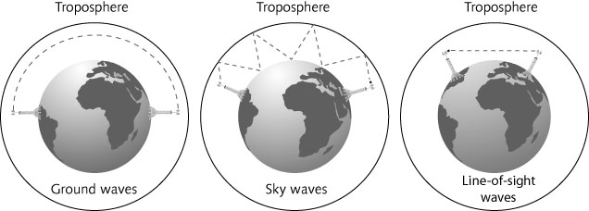
Table 4-3 RF wave propagation groups
Figure 4-18 How radio waves propagate

Slide 44
Point-to-Multipoint Links
Point-to-multipoint wireless link
One transmitter communicates with several mobile clients
Maximize the signal distance by using an omnidirectional antenna at the central location
Use directional, higher-gain antennas at the remote locations

Slide 45
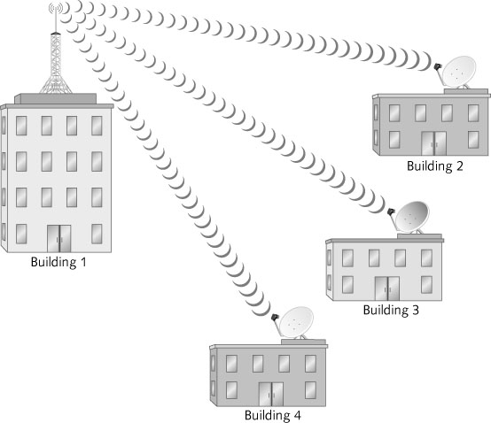
Figure 4-19 Point-to-multipoint links using a combination of omnidirectional
and directional antennas

Slide 46
Point-to-Point Links
Point-to-point wireless link
Connects two computer networks in different buildings
Directional antennas provide the most reliable method of transmitting RF waves
Narrow beams and high gain ensure that most of the energy of the RF wave will be used
Telephone companies make extensive use of point-to-point microwave links (instead of cables)
For long-distance voice and data communications
Cost of maintaining a wireless link is lower than installing and maintaining cables

Slide 47
Figure 4-20 Point-to-point link using directional antennas

Slide 48
Fresnel Zone
RF waves have a tendency to spread out
Space between two antennas would be more accurately represented by an ellipse
Called the Fresnel zone
When planning a wireless link
At least 60% of the Fresnel zone must be kept clear of obstructions
May affect the height of the antenna tower

Slide 49
Augustin-Jean Fresnel (French physicist): studied the polarization of light waves
Figure 4-21 Fresnel zone

Slide 50
Link Budgets
Link budgets
Calculate whether you will have enough signal strength to meet the receiver’s minimum requirements
A simple link budget equation looks like this:
Received Power(dBm) = Transmitted Power(dBm)
+ Gains(dB) − Losses(dB)
Information needed to calculate link budget includes:
Gain of the antennas
Cable and connector losses for receiver and transmitter
Free space loss figure, … etc

Slide 51
Antenna Alignment
One of the challenges of implementing a point-to-point link:
Positioning the antennas at the same height and point them toward one another
Some basic tools for antenna alignment:
A compass to position the antenna in the correct direction
A spotting scope or binoculars
A means of communication, such as a walkie-talkie or a cellular phone
If the distance is reasonably short, a light source, such as a flashlight or laser pointer

Slide 52
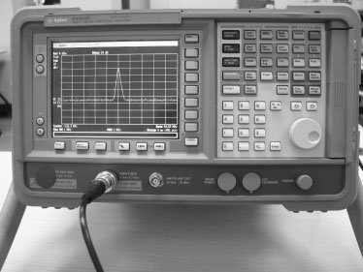
Antenna Alignment
Spectrum analyzer
Used for long distance and accurate antenna alignment
Displays the signal amplitude and frequency
Can also detect interference in a particular frequency or channel
Figure 4-22 Spectrum analyzer

Slide 53
Other Challenges of Outdoor Links
Radio waves can reflect, diffract, or be absorbed by some materials
Weather phenomena can affect the performance and reliability of wireless links
Examples: heavy fog, rain, dust, or snowstorms
Air disturbances and changes in temperature can also affect wireless links
Seasonal changes can impact a wireless link
An antenna that was setup in winter (when there were no leaves on trees) may not work as well in the spring (when leaves can block a percentage of the Fresnel zone)

Slide 54
Summary
Gain occurs when a signal is amplified or when most of the signal’s energy is focused in one direction
Loss occurs when the energy of a signal decreases
Decibel (dB) is a relative measurement
Simplifies the calculations of gain and loss, and indicates the strength of a signal
An isotropic radiator is a theoretical perfect sphere that radiates power equally, in all directions
Most common type of antenna is a passive antenna

Slide 55
Summary
Size of an antenna depends primarily on the frequency that it is designed to transmit or receive
Types of antennas: omnidirectional and directional
Free space loss is caused by the natural tendency of RF waves to spread out
Antennas have a horizontal and a vertical radiation pattern
Basic types of one-dimensional antennas
Monopole
Dipole

Slide 56
Summary
Smart antennas can track a mobile user
And send a narrower, more efficient beam
Special LMR antenna cables are used to reduce the signal loss
RF waves propagate differently depending on the frequency of the signal
Types of links: point-to-multipoint and point-to-point
Challenges of outdoor links
Weather phenomena
Seasonal changes

Slide 57
Homework (Antenna)
เสาอากาศตัวส่ง มีค่ากำลังส่ง 250 mWatt มีค่ากำลังขยาย (Gain) 9 dB และ มีค่าลดทอนในสายสัญญาณ (Cable loss) 4 dB ค่า Free Space Path loss คิดเป็น 0.5 dB ต่อ 100 เมตร เสาอากาศฝั่งรับไม่มีการขยายสัญญาณ แต่มีค่าลดทอนสัญญาณในสายสัญญาณ 2 dB
จงคำนวณหากำลังของสัญญาณที่ฝั่งรับได้รับ หลังจากสัญญาณผ่านสายอากาศและสายสัญญาณฝั่งรับแล้วว่ามีขนาดกี่ Watt โดยใช้กฎ Ten & Three
กำหนดให้ฝั่งรับและฝั่งส่งมีระยะทางห่างกัน 400 เมตร

