Slide 1
Chapter 6 High rate wireless personal area networks
Reference: Jorge Olenewa, Guide to Wireless Communications, 3rd edition, ISBN-13: 9781111307318, 2013
© Cengage Learning 2014
Department of Computer Engineering, Faculty of Engineering Prince of Songkla University, Phuket Campus

Slide 2
Objectives
Define a high rate wireless personal area network (HR WPAN)
List the different HR WPAN standards and their applications
Explain how WHDI, WiGig, WirelessHD
Outline the issues facing WPAN technologies
Describe the security features of each HR WPAN technology

Slide 3
High Rate WPAN Standards
HR WPAN applications
Connecting digital cameras to printers and kiosks
Connecting laptops to multimedia projectors and sound systems
Connecting camera-equipped cell phones and tablets to laptops and printers
Connecting speakers in a surround system to amps and receivers
Linking multiple display monitors
And others

Slide 4
High Rate WPAN Standards
Application characteristics
Require high throughput; 20 Mbps or more
Low-power transceivers, Low cost
Require quality-of-service (QOS) capabilities
Connections should be simple and automatic
Security features should be included
Internet access and use of digital TVs as wireless displays

Slide 5
High Rate WPAN technologies
WirelessHD
802.15.3c ➔ 7-25 Gbps ➔ 60 GHz
www.wirelesshd.org
WHDI ➔ 1.5 Gbps ➔ 5 GHz
www.whdi.org
WiGig (www.wigig.org)
802.11ac ➔ 7 Gbps ➔ 5 GHz
802.11ad ➔ 7 Gbps ➔ 60 GHz
WLAN
802.11n ➔ 600 Mbps ➔ 2.4 or 5 GHz
Notes:
60 GHz uses beamforming
5 GHz uses MIMO
WirelessHD is a standard of the WirelessHD Consortium. It uses the 60-GHz band but is not Wi-Fi compatible. In fact, it was designed from scratch to be used as a video transport method rather than using existing Wi-Fi or some other technology not optimized for video. It supports the 1080p/60-Hz video format with a 10^{–9}-pixel error rate in addition to all EIA-861 video formats. It also supports both picture-in-picture (PI) and single source to multiple displays.
WirelessHD เน้น Audio/Video cable replacement โดยใช้ RF 60 GHz

Slide 6
High Rate WPAN Standards
IEEE 802.15.3c
WirelessHD Consortium created a spec based on this standard for combining the transmission of HD video, multichannel audio, and data for multimedia streaming in the 60 GHz band

Slide 7
Networking Audio, Video, and Other I/O Devices
Wireless Home Digital Interface (WHDI)
Developed primarily for delivery of uncompressed video and audio with cable-connection quality
Used to mirror screens of multiple devices
Works in 5 GHz frequency band; coexists with 802.11a and 802.11n and cordless phones
Max range of 100 ft.
No special adapters needed; supports HDMI

Slide 8
Networking Audio, Video, and Other I/O Devices
Wireless Gigabit (WiGig) Architecture
Designed for 802.11n and 802.11ac compatibility; will support 802.11ad in 60 GHz band
WiGig uses beamforming to maintain reliable connections at higher frequencies
Supports two modulation types in 60 GHz band:
Single-carrier modulation
Orthogonal frequency-division multiplexing (OFDM)
Notes:
Single carrier modulation (max: pi/2-16QAM at 4 Gbps)
OFDM (max: 64QAM at 7 Gbps)
AV display standard support เช่น HDMI, I/O (USB , PCIe) at the PHY and MAC layer, bypassing higher-layer WLAN (TCP/IP)

Slide 9
Networking Audio, Video, and Other I/O Devices
WirelessHD and IEEE 802.15.3c
Consumer products already available
802.15.3c amendment only refers to 60 GHz band
Supports devices transmitting at different speeds to allow mobile devices to conserver battery power
Table 6-1 shows speeds and applications supported by WirelessHD

Slide 10
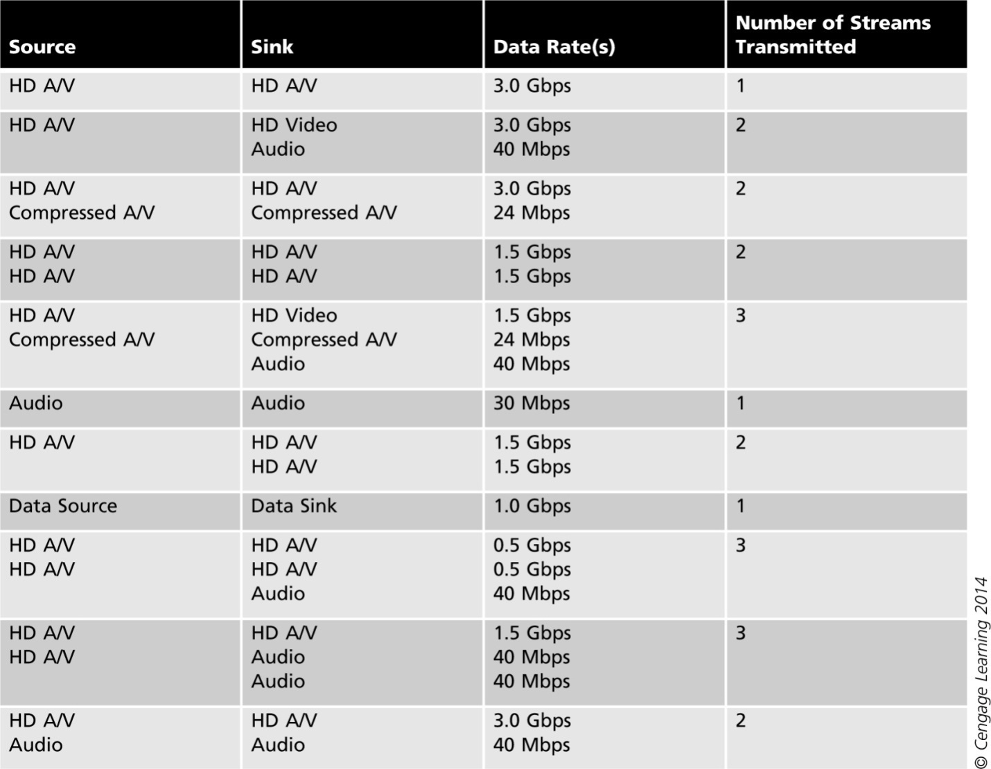
Table 6-1 Speeds supported in WirelessHD

Slide 11
Networking Audio, Video, and Other I/O Devices
WirelessHD and IEEE 802.15.3c
Source device: transmitter
Sink device: receiver
Divides PHY layer into three sections:
Low-Rate PHY (LRP) – data rates 2.5 to 40 Mbps
High-Rate PHY (HRP) – data rates to 7 Gbps and up to 25 Gbps using spatial multiplexing
High-or-Medium-Rate PHY (HMRP) – data rates of 476 Mbps to 2 Gbps
Also supports USB 2.0, 3.0 and HDMI
Uses beamforming for line-of-sight/non-line-of-sight transmissions
Notes:
Spatial multiplexing = a technique that divides the data frame into multiple parts and transmits each part of the same data frame using a separate radio and antenna,
Effectively increasing the transmission rate by sending the data in parallel.

Slide 12
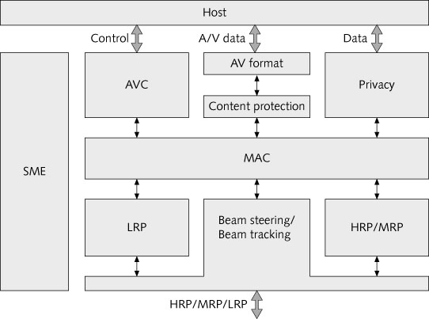
Figure 6-3 Recommended WirelessHD protocol-layer implementation
Notes:
There are four functional divisions in the WirelessHD layering model; the PHY layer, the
MAC sublayer, the Adaptation sublayer and the Station Management Entity (SME). The
relationships of the various parts is illustrated in Figure 6-3. There are two protocols in the
adaptation sublayer; the AVC protocol and the A/V packetizer. The AVC protocol
performs the device control, the connection control, the device capability and so on. The
role of A/V packetizer is to make the formatted A/V data for the HMRP data service.
The four entities provide three types of service: high rate data service, low rate data
service, and the management service. The high data rate service supports video, audio
and data delivery. The low data rate service supports audio data, MAC commands, and
small amounts of asynchronous data. The layering model is defined in the specification
only to describe the functionality of the WirelessHD system.
10 Audio video control (AV/C) specification
10.1 Overview
The AV/C includes the following functions;
· Device capability exchange – In this function, a device discovers other devices
and exchanges device information (e.g. device category, device name) with other
devices.
· Connection control – In this function, a device establishes or releases the AV
stream connection between a Source and a Sink by using AVC messages.
· Device control – In this function, a device controls other device by using AVC
messages (e.g. power on/off, play/stop etc.).

Slide 13
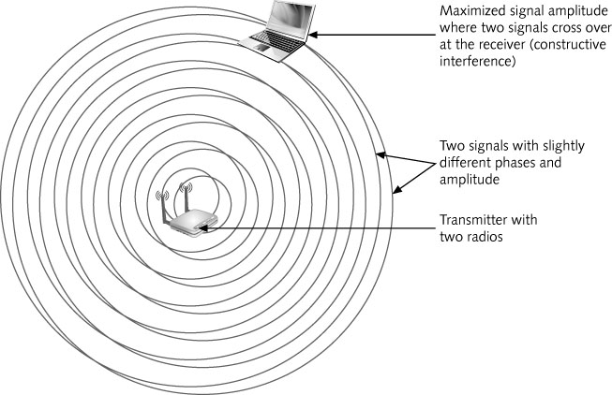
Figure 6-2 Beamforming

Slide 14
WirelessHD and 802.15.3 MAC layer
Devices associate with the piconet coordinator (PNC)
PNCs are usually a sink device such as HD TV
Coordinator acts as a station on the wireless video area network (WVAN)
The first sink devices assumes the role of PNC
PNC responsible for QoS

Slide 15
WirelessHD and 802.15.3 MAC layer
Piconet coordinator (PNC)
Role assumed by the first device in the area
Provides all of the basic communications timing in a piconet
PNC sends a beacon
The piconet is peer-to-peer
Devices can transmit data directly to each other
The PNC is also responsible for managing QoS
Devices can form a dependent piconet

Slide 16
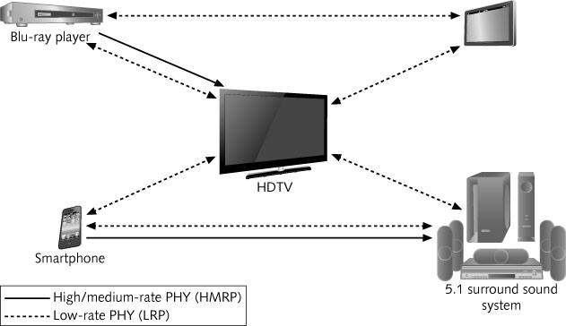
Figure 6-4 Wireless video area network (WVAN) topology example
Notes:
The WVAN consists of one Coordinator and zero or more Stations. The Coordinator is
normally, but not always, a device that is a sink for audio or video data, e.g., a display,
but also potentially a media storage device like a PVR. A Station, on the other hand, is a
device that has media that it can source and/or sink or has data to exchange, potentially at
the same time. The device that is the Coordinator also acts as a Station in the WVAN.
An example of a WVAN is illustrated in Figure 6-4.
The high-rate PHY (HRP) and medium-rate PHY (MRP) support multi-Gb/s throughput
at distance of 10 m through adaptive antenna technology. Because of this, the high-rate or
medium-rate PHY (HMRP) is highly directional and can only be used for unicast
connections. The HMRP is optimized for the delivery of uncompressed high definition
video, other data can be communicated using the HMRP. To support multiple video
resolutions, the HMRP has more than one data rate defined. The HMRP carries:
· isochronous data such as audio and video,
· asynchronous data,
· MAC commands,
· antenna steering information, and
· higher layer control data for A/V devices.
The low-rate PHY (LRP) is a multi-Mb/s bidirectional link that also provides a range of
10 m. Multiple data rates are defined for the LRP, with the lower data rates having near
omni-directional coverage while the highest data rates are directional. Because the LRP
has near omni-directional modes, it can be used for both unicast and broadcast
connections. Furthermore, because all Stations support the LRP, it can be used for
Station-to-Station links. The LRP supports multiple data rates, including directional
modes, and is used to carry:
· low-rate isochronous data such as audio,
· low-rate asynchronous data,
· MAC commands including the beacon,
· acknowledgements for HMRP packets,
· antenna beam forming information,
· capabilities information, and
· higher layer control data for A/V devices.
The HMRP and LRP operate in overlapping frequency bands and so they are coordinated
in a TDMA manner by the MAC.

Slide 17
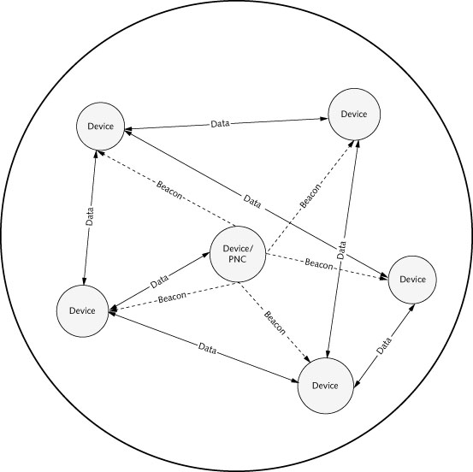
Figure 6-5 802.15.3 piconet topology

Slide 18
WirelessHD and 802.15.3 MAC layer
Two types of dependent piconets – dependent on the PNC of another (parent) piconet
Child piconets
Has its own piconet ID but child PNC is a member of the original (parent) piconet
Neighbor piconets
Separate piconet but depends on original piconet’s PNC to allocate time for transmitting

Slide 19
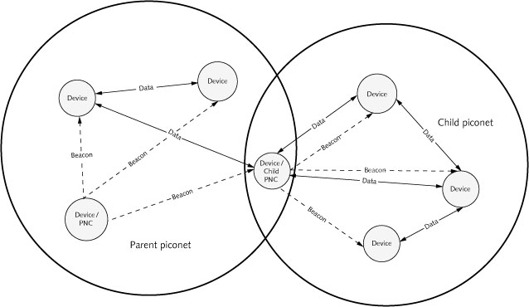
Figure 6-6 Child piconet

Slide 20
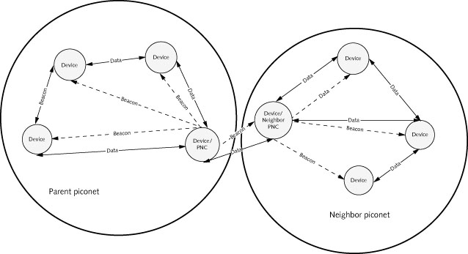
Figure 6-7 Neighbor piconet

Slide 21
WirelessHD and 802.15.3 MAC layer
Figure 6-9 General MAC frame format
Notes:
Frame control = protocol version, type of frame, encrypt status, how receiving device should acknowledge it, end frame or data follow?
Piconet id = หมายเลข piconet network, node will receiving frames by the same piconet id.
Index is used for managing and uniquely identifying different asynchronous and isochronous streams.

Slide 22
WirelessHD and 802.15.3 MAC layer
The IEEE 802.15.3 MAC layer designed to support these features:
Connection time (association) is fast
Devices associated with the piconet can use a short, one-octet device ID
Devices can obtain information about the capabilities of other devices
Peer-to-peer (ad hoc) networking
Data transport with QoS
Security
Efficient data transfer using superframes (Figure 6-8)

Slide 23
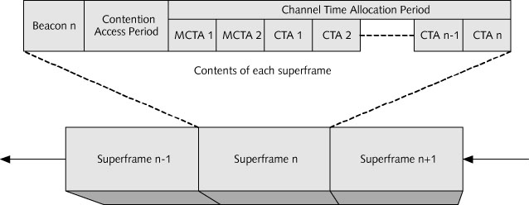
Figure 6-8 802.15.3 superframe

Slide 24
WirelessHD and 802.15.3 MAC layer
IEEE 802.15.3 superframe structure
A beacon – used to set time allocations and communicate management information
An optional contention access period (CAP) – used for association, command communication, or asynchronous data
The channel time allocation period (CTAP) – includes channel time allocations (CTA) and may include management channel time allocation (MCTA) periods

Slide 25
WirelessHD and 802.15.3 MAC layer
Communication in an 802.15.3 piconet
Beacon frame sent by the PNC includes a variable indicating the end of the CAP
Devices can send asynchronous data in the CAP
Devices can request channel time on a regular basis
Requested channel time is called isochronous time
Devices can also request channel time for asynchronous communications in the CTAP
Communications use a time division multiple access (TDMA) scheme

Slide 26
WirelessHD and 802.15.3 MAC layer
Power management
802.15.3 power-saving methods
Device synchronized power save (DSPS) mode
Piconet synchronized power save (PSPS) mode
Asynchronous power save (APS) mode
Wake superframe
Superframe designated by the PNC
Devices that are in power save mode wake up and listen for frames addressed to them

Slide 27
DSPS mode Device Synchronoized Power Save
Allows devices to sleep for the duration of several superframes
Be able to wake up in the middle of a superframe to transmit or receive data
Other devices in the piconet are informed about which devices in a group (called DSPS set) in this mode when they will awake and can receive/ transmit data

Slide 28
PSPS mode Piconet Synchronoized Power Save
Allows devices to sleep during intervals defined by the PNC
PNC selects beacons to serve as system-wide wake beacons and indicates the next one to occur in the beacon fields
All devices in PSPS mode are required to wake up and listen to the wake beacons

Slide 29
APS mode Asynchronous Power Save
Allow devices to sleep for long periods of time until they choose to wake up and listen to a beacon
A device in APS mode must communicate with the PNC before the end of its association time-out period (ATP)
To maintain its membership in the piconet

Slide 30
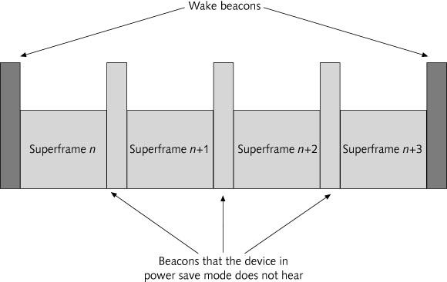
Figure 6-10 Wake beacons

Slide 31
802.15.3c PHY Layer
Uses 60 GHz band and supports the channel plan
Four 2 GHz wide channels
Channel aggregation is supported
Table 6-2 channel plan

Slide 32
802.15.3c PHY Layer
Contains a number of optional enhancements
Passive scanning
Channel scanning
Channel energy detection
Frequency and signal strength detection before joining a piconet
Channel quality requests
Link quality indication
Request channel/link quality
Transmit power control
Increase/decrease power to improve link quality

Slide 33
802.15.3c PHY Layer (Cond’t)
Contains a number of optional enhancements
Neighbor and child piconets
Two superframe transmission modes
When using omnidirectional transmission, the superframe is sent only once to all stations
When using beamforming, the superframe is transmitted multiple times in the direction of each station (round-robin fashion)
Max data frame length of 8,388,608 octets
Maximize throughput

Slide 34
802.15.3c PHY Layer
Modulation
Variations of BPSK and QPSK
Required to transmit headers using LRP
Single carrier for LRP and OFDM encoding for HRP and MRP

Slide 35
Frequency Division Multiple Access (FDMA)
Old conventional method (Analog TV, Radio etc.)
Use separate carrier frequency for individual transmission
Occupied BW
Channel separation
f_{ｃ１}
f_{ｃ2}
f_{ｃ3}
f_{ｃN}
Radio frequency
Carrier frequency
Guard band

Slide 36
Spectrum comparison for same data rate transmission
Multi carrier
frequency
Single carrier
frequency
OFDM
frequency
Notes:
Old fashion Broadband use wideband of single carrier,
OFDM uses multiple carriers (as wide as wide single carrier) :
OFDM gets high speed serial data, sperates it to multiple channels (with multiple carriers)
(also insert cyclic prefix to prevent ISI (multipath distrotion + reduce error) and send multiple carriers to a receiver,
A receiver gets mutliple carriers (which are orthogonal) and convert to serial

Slide 37
Actual OFDM spectrum
Multi-carrier Amplitude modulation scheme
Each Carrier’s amplitude is modulated
No interference on the center of each carrier
Well-suited for Wireless Communication
Amplitude
Frequency
Notes:
OFDM advantages:
- use effective bandwidth (overlap frequency band)
- use with large number of modulation (e.g. 4096-QAM) because of non-overlap channels + slower data rate (with parellel sending – less error)
- errors affected only a narrow band carrier (with wide band, errors affected to whole frequency band (faster rate)
Disadvantage:
- solves multiplath distrotion problem with guard time (cyclic prefix)

Slide 38
Mesh Networking (802.15.5)
Mesh networking
Each device connects to all other devices within range
Effectively creating multiple paths for transmission
Enable WPANs to cover an entire building

Slide 39
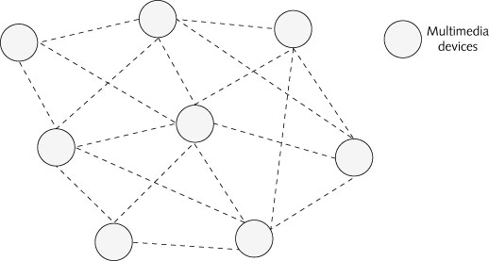
Figure 6-11 Mesh network

Slide 40
WPAN Challenges
Challenges
Competition Among WPAN Standards
WPAN Security
Security for IEEE 802.15.3 HR WPANs
Cost of WPAN Components
Industry Support for WPAN Technologies
Protocol Functionality Limitations
Spectrum Conflict

Slide 41
Competition Among WPAN Standards
IEEE 802.15.1 and 802.15.3 are positioned to compete with Bluetooth for market share
It will take a few years before 802.15.3 products begin to ship in volume
WirelessHD, WiGig, and WHDI have the potential to quickly outpace Bluetooth

Slide 42
WPAN Security
IEEE 802.15.3 HR WPAN security
Based on Advanced Encryption Standard (AES)
Uses a 128-bit key
Two security modes:
Mode 0: does not encrypt or protect the data
Mode 1: strong cryptography based on AES

Slide 43
Cost of WPAN Components
Bluetooth currently supports more devices than other WPAN technologies
Industry experts believe that price must be reduced to reach competitive advantage
Does not make economic sense to use a chip that costs $5 to replace a higher-data rate cable that costs < $10
Notes:
Bluetooth is expensive for the beginning, and about $5 presently (that’s a reason why bluetooth wins the game)
bluetooth $5 replace higher data rate cable < $10,
if wirelessHD is cheap and has data rate equal or greater than cable,
the replacing is possible.

Slide 44
Industry Support for WPAN Technologies
Industry experts predict that new technologies will be more quickly embraced by manufacturers
Such as WirelessHD and ZigBee

Slide 45
Protocol Functionality Limitations
Bluetooth protocol suffers from its lack of hand-off capability between piconets
Hand-off
Ability to move from one master or PNC to another
Without getting disconnected from the network
ZigBee and WirelessHD have the advantage over Bluetooth in this area

Slide 46
Summary
HR WPANs are optimized for multimedia transmissions
Optimized for multimedia voice and video signals
WHDI defines wireless connectivity using the 5 GHz band
WiGig defined a set of specs that include protocol adaptation layers to support wireless HDMI, USB, PCIe, data, video, and audio

Slide 47
Summary
The 60 GHz band can only support short-range connections
WiGig supports the same modulation and coding schemes in the ISM and U-NII bands as 802.11
WirelessHD is the only spec that uses IEEE 802.15.3c standard
WirelessHD defines three PHY layers: LRP, HRP, and MRP

Slide 48
Summary
WiGig and WirelessHD support beamforming
802.15.3c supports peer-to-peer networking
Efficient data transmission is accomplished using a superframe
Devices can send asynchronous data in the CAP or request channel time for async during CTAP
802.15.3 devices support three power-saving modes: DSPS, PSPS, and APS

Slide 49
Summary
Challenges for WPANs include speed, security, cost, industry support, interference, and protocol limitations
WPAN devices that are designed to be small and consume very little power have limited processing capabilities and storage

