Slide 1
Chapter 7 Low speed wireless Local area networks
Reference: Jorge Olenewa, Guide to Wireless Communications, 3rd edition, ISBN-13: 9781111307318, 2013
© Cengage Learning 2014
Department of Computer Engineering, Faculty of Engineering Prince of Songkla University, Phuket Campus

Slide 2
Objectives
Describe how WLANs are used
List the components and modes of a WLAN
Describe how an RF WLAN works
Explain the differences between IR, IEEE 802.11, and IEEE 802.11b WLANs
Outline the user mobility features offered by IEEE 802.11 networks

Slide 3
WLAN Applications
Wireless networks are increasing in popularity
Installing cabling is inconvenient and very expensive
Wireless networks solve this problem
With a wireless network
Multiple users can share a single Internet connection
Wireless residential gateway
Device that combines a router, Ethernet switch, and wireless access point; sometimes a cable or DSL modem as well
Provides better security than connecting directly to the Internet

Slide 4
WLAN Components
Minimal hardware needed for a WLAN
Computer
ISP
Wireless network interface card
Access point (AP)

Slide 5
Wireless Network Interface Card
Network interface card (NIC)
Allows a computer to be connected to a network
Wireless NIC
Connects a computer to a network without cables
Uses an antenna instead of cable port
Mini PCI
Small card that is functionally equivalent to a standard PCI expansion card
Used with notebook computers

Slide 6
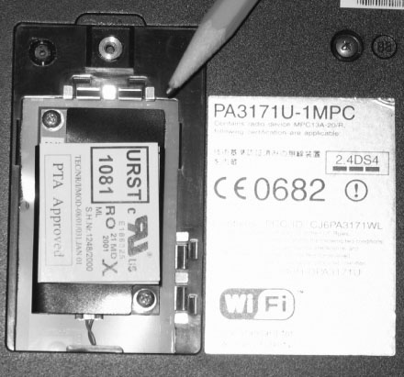
Figure 7-1 A mini PCI wireless NIC

Slide 7
Wireless Network Interface Card
Intel Centrino chipset
Integrates all of the functions of a wireless NIC
Smaller devices
Already include a wireless radio chip and antenna
Software
Built-in to operating system in most cases
Can also be a separate program

Slide 8
Access Points
Access point (AP)
Provides wireless LAN devices with a point of access into a wired network
AP parts
Radio transceiver
Antenna
RJ-45 wired network interface port
AP functions
Wireless communications base station
Bridge between the wireless and wired networks

Slide 9
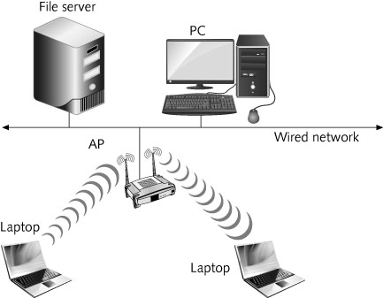
Figure 7-2 The AP as the point of access into a wired network

Slide 10
Access Points
The range of an AP is approximately 115 meters
Dynamic rate selection
AP will automatically select the highest possible data rate for transmission
Depending on the strength and quality of the signal
An AP can generally support over 100 users
20-25 is more practical for a heavily used AP
Power over Ethernet (PoE)
DC power is delivered to the AP through the unused wires in a standard UTP Ethernet cable

Slide 11
WLAN Modes
Ad hoc mode
Infrastructure mode

Slide 12
Ad Hoc Mode
Also known as peer-to-peer mode
Formal name: Independent Basic Service Set (IBSS) mode
Wireless clients communicate directly among themselves without using an AP
Quick and easy setup of a wireless network
Drawback is that wireless clients can only communicate among themselves – no wired network access

Slide 13
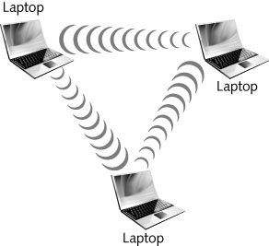
Figure 7-3 Ad hoc mode

Slide 14
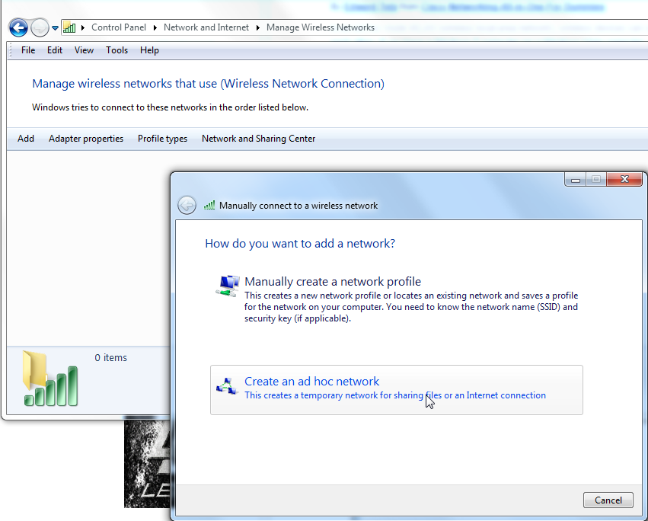
Adhoc Network (Windows7)

Slide 15
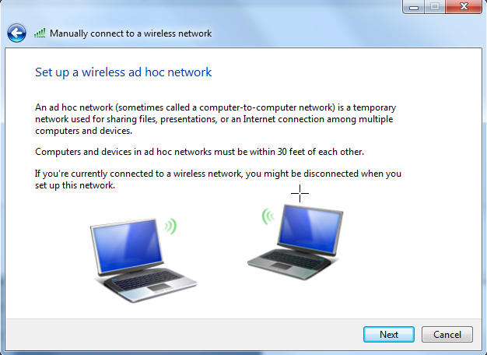
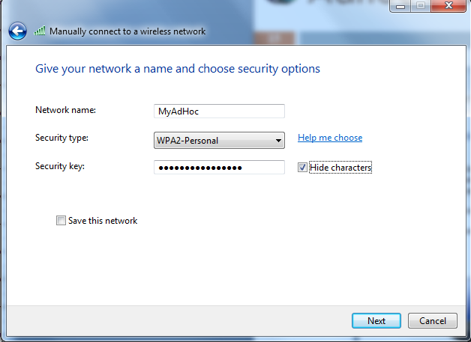
Adhoc Network (Windows7)

Slide 16
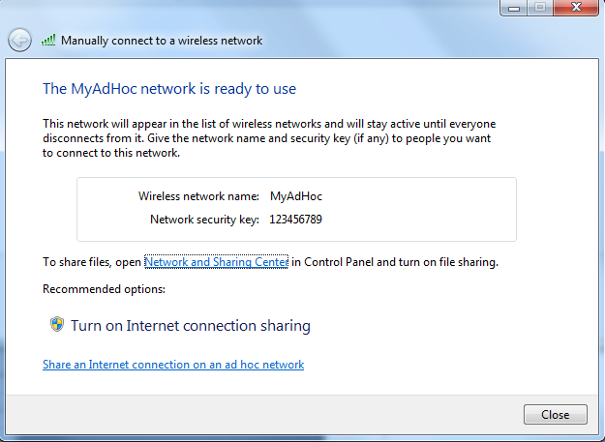
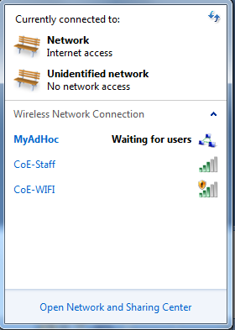
Adhoc Network (Windows7)
Other users can directly join the Adhoc network

Slide 17
Infrastructure Mode
Also known as the Basic Service Set (BSS)
Consists of wireless clients and an AP
Extended Service Set (ESS)
Two or more BSS wireless networks installed in same area using the same Service Set Identifier (SSID)
SSID – alphanumeric string that identifies the network
Provides users with uninterrupted mobile access to the network
All wireless clients and APs must be part of the same network
For users to be able to roam freely

Slide 18
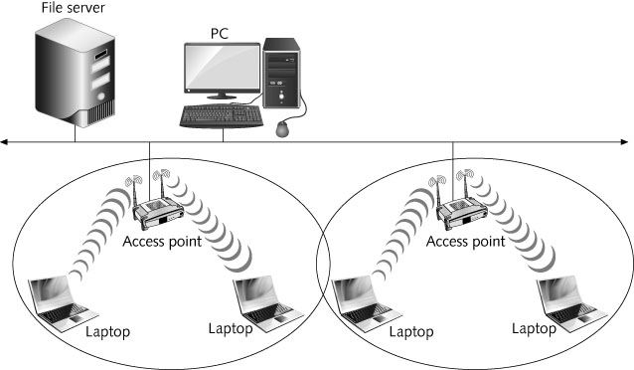
Figure 7-4 Extended Service Set (ESS)

Slide 19
Infrastructure Mode
When more than one AP exists on the same SSID, wireless devices choose which AP to associate with based on signal strength
Devices changes to that APs frequency channel
Device monitors to see if a different AP can provide better quality signal
Transition from AP to AP is called a handoff

Slide 20
Infrastructure Mode
Can be difficult to manage one large network
Performance and security may also be adversely affected
Subnets
Network units that contain fewer computers
In an ESS divided into subnets
A mobile user might not be able to freely roam between APs
Must reconnect between each subnet to get a new IP address

Slide 21
Wireless LAN Standards and Operation
Most WLANs are based on these same initial IEEE 802.11 standard:
Original standard defines a local area network that provides cable-free data access for clients
That are either mobile or in a fixed location
At a rate of either 1 or 2 Mbps
Using either diffused infrared or RF transmission
When using RF; transmissions use FHSS or DSSS
Specifies that the features of a WLAN be transparent to the upper layers of the TCP/IP protocol stack
Or the OSI protocol model

Slide 22
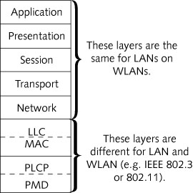
Figure 7-5 WLAN features restricted to the PHY and MAC layers

Slide 23
Low speed wireless LAN
IEEE 802.11
IEEE 802.11b

Slide 24
IEEE 802.11 Standards
IR and FHSS
No 802.11 equipment introduced into consumer market using these technologies
2 Mbps original standard
Too slow for most applications
802.11b and 802.11a were published in 1999 as a response
Provide 11 and 54 Mbps respectively
802.11g providing 54 Mbps and backward compatible to 802.11b introduced in 2003

Slide 25
IEEE 802.11b Standard
Added two higher speeds, 5.5 Mbps and 11 Mbps
Specified RF and direct sequence spread spectrum (DSSS) as the only transmission technologies
Physical layer
Divided into two parts
Physical Medium Dependent (PMD)
Physical Layer Convergence Procedure (PLCP)

Slide 26
IEEE 802.11b Standard
Physical layer convergence procedure standards
Based on direct sequence spread spectrum (DSSS)
Must reformat the data received from the MAC layer into a frame that the PMD sublayer can transmit
PLCP frame is made up of three parts: the preamble, the header, and the data
Frame preamble and header are always transmitted at 1 Mbps
Allows communication between slower and faster devices

Slide 27
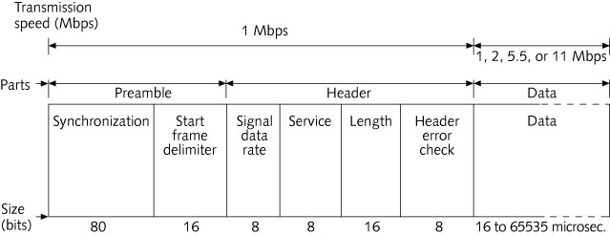
Figure 7-6 802.11b PLCP frame
Notes:
Sync = 0,1,0,1…
SFD = 1111 00 111 0 1 00000
Signal data rate = how fast the data is being sent
Service = Reserved for future use and must set to 0. Bit 2,3,7 are used in combination with the length field for data rate > 8 mbps
Length = indicates how long the data portion of the frame in micro second. (16-65535)
Data = up to 4095 bytes. (the max length of IEEE 802.11 MAC frame)

Slide 28
IEEE 802.11b Standard
Physical medium dependent standards
Translate the binary 1s and 0s of the frame into radio signals that can be used for transmission
802.11b standard uses the Industrial, Scientific, and Medical (ISM) band
Specifies 14 available frequencies, beginning at 2.412 GHz and incrementing by .005 GHz (5 MHz)
PMD can transmit the data at 11,5.5, 2,or 1 Mbps
For transmissions at 1 Mbps, two-level differential binary phase shift key (DBPSK) modulation is used

Slide 29
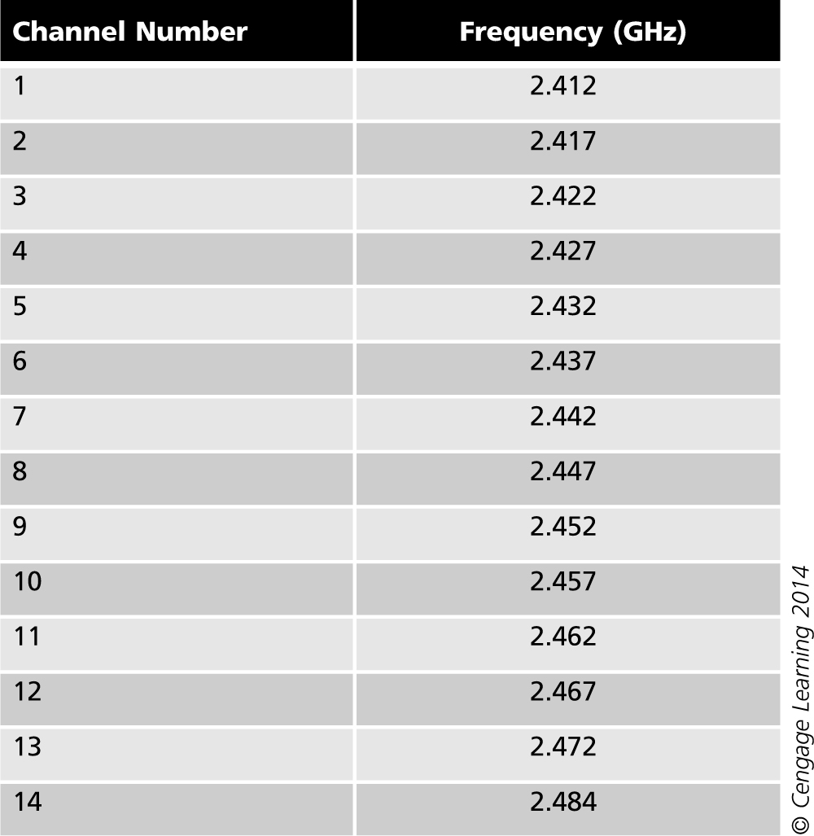
Table 7-1 802.11b ISM channels

Slide 30
IEEE 802.11b Standard
Physical medium dependent standards
Transmissions at 2, 5.5, and 11 Mbps use differential quadrature phase shift keying (QPSK)
To transmit at rates above 2 Mbps, Complementary Code Keying (CCK) is used
Media access control layer
802.11b Data Link layer consists of two sublayers
Logical Link Control (LLC) – no changes compared to 802.3 (Ethernet) networks
Media Access Control (MAC)

Slide 31
IEEE 802.11b Standard
Coordinating transmissions in the shared wireless medium
Channel access methods can prevent collisions
One way is for devices to listen before sending and use acknowledgement to ensure delivery – called distributed coordination function (DCF)
DCF employs Carrier sense multiple access with collision avoidance (CSMA/CA)
Based on 802.3 CSMA/CD

Slide 32
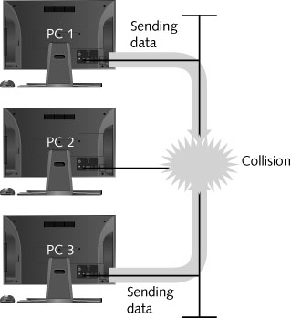
Figure 7-7 Frame collision in a wired network
Notes:
CSMA/CD uses voltages sensors on the NIC. Whenever they detect a voltage higher than 5 volts, means that more than one device is transmitting at the same time. This method cannot be used in a wireles system when the signal are transmitted and received in the same frequency. The RF signal from a transmitter is so strong. While transmitting, a device drown ability to detect a collision.
In addition, the amount of attenuation of a signal sent by another device cannot be effectively predicted in a wireless system.
So, measuring the strength of voltage of an RF signal is not practical.

Slide 33
IEEE 802.11b Standard
Coordinating transmissions in the shared wireless medium
CSMA/CD is designed to handle collisions
CSMA/CA attempts to avoid collisions altogether
With contention-based channel access methods
Most collisions occur after a device completes its transmission
CSMA/CA makes all devices wait a random amount of time (backoff interval) after the medium is clear
The amount of time is measured in time slots
CSMA/CA also reduces collisions by using an explicit acknowledgment (ACK)

Slide 34
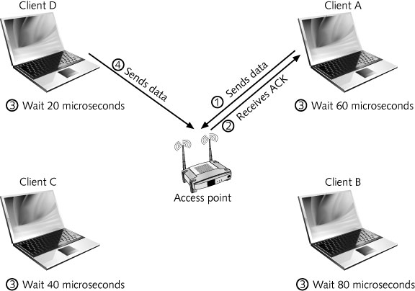
Figure 7-8 CSMA/CA

Slide 35
IEEE 802.11b Standard
Coordinating transmissions in the shared wireless medium
Additional mechanisms to reduce collisions
Request-to-send/Clear-to-send (RTS/CTS) protocol
Fragmentation
Polling
Another type of channel access method
Each computer is asked if it wants to transmit
Polling effectively eliminates collisions
Point coordination function (PCF)
AP serves as the polling device

Slide 36
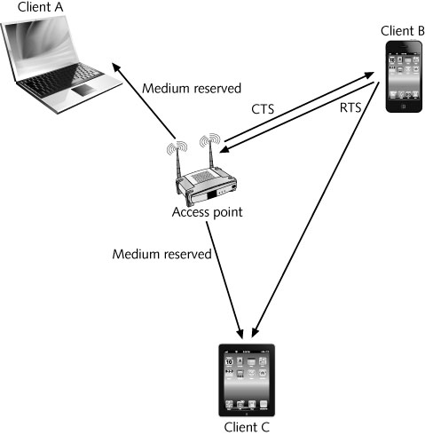
Figure 7-9 RTS/CTS

Slide 37
IEEE 802.11b Standard
Polling
Another type of channel access method
Each computer is asked if it wants to transmit
Polling effectively eliminates collisions
Polling is known as point coordination function (PCF)
AP serves as the polling device
Designed for time-sensitive transmissions (voice/video)
Not used in commercial-grade 802.11 APs

Slide 38
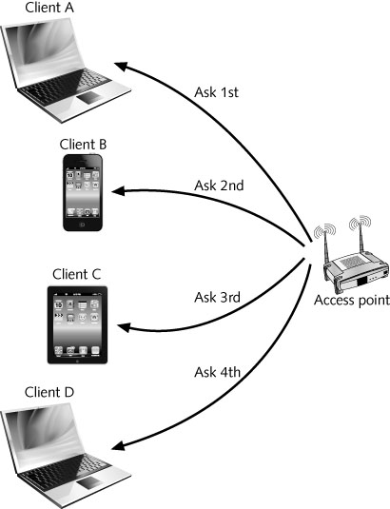
Figure 7-10 Polling in PCF

Slide 39
IEEE 802.11b Standard
MAC layer of 802.11b provides functionality to join a WLAN and stay connected
Process known as association and reassociation
Association begins with the client scanning the wireless medium
Passive scanning
Client listening to each available channel for a set period of time
Client listens for a beacon frame transmitted from all available APs
Frame includes the AP’s SSID and BSSID

Slide 40
IEEE 802.11b Standard
Active scanning
Client sends a probe frame to each channel
Client then waits for the probe response frame
Associate request frame
Includes the client’s capabilities and supported rates
Associate response frame
Sent by the AP
Contains a status code and client ID number for that client
Client is now part of the WLAN
Notes:
Beacon frame – AP periodically broadcast beacon frame (SSID, BSSID)
Probe frame – to query AP capabilities (wait information (SSID, supported data rate etc)
Associate request frame – to connect WLAN (client has to sent preferred SSID, supported data rate to connect to an AP)

Slide 41
IEEE 802.11b Standard
Reassociation
Client may drop the connection with one AP and reestablish the connection with another
Necessary when mobile clients roam beyond the coverage area of one AP
Client sends a reassociate request frame to new AP
AP sends back a reassociate response frame
New AP sends a disassociate frame to old AP to terminate the client’s association to old AP

Slide 42
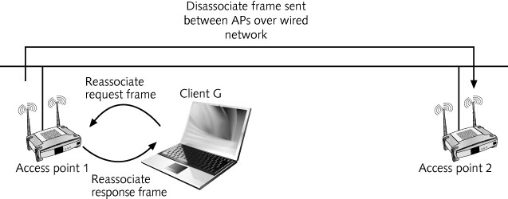
Figure 7-11 Reassociation process

Slide 43
IEEE 802.11b Standard
Power management
Most clients in a WLAN are portable devices
To conserve battery power, they can go into sleep mode
When a client is part of a WLAN, it must remain fully powered
Power management allows the mobile client to shut down its radio to save energy
But still not miss out on data transmissions
The key to power management is synchronization

Slide 44
IEEE 802.11b Standard
Power management
When a mobile 802.11b client goes into sleep mode, the AP is informed of the change
AP temporarily stores the frames destined for sleeping clients (this function is called buffering)
At predetermined times, the AP sends out a beacon frame to all clients
Known as the traffic indication map (TIM)
Traffic indication map (TIM)
List of clients with buffered frames waiting at the AP

Slide 45
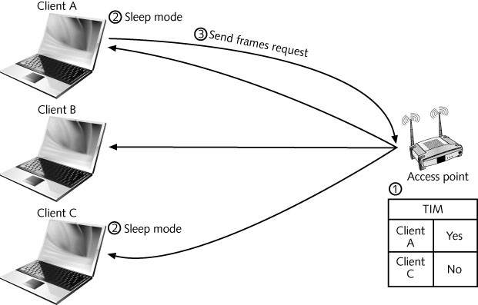
Figure 7-12 Power management in 802.11

Slide 46
IEEE 802.11b Standard
MAC frame formats
Three types of MAC frame formats
Management frames
Used to set up the initial communications
Control frames
Provide assistance in delivering the frames that contain the data
Data frames
Carry the information to be transmitted to the destination client

Slide 47
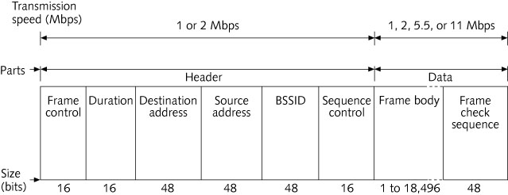
Figure 7-13 Structure of a management frame
Notes:
Frame control field indicates the current version number of the stand and wheather encryption is being used.
Duration field contains the number of micro seconds needed to transmit. The value will differ depending on wheather the PCF or DCF is being used.
Sequence control is the seq number for the frame and, if necessary, the fragment number.

Slide 48
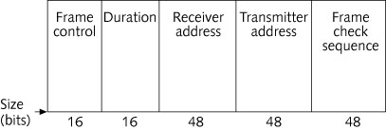
Figure 7-13 RTS (control) frame

Slide 49
Figure 7-15 Data frame
Notes:
Address1 = SSID
Address2 = destination address
Address3 = source adddress
Address4 = transmitter / receiver depending on the network configure

Slide 50
IEEE 802.11b Standard
802.11 standard defines a number of interframe spaces (IFS)
To handle the contention for the medium
Interframe space types
Short interframe space (SIFS)
DCF interframe space (DIFS)
Table 7-2 Interframe space duration

Slide 51
IEEE 802.11b Standard
Basic rules of communication in an 802.11 network
Device that wants to transmit begins listening for an RF signal
Size of a frame includes both the length of time necessary to send the data and the SIFS time
Sending device begins listening for an ACK
After receiving an ACK, the transmitting client begins to wait a random backoff interval
If the transmitting device does not receive an ACK after the SIFS
It is allowed to maintain control of the medium
If the frame was acknowledged correctly
Transmitting device listens to the medium while waiting its backoff interval

Slide 52
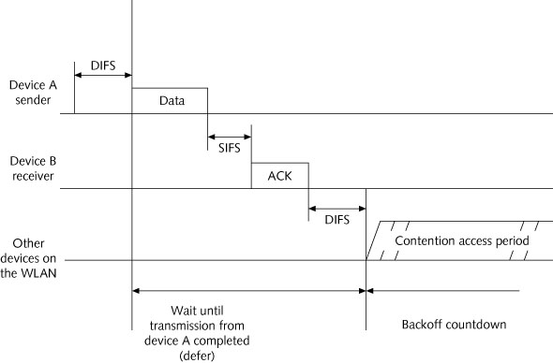
Figure 7-16 Single device transmitting

Slide 53
IEEE 802.11b Standard
In the case of two devices having frames to transmit
Client A has a frame to transmit and a backoff counter of 0; Client B has a backoff period of 2
Client A transmits its first frame
Client B detects traffic and waits
After client A transmits, it sets its backoff counter to 3
At the end, clients A and B begin their backoff interval
Network enters a contention access period
Both clients being counting
After two time slots, client B reaches 0 and transmits
Once client B receives an ACK, the process continues

Slide 54
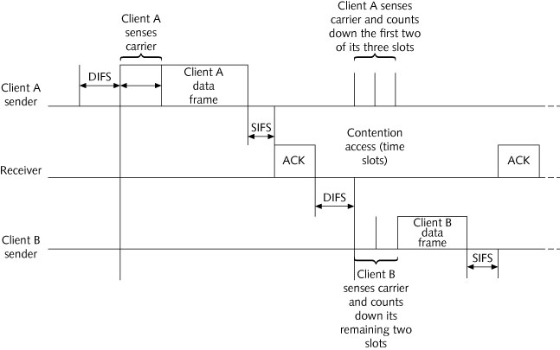
IEEE 802.11b Standard
Figure 7-17 CSMA/CA with two clients transmitting
Notes:
If medium is clear, they may all try to transmit at the same time, resulting in collision.
Thus, all devices wait a random amount of time (the backoff interval) after medium is clear, which significantly reduces the occurrence of collision. The amount of time that a device must wait measured in time slots.

Slide 55
Summary
The wireless technology that attracts the most attention today
Radio frequency (RF) wireless local area networks (WLANs)
Wireless NIC performs same functions as wired NIC
Access points parts
Antenna
Radio transceiver
RJ-45 wired network interface

Slide 56
Summary
Data can be sent and received in an RFWLAN either in ad hoc or infrastructure mode
IEEE 802.11 standard defines a local area network that provides cable-free data access
In 1999, IEEE approved 802.11b and 802.11a
PCLP for 802.11b based exclusively on DSSS
802.11 standard uses an access method known as the distributed coordination function (DCF)
Specifies that carrier sense multiple access with collision avoidance (CSMA/CA) be used

Slide 57
Summary
802.11 standard provides for an optional polling function known as point coordination function (PCF)
Mobile WLAN devices often depend on batteries as their primary power source
Sleep mode conserves battery power
802.11 standard specifies three different types of MAC frame formats
Management frames
Control frames
Data frames

