Slide 1
Chapter 8
High speed wireless LAN and security
Reference: Jorge Olenewa, Guide to Wireless Communications, 3rd edition, ISBN-13: 9781111307318, 2013
© Cengage Learning 2014
Department of Computer Engineering, Faculty of Engineering
Prince of Songkla University, Phuket Campus

Slide 2
Objectives
Describe how IEEE 802.11a networks function and how they differ from 802.11 networks
Outline how 802.11g enhances 802.11b networks
Discuss the 802.11n, 802.11ac, and 802.11ad amendments to the standard
Explain how the use of wireless bridges and wireless switches expands the functionality and management of WLANs
List the security features and issues with IEEE 802.11 networks

Slide 3
High speed wireless LAN
IEEE 802.11a
IEEE 802.11g
IEEE 802.11n
IEEE 802.11ac
IEEE 802.11ad
IEEE 802.11ax

Slide 4
IEEE 802.11a
802.11a standard maintains the same medium access control (MAC) layer functions as 802.11b WLANs
  Differences are confined to the physical layer
802.11a achieves its increase in speed and flexibility over 802.11b through:
  Its multiplexing technique
  A more efficient error-correction scheme

Slide 5
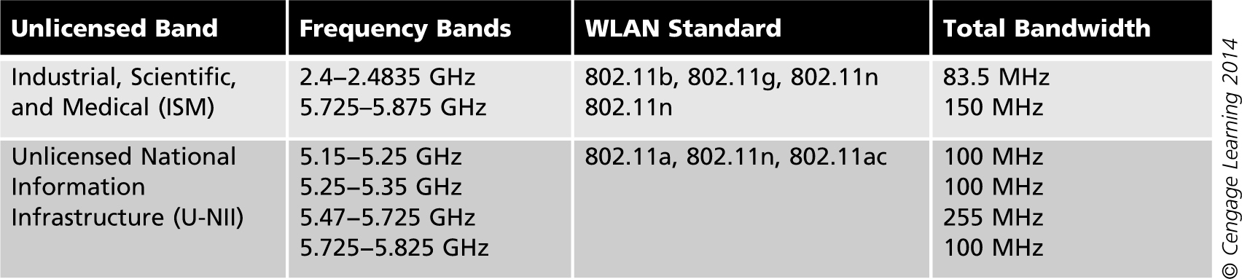
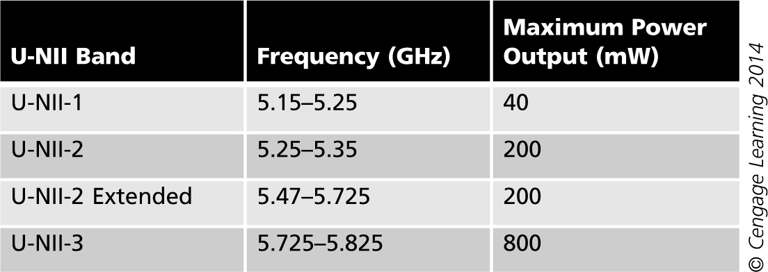
Table 8-1 ISM vs. U-NII
Table 8-2 U-NII bands

Slide 6
Channel Allocation in 802.11a
Channel allocation
  With 802.11b, the available frequency spectrum is divided into 11 channels in the United States
    Only three non-overlapping channels are available for simultaneous operation
  In 802.11a, eight frequency channels operate simultaneously
    In the Low Band (5.15 to 5.25 GHz) and Middle Band (5.25 to 5.35 GHz)
    23 channels are available
    Within each frequency channel there is a 20 MHz-wide channel that supports 52 subcarrier frequencies

Slide 7
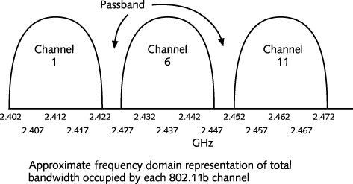
Figure 8-1 802.11b channels

Slide 8
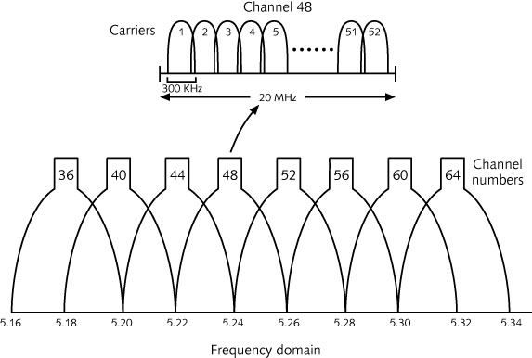
Figure 8-2 802.11a channels

Slide 9
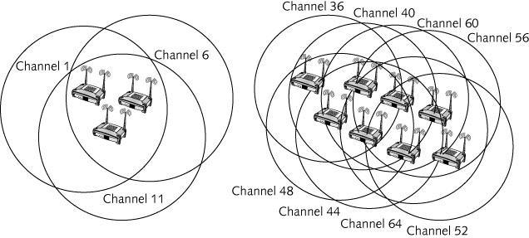
Figure 8-3 802.11b vs. 802.11a channels

Slide 10
Orthogonal Frequency Division Multiplexing
Multipath distortion
  Receiving device gets the signal from several different directions at different times
    Must wait until all reflections are received
802.11a solves this problems using OFDM
Orthogonal Frequency Division Multiplexing (OFDM)
  Splits a high-speed digital signal into several slower signals running in parallel
  Sends the transmission in parallel across several lower-speed, narrower frequency channels

Slide 11
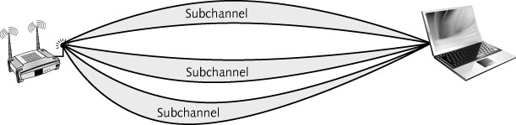
Figure 8-4 Transmitting on multiple subchannels simultaneously

Slide 12
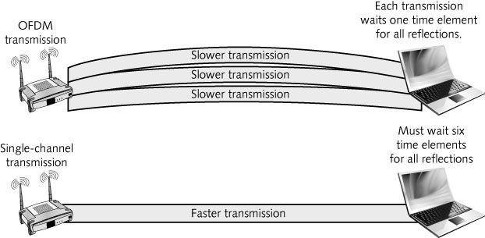
Figure 8-5 Comparison of OFDM and single channel transmission

Slide 13
Orthogonal Frequency Division Multiplexing
OFDM uses 48 of the 52 subchannels for data
Modulation techniques
  At 6 Mbps, phase shift keying (PSK)
  At 12 Mbps, quadrature phase shift keying (QPSK)
  At 24 Mbps, 16-level quadrature amplitude modulation (16-QAM)
  At 54 Mbps, 64-level quadrature amplitude modulation (64-QAM)

Slide 14
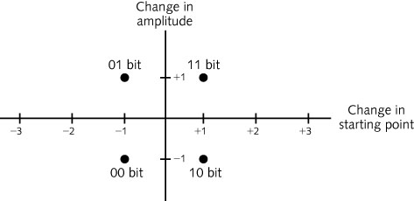
Figure 8-6 Quadrature amplitude modulation

Slide 15
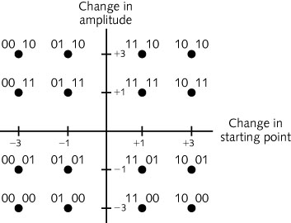
Figure 8-7 16-level quadrature amplitude modulation (16-QAM)

Slide 16
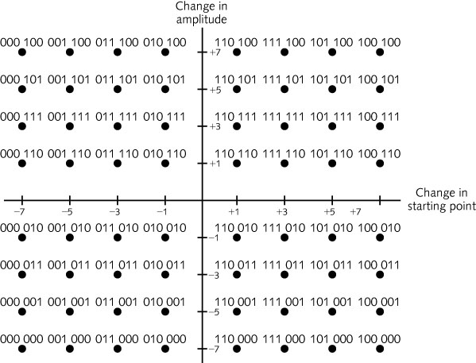
Figure 8-8 64-level quadrature amplitude modulation (64-QAM)

Slide 17
Error Correction in 802.11a
Number of errors is significantly reduced
  Due to the nature of 802.11a transmissions
Because transmissions are sent over parallel subcarriers
  Radio interference from outside sources is minimized
Forward Error Correction (FEC) transmits extra bits per byte of data
  Eliminates the need to retransmit if an error occurs, which saves time, increases throughput

Slide 18
802.11a PHY Layer
The 802.11a PHY layer is divided into two parts
  Physical Medium Dependent (PMD) sublayer
    Defines the characteristics of the wireless medium
    Defines the method for transmitting and receiving data through that medium
  Physical Layer Convergence Procedure (PLCP)
    Based on OFDM instead of DSSS
    Reformats the data received from the MAC layer into a frame that the PMD sublayer can transmit
    Determines when the medium is free so data can be sent

Slide 19
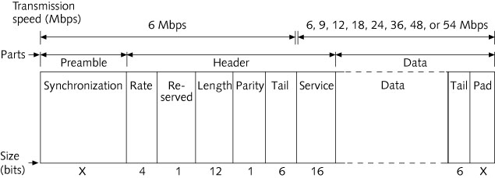
Figure 8-9 802.11a PLCP frame
Notes:
Rate – Data rate
Length – data length from 1 – 4096 octet
Service – The first seven bits are used to initialize part of the transmitter and receiver circuits and are set to 0. Remaining reserved to future use and also set to 0.

Slide 20
802.11a PHY Layer
802.11a networks have a shorter range of coverage
  Approximately 225 feet (70 meters)
  Compared to 375 feet (114 meters) for an 802.11b WLAN

Slide 21
IEEE 802.11g
Operates in the same frequency band as 802.11b
Follows the same specifications for 802.11b
Standard outlines two mandatory transmission modes along with two optional modes
Mandatory transmission modes
  Same mode used by 802.11b and must support the rates of 1, 2, 5.5, and 11 Mbps
  Same OFDM mode used by 802.11a but in the same frequency band used by 802.11b
Number of channels available with 802.11g is three
  Compared with eight channels for 802.11a

Slide 22
IEEE 802.11n and Other Amendments
IEEE 802.11n
  Ratified end of 2009
  Uses multiple radios and antennas in each device
  Works in 2.4 and 5 GHz bands; backward compatible with 802.11

Slide 23
IEEE 802.11n
Multiple-input and multiple-output (MIMO)
  Based on using multiple radios and antennas
  Prior to 802.11n, two antennas were used for antenna diversity – antenna with the strongest signal is used
  802.11n MIMO devices employ beamforming to direct transmissions to the device from which a frame was received
  802.11n MIMO also uses spatial multiplexing - frames are broken up and sent in multiple parts from different radios

Slide 24
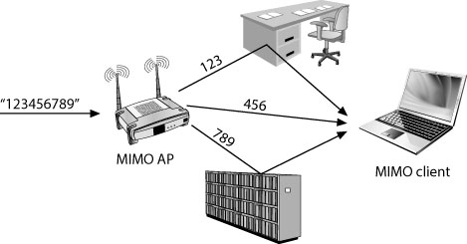
Figure 8-13 Spatial multiplexing sending multiple (spatial) streams of data

Slide 25
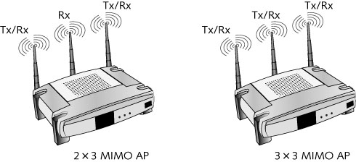
IEEE 802.11n
Up to 4 transmitters and 4 receivers
  Max transmission speed of 600 Mbps
  Configurations such as 2x3 (2 transmitters and 3 receivers) and 3x3 (3 of each) exist
Figure 8-14 802.11n MIMO devices

Slide 26
IEEE 802.11n
Channel configuration
  Uses more bandwidth than other standards
    Can use 22 or 20 MHz to communicate with 802.11b (DSSS) or 802.11g/n (OFDM) devices
    Uses 40 MHz for High Throughput (HT); 300 to 600 Mbps
  Support DSSS and OFDM
  802.11n supports channel bonding – two channels are combined into on 40 MHz channel
Notes:
https://superuser.com/questions/772145/optimal-wi-fi-channels-in-2-4-ghz
802.11b – DSSS 22 MHz, 802.11g/n OFDM 20 MHz wide

Slide 27
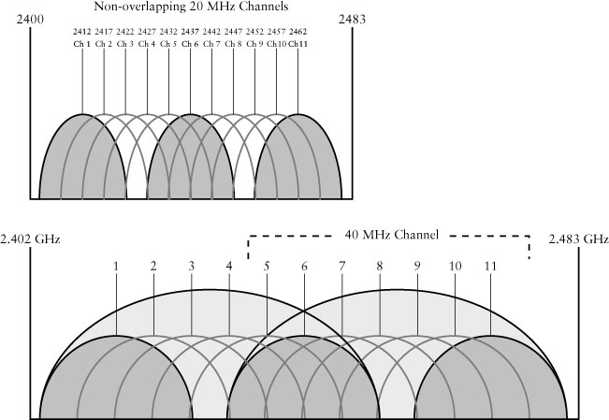
IEEE 802.11n
Figure 8-15 Channel bonding in 802.11n

Slide 28
IEEE 802.11n
Guard interval
  In non-HT transmissions, delay is required at the end of each frame to allow reflected signals to arrive
    The delay is called the guard interval
    Prevents intersymbol interference (ISI)
Modulation and coding scheme (MCS)
  Nine different factors define the data rates
    Examples: number of spatial streams, GI, FEC coding etc.
HT PHY Layer
  Supports 3 frame formats
    1 – (non-HT) when communicating with 802.11a/g devices (54 mbps)
    2 – (mixed-HT) when used in mixed HT and legacy devices (802.11/b)
    3 – (greenfield) 802.11n only
Notes:
Because of multiple factors involved in determining the data rate in 802.11n – the type of modulation, the number of spatial streams, the GI, the FEC coding , etc.
The amendment now uses combination of nine different factors to define the data rates. These combination are referred to as MCSs.
HT PHY
1 – non HT mode
2 – mix HT (both HT and non-HT)
3 – HT only
In the first several “How Stuff Works” posts, I have been talking about technical improvements to 802.11n such as MIMO antennas, Spatial Multiplexing, andChannel Bonding. In this post, I want to talk about another such technical improvement, Short Guard Interval.
The guard interval is the space between symbols (characters) being transmitted. This is often confused with the space between packets, which is the interframe space (IFS). The guard interval is there to eliminate intersymbol interference, which is referred to as ISI. ISI happens when echos or reflections from one symbol interfere with another. Adding time between symbol transmission allows these echos and reflections to settle in before the next symbol is transmitted. In normal 802.11 operation, the guard interval is 800 ns.
With 802.11n, short guard intervals are possible. The short guard interval time is 400ns, or half of what it used to be. Shorter wait time (guard interval) between symbols increases throughput. However, if it’s too short, the amount of ISI will increase, and throughput will decrease. On the other hand, if the guard interval is too long, there is increased overhead due to the additional idle time. If you look at an 802.11 Modulation and Coding Scheme (MCS) chart, you will see thatShort Guard Interval increases the data rate by roughly 10-11%.
http://wifijedi.com/2009/02/11/how-stuff-works-short-guard-interval/

Slide 29
IEEE 802.11n
HT MAC Sublayer
  Enhancements to increase throughput and power management
    Frame aggregation – combines multiple MAC frames into one PHY frame to reduce overhead
    Two new power management methods
      Spatial multiplexing power save mode (SMPS)
        Devices turn off all but one radio.
        AP can wakup devices (similar to previous power saving)
      Power save multi-poll (PSMP)
        Similar with SMPS, but using RTS frame sent by AP
Notes:
Power management is important because the optional use of multiple radios (the more radios a device has, the more power it will consume).
SMPS – AP sent a beacon frame (with TIM) to notify client of waiting frame.

Slide 30
IEEE 802.11n
Reduced interframe space (RIFS)
  Allowed only in greenfield mode
    Shorter 2-microsecond interframe space
    Less timing overhead (normal SIFS interval is 10 microseconds)

Slide 31
802.11ac and 802.11ad
802.11ac and 802.11ad are under development
  Ratification expected late 2013
  Achieves data rates from 433 Mbps to almost 7 Gbps
  Allows between two and eight radios
  802.11ac works only in the 5 GHz U-NII band
  802.11ad goal is to expand the 802.11 standard to work in the 60 GHz band while maintaining backward compatibility
Notes:
802.11ac 6.93 Gbps with 160 MHz

Slide 32
802.11ac features enhancements
802.11ac features | Benefits
Wider channels | Higher data rates
Higher encoding density | Higher bit density per packet
Increased number of spatial streams | Higher data rates per AP/client link
Beamforming | Greater wireless AP/client link reliability
Multi-user MIMO | Greater AP/client capacity and efficient use of spectrum
From: http://www.merunetworks.com/products/technology/80211ac/

Slide 33
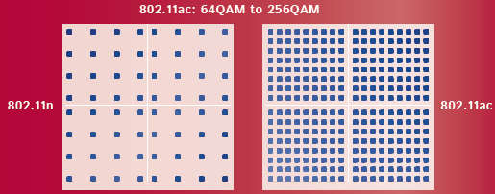
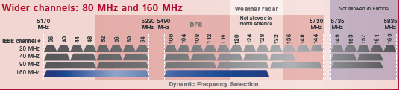
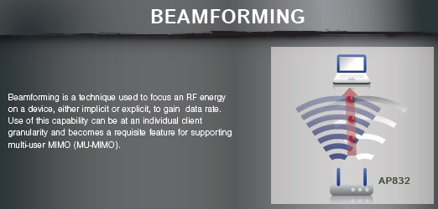
802.11ac features enhancements
More spatial streams - up to 8 spatial streams, further increasing the data rate for each radio (802.11n has 4 spatial streams).
802.11n supported 40 MHz channels
Multi-user MIMO – supports simultaneous transmissions to multiple clients and maximizes RF band utilization.
Notes:
Multi-user MIMO – supports simultaneous transmissions to multiple clients and maximizes RF band utilization. Up to four distinct clients can receive data simultaneously from a single AP at full channel data rate.

Slide 34
802.11ad
While IEEE 802.11ac is an extension of the existing 802.11n specification, IEEE 802.11ad represents a completely new paradigm.
Today, the 2.4- and 5-GHz wireless bands for the earlier 802.11 standards are heavily congested.
  They also lack the capacity to deliver the extreme data rates required for emerging business and consumer applications.
  The multi-gigabit data rates required for uncompressed high-definition multimedia transmissions

Slide 35
802.11ad
Because 60-GHz transmission suffers from large attenuation when propagating through physical barriers, this usage model is different from the other IEEE 802.11 standards.
Low-power transmissions will not propagate very far.
  This is considered an advantage, as it reduces the likelihood of co-channel interference and increases the potential density for frequency re-use.
  Another perceived advantage of limited range is the reduced opportunity for "theft" of protected content by eavesdropping on nearby transmissions.

Slide 36


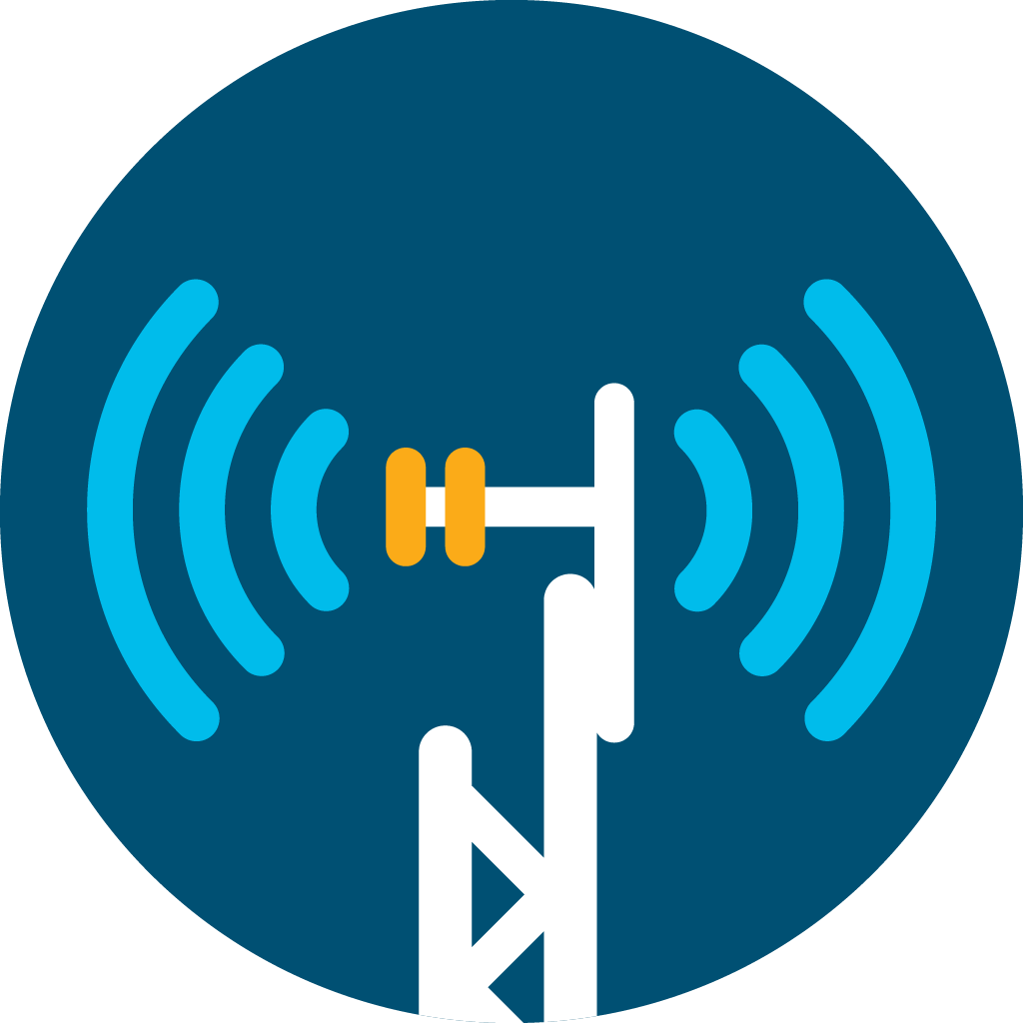
Experience: Wi-Fi 6 (802.11ax)
What is the big deal?
36
Higher
data rates
Increase in overall network capacity
Reduced latency and greater reliability
Improved power efficiency
1024-QAM for up to 9.6 Gbps per radio and single-antenna speeds of
1.2 Gbps
8x8:8SS
Enables next-generation 4K/8K and AR/VR video
3x to 4x more throughput than 802.11ac via OFDMA
Up to 4x capacity gain
in dense scenarios with BSS coloring
Multiuser MIMO gains
on all client types
Scheduled uplink and downlink OFDMA for deterministic “cellular-like” latency, reliability, and QoS
Optimized for IoT scale with hundreds of devices per AP
Up to 3x better battery life with Target Wake Time (TWT)
New coding structure and signaling procedures for better transmit and receive efficiency
For more information, see: https://www.cisco.com/c/en/us/products/collateral/wireless/white-paper-c11-740788.html
Slide 36-39 from: Tjie Seng, Njauw
TECHNICAL SOLUTIONS ARCHITECT, ASEAN
Notes:
Remove the graphics and enlarge the color blocks – put graphics in back up slide – same header (hide slide)
Multi-gigabit Performance
4x throughput increase over 802.11ac by doubling the number of RF chains
2.5x more throughput to a single Client allowing 1.2Gbps per 1SS client
Client scalabiity
Increase Capacity by providing the ability to Tx/Rx to multiple client at the same time
Quality of experience
Increase physcal number of clients by breaking channel into smaller IOT focused slots
Cellular-like
determinism & reliability
Increases throughput per AP
Battery Savings
Improve device battery life up to 3x by scheduling radio wake time

Slide 37
OFDMA – Using subcarriers more efficiently
Maximizing client count – lowering latency
37
OFDM
OFDMA
t₁
t₂
t₃
t₄
t₅
t₆
t₇
t₈
t₁
t₂
t₃
t₄
t₅
t₆
t₇
t₈
Each User gets 1 time slot – whole channel bandwidth
Each User must wait t₈ before Next TX_op
As more clients Join the cell, Latency – Jitter Increases
QOS only manages TXop – someone has to wait
Multi user Packet makes flight more efficient
Also provides much more regular and consistent TX_op
Deterministic nature – miss this truck – no worries here comes another “meaning the truck” is always leaving “full”… net result is lower latency
User 1 - Telemetry
User 2 - Voip
User 3 - Video
User 4 - Voip
User 5 - Data
User 6 - IoT
User 7 - Data
User 8 - Voip
Each subcarrier is a transport - Latency goes up when subcarriers go out “half empty”…
OFDMA solves this by allowing multi-user packets to go out on one subcarrier

Slide 38
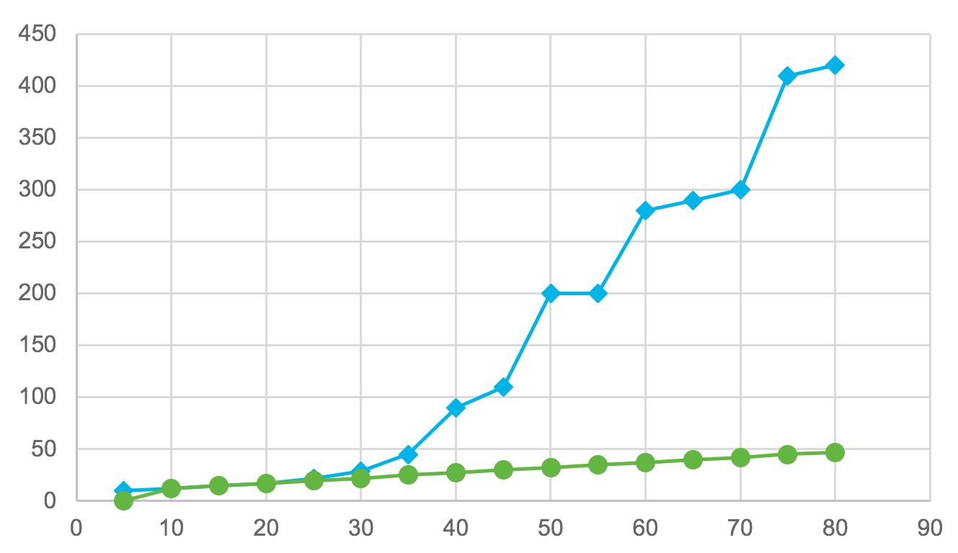
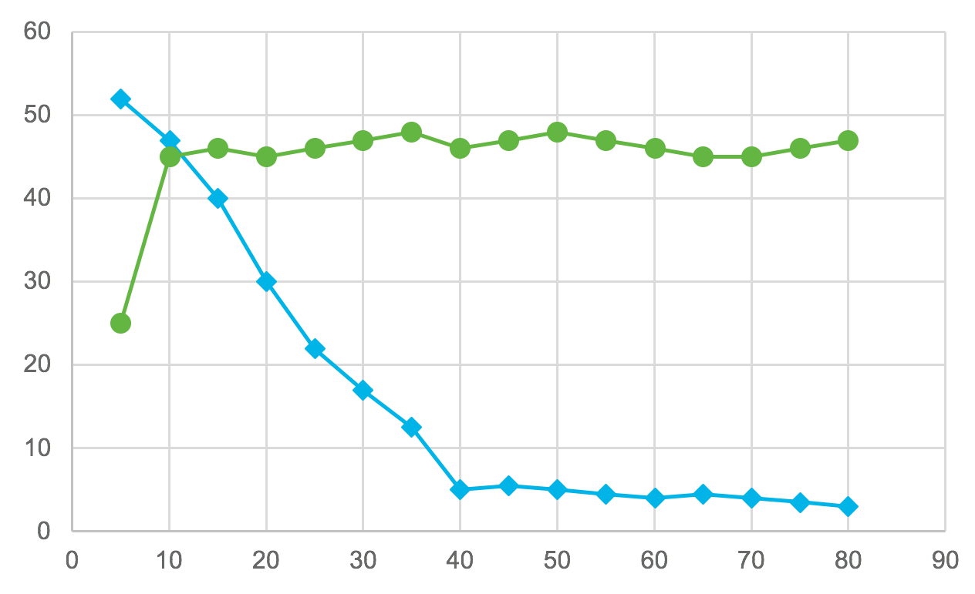

802.11ax (OFDMA) provides determinism at scale:
Enabling high-quality voice/video/data services cost effectively
38
Linear VOICE delay
Consistent DATA throughput
Source: Cisco sponsored research
Source: Cisco sponsored research
Wi-Fi 6 (ax)
Wi-Fi 5 (ac)
CBP*
Source: Cisco sponsored research
*Cisco best practice
Wi-Fi 6 (ax)
Wi-Fi 5 (ac)
Latency (ms)
Throughput (Mbps)
Client count
Client count
Wi-Fi 6 is not only cost-effective and ubiquitous but is now capable of delivering SLAs
Notes:
In the notes.. Perhaps list the conditions..??? Ask Malcolm Smith chances are pretty good he used theoretical modeling

Slide 39

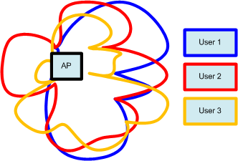

Multi-User MIMO (MU-MIMO) .11ac wave2
Occurs when TxBF is able to focus the RF at a client while creating a null to the other clients
39
  Similar to what the truck did with two antennas, using TxBF we have 4 antennas, and can place the signal anywhere we want
  While TxBF (directing) the signal at say User1, you have to also create a NULL or lower signal for Users 2 and 3 etc.

Slide 40
IEEE 802.11e
Approved for publication in November 2005
Defines enhancements to the MAC layer of 802.11
  To expand support for LAN applications that require Quality of Service (QoS)
802.11e allows the receiving device to acknowledge after receiving a burst of frames
Enables prioritization of frames in distributed coordinated function (DCF) mode

Slide 41
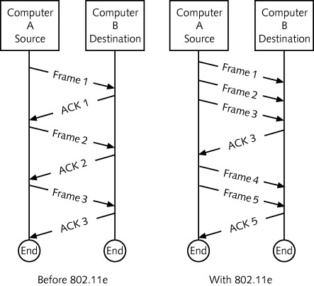
Figure 8-16 802.11e frame acknowledgements

Slide 42
IEEE 802.11e
Implements two new coordination functions
  Enhanced DCF (EDCF)
    Station with higher priority traffic waits less to transmit
  Hybrid coordination function (HCF)
    Combination of DCF and point coordination function (PCF)
Supports traffic prioritization based on QoS (quality-of-service); improves security features for mobile and nomadic users
Nomadic user
  Moves frequently but does not use the equipment while in motion

Slide 43
Expanding WLAN Functionality
Devices
  Wireless bridges and repeater
    Connect two wired networks or extend the range of a WLAN
  Wireless controller
    Incorporate most of the functions of an AP but do not have radios
    Connect multiple, less-complex APs via cable connection or logical network connection
Notes:
Connect two wired networks (Via wireless APs or base stations)

Slide 44
Wireless Bridges and Repeaters
WLAN extension
  Wireless bridges can extend range of a WLAN
  Bridge can be configured to connect to an AP as a repeater in point-to-multipoint mode
  Client devices can associate with the bridge
Keep in mind the amount of extra delay introduced in WLAN extension applications

Slide 45
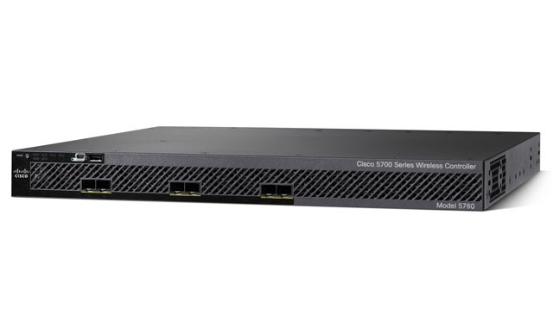
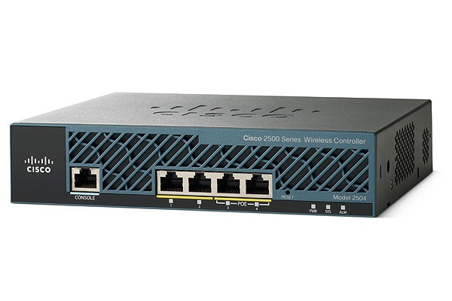
Wireless Controllers
Since the frequency range is limited, user density in each access point will be more considered.
Wireless controller help an access points to manage connected users:
  If the number limited connected users is reached, wireless controller will move other users to another access points.
  More users will be supported to connect to this kind of access points.

Slide 46
WLAN Security
Broadcasting network traffic over the airwaves
  Has created new research issues how to keep secured data transmissions
  More wireless security vulnerabilities are investigated
    WLANs are far more exposed to intrusion because the data is easier to trap than wire network

Slide 47
Attacks Against WLANs
Some of the most dangerous attacks
  Hardware theft
    Device may contain information that can assist someone in breaking into the network
  AP impersonation
    A rogue AP can impersonate a valid device
  Passive monitoring
    Data transmissions can be monitored
  Denial of service (DoS)
    Flood the network with transmissions and deny others access to the AP

Slide 48
802.11 Security
Authentication
  Process that verifies that the client device has permission to access the network
  Each WLAN client can be given the SSID of the network manually or automatically
  Turning off SSID broadcast can only protect your network against someone finding it unintentionally
Privacy
  Ensures that transmissions are not read by unauthorized users
  Accomplished with data encryption

Slide 49
802.11 Security
Wired Equivalent Privacy (WEP)
  Data encryption specification for wireless devices
  Two versions: 64-bit and 128-bit encryption
  Attackers can decrypt a 128-bit WEP key in minutes
  Uses weak RC4 implementation
  Seldom used today except in some home networks

Slide 50
802.11 Security
Wi-Fi Protected Access
  Standard for network authentication and encryption
    Introduced by the Wi-Fi Alliance in response to the weaknesses in WEP
  Uses a 128-bit pre-shared key (PSK)
  WPA-PSK uses a different encryption key for each client device, for each packet, and for each session
  WPA employs temporal key integrity protocol (TKIP)
    Which provides per-packet key-mixing
  TKIP also provides message integrity check (MIC)
  TKIP uses a 48-bit hashed initialization vector

Slide 51
802.11 Security
Wi-Fi Protected Access
  WPA2: version of WPA that has been certified by the IEEE to be compatible with IEEE 802.11i
IEEE 802.1x
  Define a robust security network association (RSNA)
  Provide
    Mutual authentication between client devices and AP
    Controlled access to the network
    Establishment of security keys
    Key management

Slide 52
802.11 Security
IEEE 802.1x
  Client device must be authenticated on the network by an external authentication server
    Remote Authentication Dial In User Service (RADIUS)
    Or by AP itself
  All communication between the client device and the AP is blocked
    Until the authentication process is completed
  802.1x uses the Extensible Authentication Protocol (EAP)
    For relaying access requests between a wireless device, the AP, and the RADIUS server
Notes:
IEEE 802.11i-2004 or 802.11i, implemented as WPA2, is an amendment to the original IEEE 802.11.
802.11i supersedes the previous security specification, Wired Equivalent Privacy (WEP), which was shown to have security vulnerabilities.
802.1x -> Port base authen (Port switch for wire network, client connect to AP (in wireless)); using LEAP/PEAP/EAP-TLS/EAP-FAST with authentication server (e.g. Radius server) to authen clients.
https://supportforums.cisco.com/discussion/10019606/difference-between-wpa2eapleap-and-8021x
http://www.cisco.com/c/en/us/support/docs/wireless-mobility/wlan-security/68583-FAQ-Wireless-Security.html

Slide 53
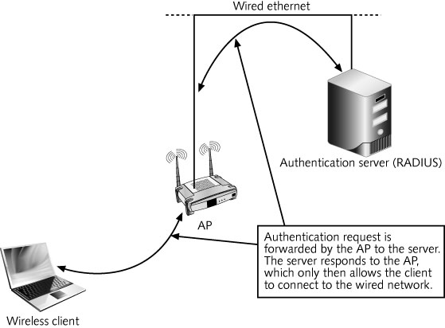
Figure 8-19 Securing a wireless network using a RADIUS server

Slide 54
802.11 Security
Virtual Private Networks (VPNs)
  Use an encrypted connection to create a virtual tunnel between two points
    Across a public or corporate network
  VPNs using strong encryption algorithms
    Most secure method of implementing a wireless network

Slide 55
Additional WLAN Security Strategies
Additional strategies
  Reduce WLAN transmission power
  Change the default security settings on the APs
  Antivirus and antispyware software
  Separate WLAN transmissions from wired network traffic
    Place a firewall between the WLAN and the wired LAN

Slide 56
Summary
Operating in the 2.4 GHz ISM frequency range, 802.11b has a maximum data rate of 11 Mbps
The 802.11a has a maximum rated speed of 54 Mbps
IEEE 802.11a networks use the Unlicensed National Information Infrastructure (U-NII) band
In 802.11a, 23 frequency channels can operate simultaneously
IEEE 802.11b WLAN reception is slowed down by multipath distortion
  802.11a solves this problem using OFDM

Slide 57
Summary
OFDM uses 48 of the 52 subchannels for data, while the remaining four are used for error correction
  Number of errors in an 802.11a transmission is significantly reduced
The 802.11a standard made changes only to the physical layer (PHY layer)
  Of the original 802.11 and 802.11b standard
802.11g preserves the features of 802.11b but increases the data transfer rates to those of 802.11a
802.11e standard adds QoS to 802.11 standards

Slide 58
Summary
The 802.11n amendment increases the data rate up to 600 Mbps using either the 2.4 GHz ISM or the 5 GHz U-NII band
The 802.11r amendment enables fast roaming and reduces the time required for a device to associate with a new AP
The 802.11ac amendment boosts the speed of WLANs up to nearly 7 Gbps

Slide 59
Summary
The new 802.11ad amendment operates in the 60 GHz band for short-range connections at up to 7 Gbps
WLANs can suffer a range of security attacks
WLANs can be protected through the use of VPNs, 802.11i and 802.1x for authentication and privacy

