Slide 1
Chapter 10 Wireless WIDE Area Networks
Reference: Jorge Olenewa, Guide to Wireless Communications, 3rd edition, ISBN-13: 9781111307318, 2013
© Cengage Learning 2014
Department of Computer Engineering, Faculty of Engineering Prince of Songkla University, Phuket Campus

Slide 2
Objectives
Describe wireless wide area networks (WWANs) and how they are used
List the types of applications that can be used on a digital cellular phone
Explain the basic concepts of how cellular telephony functions
Describes the various generations of cellular telephony
Discuss satellites and their applications in WWANs

Slide 3
Cellular Telephone Technology
Digital cellular telephones can be used to:
Browse the Internet
Send and receive short messages and e-mails
Participate in videoconferencing
Receive various sorts of information
Run a variety of business applications
Connect to corporate networks
Watch television or on-demand movies
Take and transmit pictures and short movies
Locate family members and employees using GPS

Slide 4
Cellular Telephone Technology
Short Message Services (SMS)
One of the most widely used applications
Allows for the delivery of short, text-based messages between cellular phones
Messages are limited to 160 characters
Applications
Person-to-person
Agent-to-person
Information broadcast services
Software configuration
Advertising

Slide 5
How Cellular Telephony Works
Keys to cellular telephone networks
Cells
Typical cell ranges from a few thousand feet (diameter) to approximately 10 square miles (26 square meters)
Cells may vary in radius from 1 to 30 kilometers
At the center of each cell is a cell transmitter connected to a base station
Each base station is connected to a mobile telecommunications switching office (MTSO)
Link between the cellular network and the wired telephone world
Controls all transmitters and base stations
Notes:
Cells may vary in radius from 1 to 30 kilometres (0.62 to 18.64 mi). The boundaries of the cells can also overlap between adjacent cells and large cells can be divided into smaller cells.

Slide 6
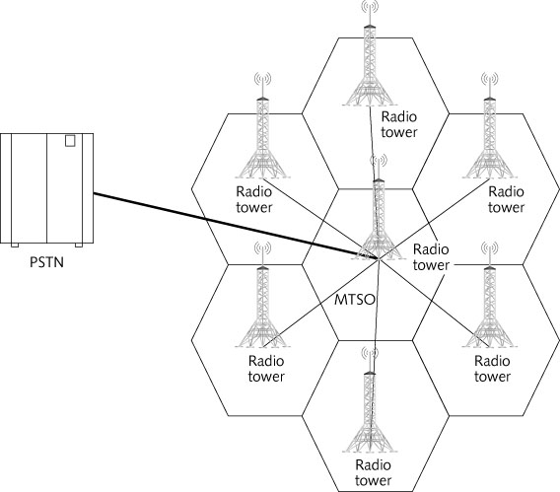
Figure 10-1 Cellular phone network

Slide 7
How Cellular Telephony Works
Keys to cellular telephone networks (cont’d)
Transmitters and cell phones operate at low power
Enables the signal to stay confined to the cell
Signal at a specific frequency does not go far beyond the cell area
Same frequency can be used in other cells at the same time
Except in adjacent cells

Slide 8
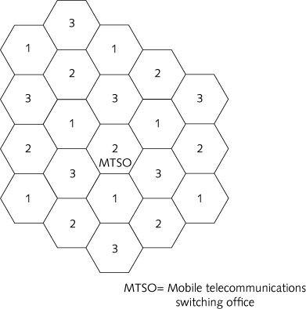
Figure 10-2 Frequency reuse with three frequencies

Slide 9
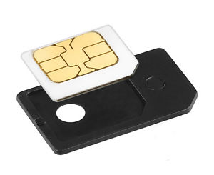
How Cellular Telephony Works
Cell phones have special codes
Codes are used to identify the phone, phone’s owner, and carrier or service provider (e.g., AIS, DTAC, TRUE)
Some cellular phones require a SIM card to be installed before they can be used

Slide 10
How Cellular Telephony Works
SIM (subscriber identity module) card – very small electronic card used to associate the phone with the user’s account and with the carrier
SIM cards have:
ROM between 64 KB and 512 KB
RAM between 1 KB and 8 KB
EEPROM between 64 KB and 512 KB
Users can move the card between one phone and another and use different phones without reprogramming
Notes:
SIM cards are like micro-computers and contain many of the same elements or components that one would find in a computer or PDA. SIM cards are composed of a CPU (Central Processing Unit) to execute programs and commands, a ROM unit for "program memory," a RAM unit for "working memory," an EPROM for "data memory" and a "Serial communication module" for communicating with the cell service provider's network. Read more : http://www.ehow.com/how-does_5369478_sim-cards-work.html
More: https://www.defcon.org/images/defcon-21/dc-21-presentations/Koscher-Butler/DEFCON-21-Koscher-Butler-The-Secret-Life-of-SIM-Cards-Updated.pdf

Slide 11
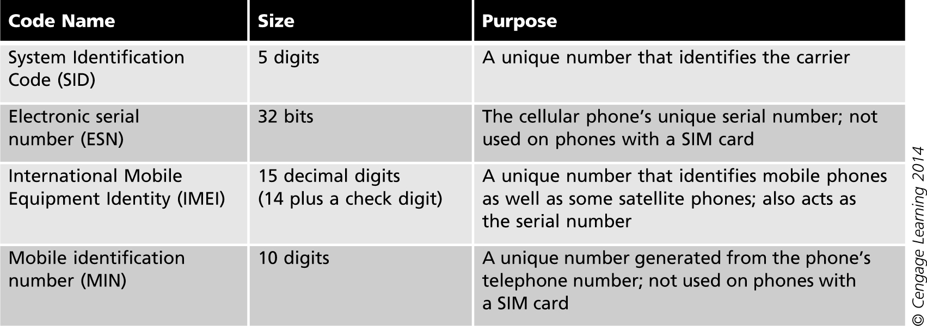
Table 10-1 Cellular phone codes
Notes:
SID = ISP (sent from ISP and store in SIM card)
ESN (CDMA phone) = IMEI (GSM) = phone serial number
IMSI = MCC + MNC + MIN
MCC = Country code
MNC = Network code (local area code)
MIN = phone number

Slide 12
How Cellular Telephony Works
When user moves within the same cell
Transmitter and base station for that cell handle all of the transmissions
As the user moves toward the next cell
A handoff process occurs
Roaming
User moves from one cellular network to another

Slide 13
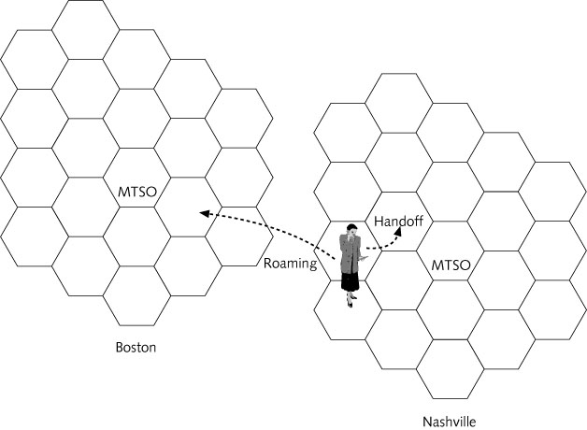
Figure 10-4 Handoff and roaming

Slide 14
How Cellular Telephony Works
Steps to receive a call
Cell phone listens for the SID being transmitted by the base station on the control channel
Phone compares SID with its programmed SID
If they match, phone is in a network owned by carrier
If SIDs do not match, phone is roaming
When a call comes in, MTSO locates the phone through the registration request
User can move to another cell
Phone and transmitter can change frequencies as required

Slide 15
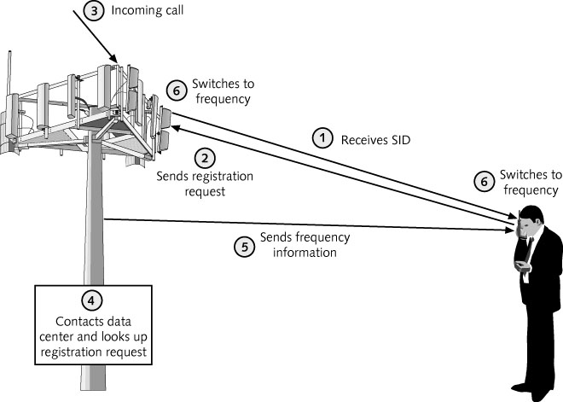
Figure 10-5 Receiving a call on a cellular phone

Slide 16
Evolution of Cellular Telephony
Cellular phones have been available since the early 1980s in the United States
Most industry experts outline several generations of cellular telephony

Slide 17
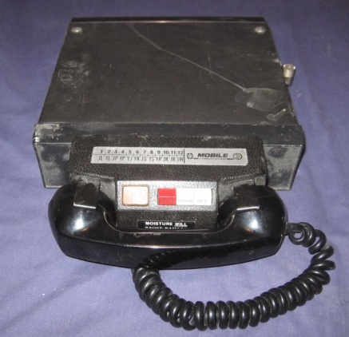
Cellular Network Generations
It is useful to think of cellular Network/telephony in terms of generations:
0G: Briefcase-size mobile radio telephones
1G: Analog cellular telephony
2G: Digital cellular telephony
3G: High-speed digital cellular telephony (including video telephony)
4G: IP-based “anytime, anywhere” voice, data, and multimedia telephony at faster data rates than 3G (2012–2015)
5G: Super fast/efficient Mobile network (converged fiber, 2020)
From: ftp://ftp.kemt.fei.tuke.sk/MobilneKomunikacie/ _materialy/Podklady/10_IPv6_summit.ppt

Slide 18
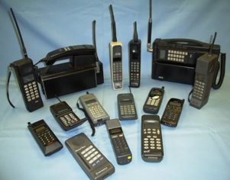
First Generation Cellular Telephony
First Generation (1G)
Uses analog signals modulated using FM
Based on Advanced Mobile Phone Service (AMPS)
Operates in the 800-900 MHz frequency spectrum
Each channel is 30 KHz wide with a 45 KHz passband
There are 832 frequencies available
Uses Frequency Division Multiple Access (FDMA)
FDMA allocates a single cellular channel with two frequencies to one user at a time
1G networks use circuit-switching technology
http://www.cntr.salford.ac.uk/comms/etacs_mobiles.php

Slide 19
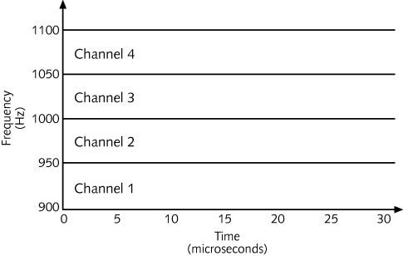
Figure 10-6 FDMA

Slide 20
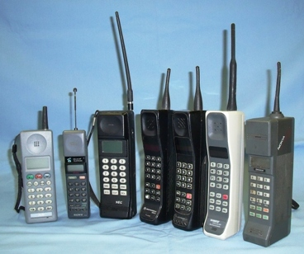
First Generation Cellular Telephony
Circuit-switching technology
Makes a dedicated and direct physical connection
Between the caller and the recipient
Analog signals are prone to interference
Do not have the same quality as digital signals

Slide 21
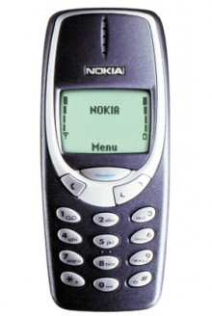
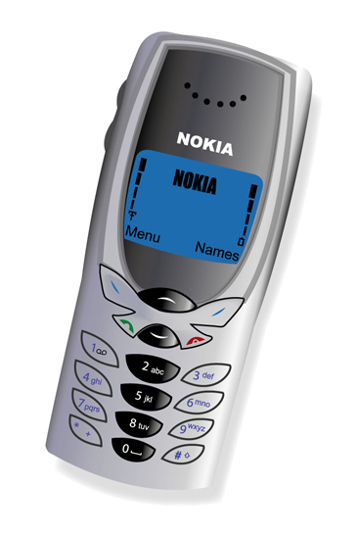
Second Generation Cellular Telephony
Second Generation (2G)
Transmits data between 9.6 Kbps and 14.4 Kbps
In the 800 MHz and 1.9 GHz frequencies
2G networks are also circuit-switching
2G systems use digital transmissions
Digital transmissions
Use the frequency spectrum more efficiently
Over long distances, the quality of the voice transmission does not degrade
Difficult to decode and offer better security

Slide 22
Second Generation Cellular Telephony
Digital transmissions (cont’d)
Use less transmitter power
Enable smaller and less expensive individual receivers and transmitters
Multiple access technologies
Time Division Multiple Access (TDMA)
Code Division Multiple Access (CDMA)
Global System for Mobile communications (GSM)
Uses a combination of FDMA and TDMA technologies

Slide 23
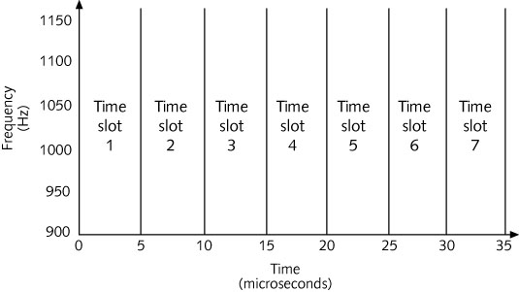
Figure 10-7 TDMA

Slide 24
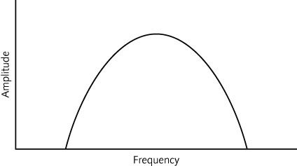
Figure 10-8 CDMA

Slide 25
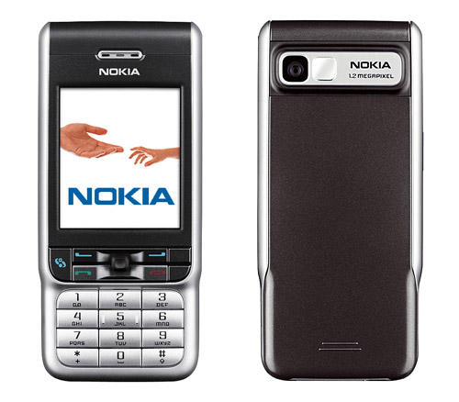
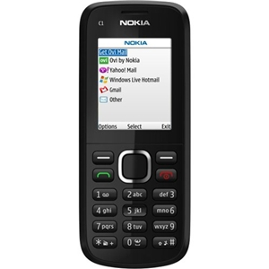
2.5 Generation Cellular Telephony
2.5 Generation (2.5G)
Interim step between 2G and 3G
Operates at a maximum speed of 384 Kbps
Primary difference between 2G and 2.5G:
2.5G networks are packet-switched
Advantages of packet switching
Much more efficient
Can handle more transmissions over a given channel
Permits an always-on connection

Slide 26
2.5 Generation Cellular Telephony
Three 2.5G network technologies
General Packet Radio Service (GPRS)
For TDMA or GSM 2G networks
Uses eight time slots in a 200 KHz spectrum and four different coding techniques to transmit at 114 Kbps
Enhanced Data rates for GSM Evolution (EDGE)
Can transmit up to 384 Kbps
Based on a modulation technique called 8-PSK
CDMA2000 1xRTT (1-times Radio Transmission Technology)
Operates on two 1.25 MHz-wide frequency channels
Supports 144 Kbps packet data transmission

Slide 27
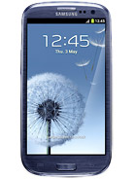
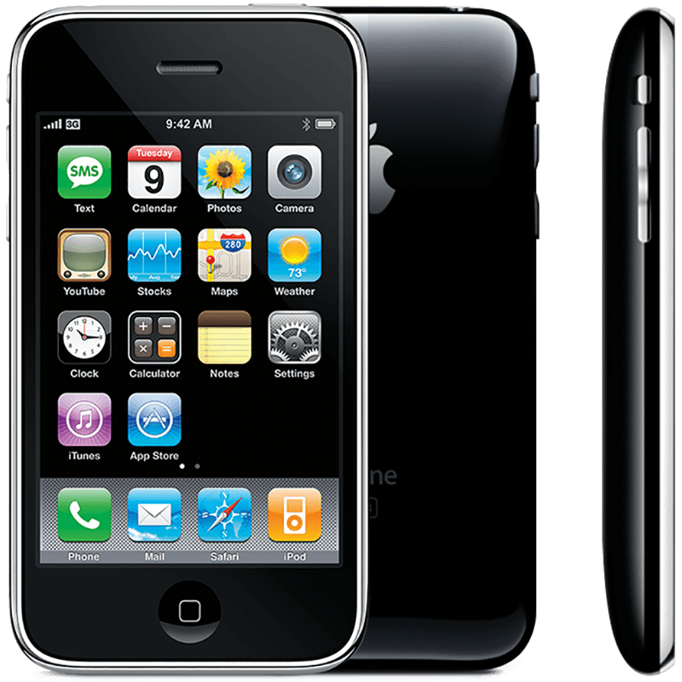
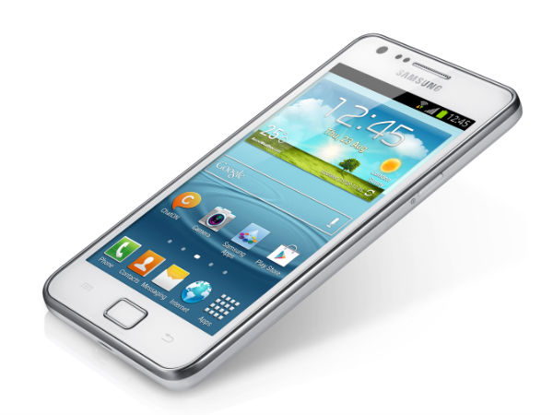
Third Generation Cellular Telephony
Third Generation (3G)
Intended to be a uniform and global standard for cellular wireless communication
Standard data rates
144 Kbps for a mobile user
386 Kbps for a slowly moving user
2 Mbps for a stationary user
3G network technologies
CDMA2000 1xEVDO
For 2.5G CDMA2000 1xRTT networks

Slide 28
Third Generation Cellular Telephony
3G network technologies (cont’d)
CDMA2000 1xEVDV is the successor of CDMA2000 1xEVDO
Wideband CDMA (W-CDMA)
For 2.5G EDGE networks
High-Speed Downlink Packet Access (HSDPA)
Beyond W-CDMA
Uses a 5 MHz W-CDMA channel, variety of adaptive modulation, multiple in multiple out (MIMO) antennas, and hybrid automatic repeat request (HARQ)

Slide 29
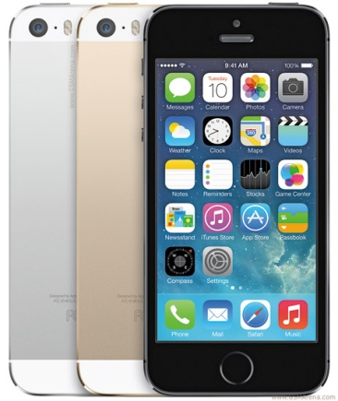
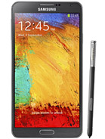
Third Generation Cellular Telephony
3G network technologies (cont’d)
HSPA+ (also called Evolved HSPA) – successor to HSDPA
Provides theoretical data rates up to 168 Mbps on the downlink and 22 Mbps on the uplink
Provides an upgrade path to latest-generation technology: LTE (Long Term Evolution)
LTE (also known as 4G)
LTE Advanced: expands on LTE by allowing carriers to combine up to five 20-MHz-wide frequency channels
Maximum downlink data rate: up to 1 Gbps
Notes:
HSPA+: IP4, IP4S, S3
4G LTE:
IP5, IP5S, IP5C, IP6Plus
SS Note 3, S4, S5

Slide 30
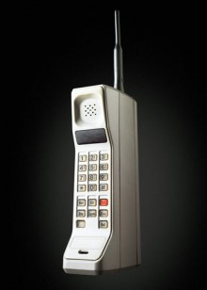
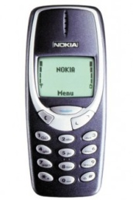
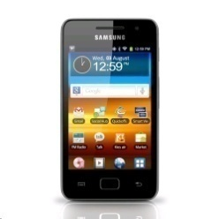
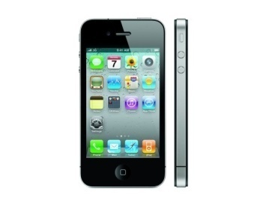
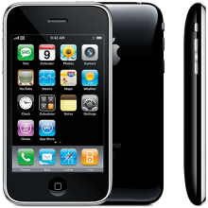
Figure 10-9 Cellular technology migration paths

Slide 31
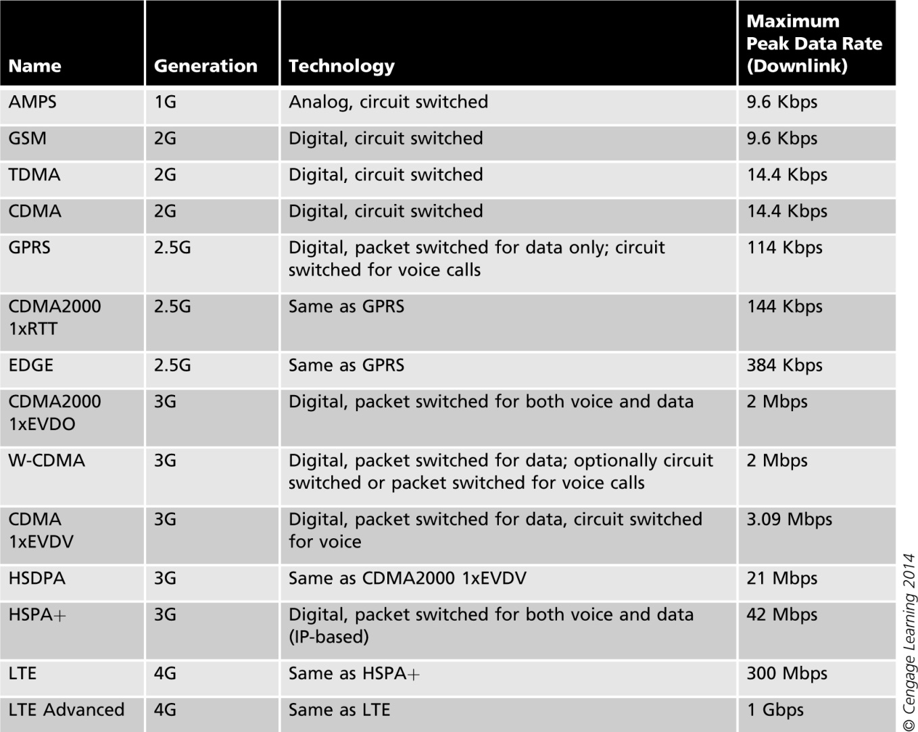
Table 10-2 Digital cellular technologies

Slide 32
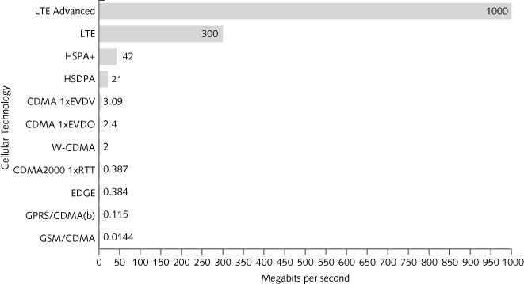
Figure 10-10 Comparison of data-rate speeds for various cellular technologies

Slide 33
Limited Spectrum
Spectrum
Single largest factor limiting the development of 3G
Although 3G and 4G can operate at almost any spectrum
Industry tries to use the same part of the spectrum for communications around the world
1.710 to 1.855 GHz and 2.520 to 2.670 GHz
In North America, the 700 MHz band (formerly used for analog television), is also being used for cellular networks

Slide 34
Costs
Monthly service fees for data transmission can be expensive
User cost for cellular phone service pales in comparison to costs for the carriers to build and constantly upgrade cellular networks
In 2001, Germany paid over $46 billion for licenses to use the spectrum

Slide 35
Satellite Broadband Wireless
Use of satellites for personal wireless communication is fairly recent
Satellite use falls into three broad categories
Satellites are used to acquire scientific data and perform research in space
Satellites look at Earth from space
Satellites are used as reflectors that bounce or relay signals from one point on Earth to another
Wireless communications falls under this use of satellites

Slide 36
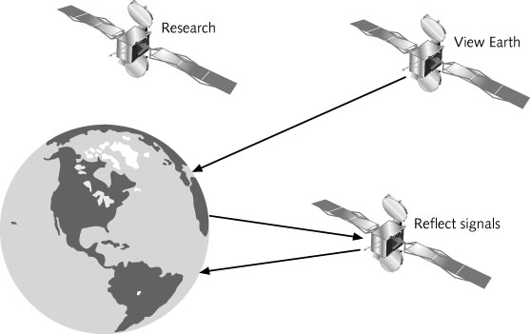
Figure 10-11 Three types of satellites

Slide 37
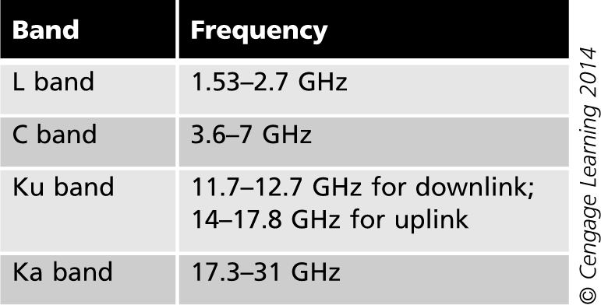
Satellite Transmissions
Satellites generally send and receive on one of four frequency bands
Frequency band affects the size of the antenna
Table 10-3 Satellite frequencies

Slide 38
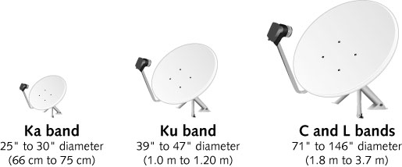
Figure 10-12 Satellite antenna sizes

Slide 39
Satellite Transmissions
Class and Type of Service
Satellites can provide two classes of service
Consumer class service
Shares the available bandwidth between the users
Business class service
Offers dedicated channels with dedicated bandwidth
More expensive
Types of connectivity
Point-to-point, point-to-multipoint, and multipoint-to-multipoint

Slide 40
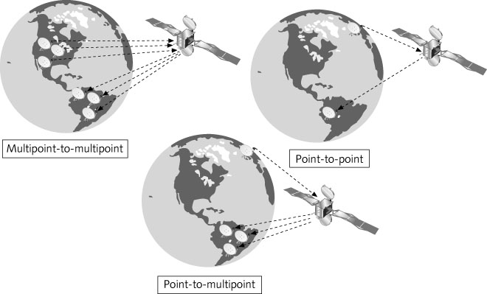
Figure 10-13 Types of satellite service

Slide 41
Satellite Transmissions
Modulation techniques
Binary phase shift keying (BPSK) – Shifts the starting point of a carrier wave by 180 degrees
Quadrature phase shift keying (QPSK) – Shifts the starting point of the carrier wave by 90 degrees
Eight-phase shift keying (8-PSK) – Can transmit up to 3 bits per symbol
16-level quadrature amplitude modulation (16-QAM) – Primarily used for sending data downstream; considered efficient but is susceptible to interference

Slide 42
Satellite Classification
Satellite systems are classified according to the type of orbit they use
Three orbits:
Low earth orbit (LEO)
Medium earth orbit (MEO)
High earth orbit (HEO)
Most HEO satellites fall into a subclass called geosynchronous earth orbit (GEO)

Slide 43
Low Earth Orbit (LEO)
Low earth orbit (LEO) satellites
Circle the Earth at altitudes between 200 to 900 miles
Must travel at high speeds
So that the Earth’s gravity will not pull them back into the atmosphere
Area of Earth coverage (called the footprint) is small
LEO systems have a low latency
Use low-powered terrestrial devices (RF transmitters)
Round trip time: 20 to 40 milliseconds for a signal to bounce from an Earth-bound station to a LEO, then back to an Earth station

Slide 44
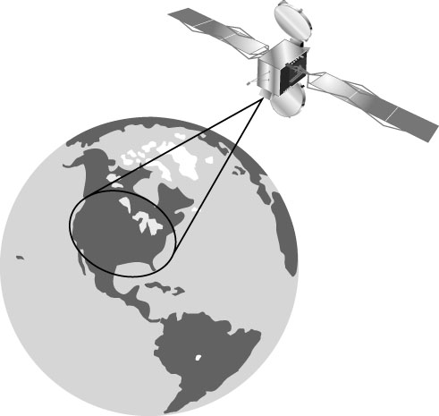
Figure 10-14 LEO footprint

Slide 45
Low Earth Orbit (LEO)
LEO satellites groups
Little LEOs
Frequencies below 1 GHz
5MHz of bandwidth, Data rates up to 10 kbps
Provides pager, satellite telephone, and location services
Big LEOs
Frequencies above 1 GHz
Support data rates up to a few mbps
Carries voice and data broadband services, such as wireless Internet access
In the future, LEOs are expected to be in demand for three markets:
Rural conventional telephone, global mobile digital cellular, and international broadband services

Slide 46
Medium Earth Orbit (MEO)
Medium earth orbit (MEO) satellites
Orbit the Earth at altitudes between 1,500 and 10,000 miles
Some MEO satellites orbit in near-perfect circles
Have a constant altitude and constant speed
Other MEO satellites revolve in elongated orbits called highly elliptical orbits (HEOs)
Advantages
MEOs do not have to travel as fast; a MEO can circle the Earth in up to 12 hours
Have a bigger Earth footprint

Slide 47
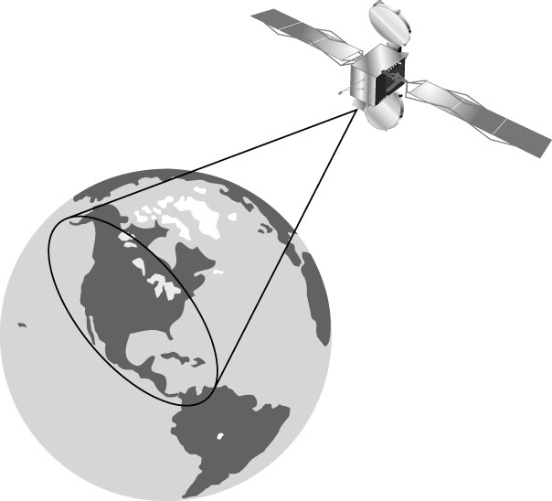
Figure 10-15 MEO footprint

Slide 48
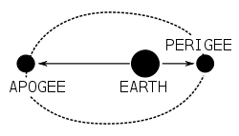
Medium Earth Orbit (MEO)
MEO Disadvantage
Higher orbit increases the latency
Round trip time: 50 to 150 milliseconds
HEO satellites (High Earth Orbit)
Have a high apogee (maximum altitude) and a low perigee (minimum altitude)
Can provide good coverage in extreme latitudes
Orbits typically have a 24-hour period

Slide 49
Geosynchronous Earth Orbit (GEO)
Geosynchronous earth orbit (GEO) satellites
Stationed at an altitude of 22,282 miles (35,860 km)
Orbit matches the rotation of the Earth
And moves as the Earth moves
Can provide continuous service to a very large footprint
Three GEO satellites are needed to cover the Earth
Have high latencies of about 250 milliseconds
Require high-powered terrestrial transmitting devices

Slide 50
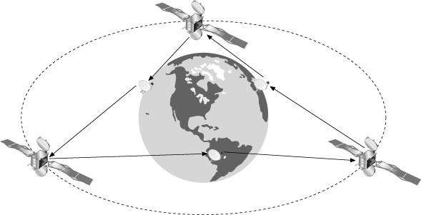
Figure 10-16 Three GEO satellites covering the entire planet

Slide 51
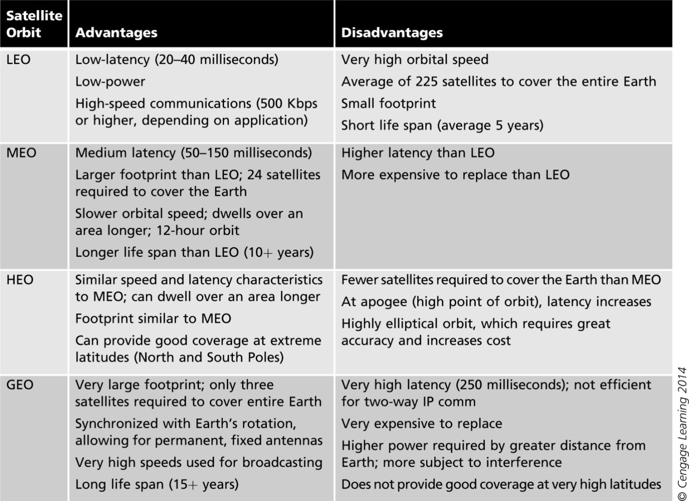
Table 10-4 Satellite orbit advantages and disadvantages

Slide 52
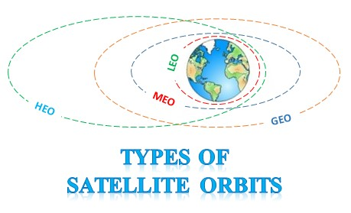
Satellite orbits
 | Distance (km) | Period
Low Earth Orbit (LEO) | 700 - 2000 | ~2 hr
Medium Earth Orbit (MEO) | 10,000 – 15,000 | 6-12 hr
Geosynchronous Earth Orbit (GEO) | 36,000 | 24 hr
From: Omer, Satellite Networks Research Laboratory (SATLAB)

Slide 53
Satellite Technology Outlook
Satellites can provide wireless communication
In areas not covered by cellular or WiMAX
Satellites today are enabling carriers to offer
Internet access and voice calls to passengers and crews across large oceans
And in high latitudes and remote corners of the Earth
Can also make these services available in many other unpopulated areas

Slide 54
Summary
In cellular telephone networks, the coverage area is divided into sections called cells
Some cellular phones use SIM cards to store user and carrier information
First Generation (1G) cellular technology uses analog signals and a circuit-switching technology to transmit data at a maximum speed of 9.6 Kbps
Second Generation (2G) can transmit data between 9.6-14.4 Kbps using digital signals instead of analog signals

Slide 55
Summary
2.5G networks transmit data at a maximum speed of 384 Kbps and uses a packet-switched technique
3G networks provide new and expanded capabilities and data applications features to mobile users
4G networks achieve data rates comparable to wired networks
Long Term Evolution (LTE) technology
One of the most widely used applications in the world today is Short Message Services (SMS)
Allows for delivery of short, text-based messages

Slide 56
Summary
Satellites used for wireless data connectivity
Employ common modulation and multiplexing techniques
Satellite orbit types
LEO satellites
MEO satellites
GEO satellites

