Slide 1
#10
Blockchain
240-311 Distributed Computers and Web Technologies (3-0-6)

Slide 2
Outline
Trust and problem
Why Blockchains
How it works
Blockchain benefits
Blockchain types
Hyperledger composer
  Scenario: carauction

Slide 3
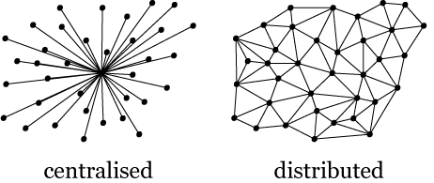
Trust and problem
Cons of centralized architecture
  Fault tolerance
  Attack resistance
  Collusion resistance
Bitcoin paper: https://bitcoin.org/bitcoin.pdf
Notes:
Fault tolerance— decentralized systems are less likely to fail accidentally because they rely on many separate components that are not likely.
Attack resistance— decentralized systems are more expensive to attack and destroy or manipulate because they lack sensitive central points that can be attacked at much lower cost than the economic size of the surrounding system.
Collusion resistance — it is much harder for participants in decentralized systems to collude to act in ways that benefit them at the expense of other participants, whereas the leaderships of corporations and governments collude in ways that benefit themselves but harm less well-coordinated citizens, customers, employees and the general public all the time.
Ref: https://medium.com/@VitalikButerin/the-meaning-of-decentralization-a0c92b76a274

Slide 4
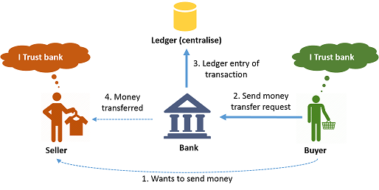
Why Blockchain
Notes:
https://www.c-sharpcorner.com/article/basics-of-blockchain/

Slide 5
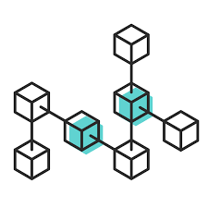
Blockchain
Blockchain is a growing list of records, called blocks, which are linked using cryptography.
Each block contains a cryptographic hash of the previous block, a timestamp, and transaction data.
Notes:
(https://en.wikipedia.org/wiki/Blockchain)

Slide 6
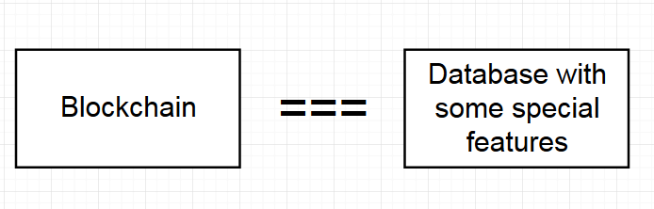
Blockchain
Simple definitions
Notes:
https://medium.com/coinmonks/ethereum-blockchain-hello-world-smart-contract-with-java-9b6ae2961ad1

Slide 7
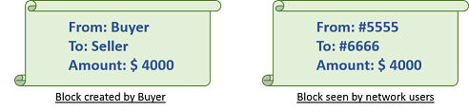
How Blockchain works?
Remove dependency on third party trust
  form a group of Members, termed as a NETWORK.
Terms
  Members
  Ledgers
  Block

Slide 8
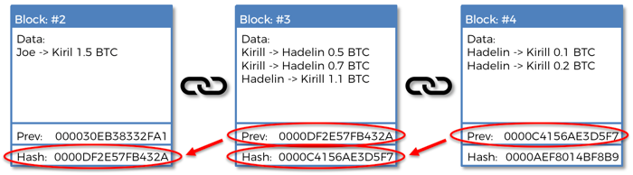
Blocks are chained (Linked)
Hash directly affects the value of the current block’s hash.
if anyone were to tamper with any given block’s data, ALL of the following blocks’ hashes invalid.
Notes:
https://medium.com/swlh/how-does-bitcoin-blockchain-mining-work-36db1c5cb55d

Slide 9
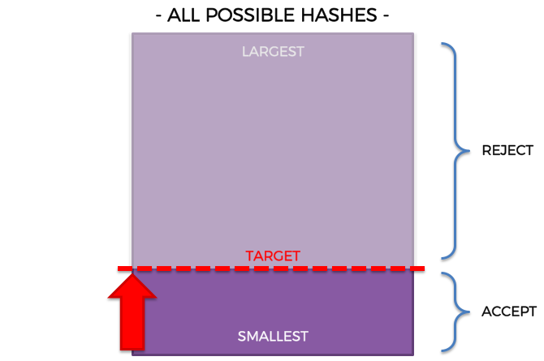
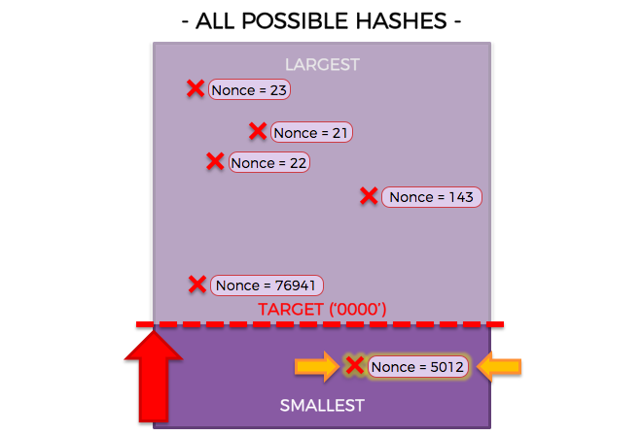
Nonces
Miners compete to find a Nonce (also called a Golden Nonce)
5012 is the smallest one which is closest to ‘0000’ (4 digits)
Notes:
https://medium.com/swlh/how-does-bitcoin-blockchain-mining-work-36db1c5cb55d
Number used ONly onCE

Slide 10
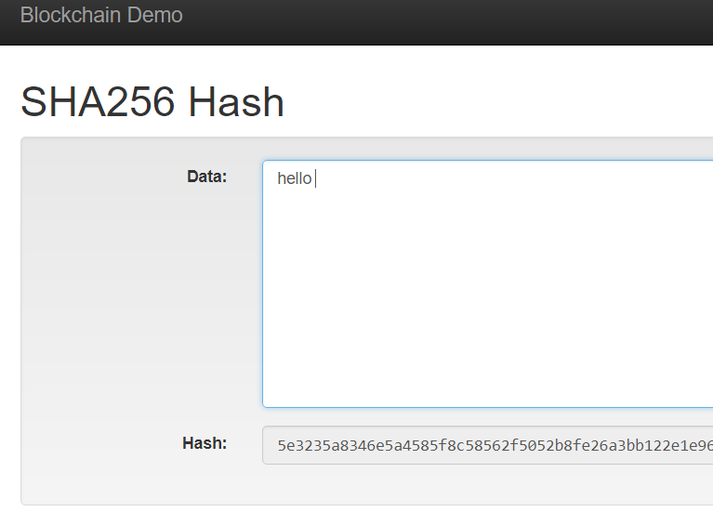
Hash demo
https://anders.com/blockchain/hash.html

Slide 11
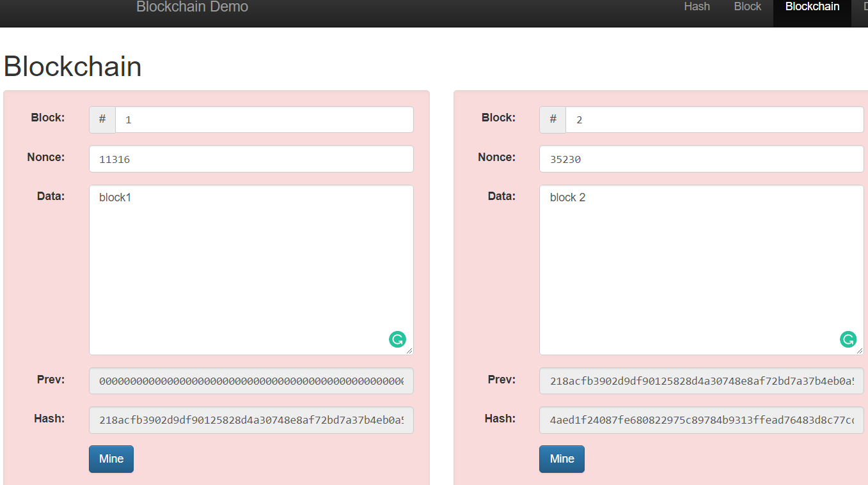
Nonce and miner demo
https://anders.com/blockchain/blockchain.html

Slide 12
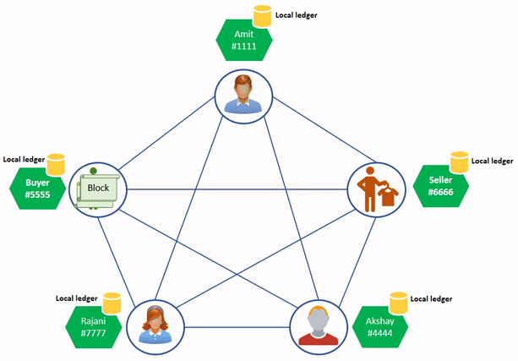
Distributed Blocks
Notes:
Buyer wants to transfer a fund to the seller, so he/she will create a block with details like from user's name, to user's name, and amount. And he/she will broadcast the block to all network users. Users can see network IDs of from and to user (not the exact user names) and amount.
Users will validate the block by checking balance of Buyer account, if he has sufficient balance, transaction will be approved and every user will add this block to their ledgers.
When user creates a block, user also needs to send digitally signed data with the block. User will have private key associated with the account to sign the data. Other network users will verify transaction by providing public key to validation algorithm.

Slide 13
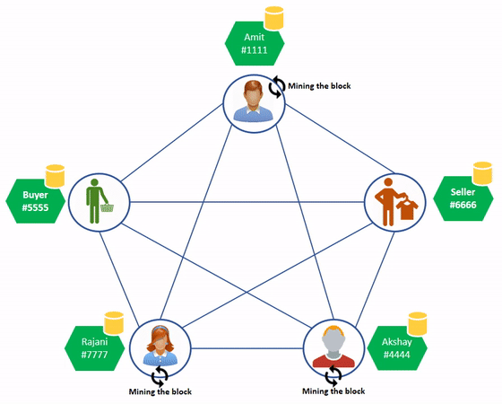
Mining
Proof of work
Notes:
There is puzzle associated with the block. After validating the transaction data, network users need to solve this puzzle to publish the block as valid block to other users. This is a mathematical puzzle which involves Hash Function. Hash function is a one way function which does complex mathematical operations on input data and gives output. It is difficult to find out input data by looking at the output. Hence, it is also called irreversible.
Let's take an example. The puzzle is to find out the value of ‘x’ where x is previous block hash and current transaction data when provided to HASH function, it will give output data starting with string ‘4444’ (like 4444……….667)
To find out value of ‘x’, users need to try different values of ‘x’ and feed it to HASH function to see the output. This will consume CPU for processing. The more CPUs you have, the faster you can solve the puzzle. Those who take part in solving puzzles are called as MINERS. They are mining the block by computing efforts.
One who solves the puzzle, will broadcast the block with value of ‘x’ i.e. solution of puzzle named as ‘nonce’. Other users will check output by passing nonce value and other parameters to hash function. If the majority of users agree, the block will be added to the individual ledgers.
In our case, if Akshay (#4444) mined the block, he will send block with nonce value to all users. They will verify the nonce value and if valid, they will update respective ledgers. This is how ledgers will be kept updated. If in future, anyone tampered with the block data, this ‘nonce’ will allow network users to check integrity of block data.

Slide 14
Blockchain benefits
Traceability
Enhanced security
  Update through consensus
  Immutable (process integrity)
Efficiency and speed
  Fast processing with distributed technologies
Reduced costs

Slide 15
Blockchain scenario examples
Electronic voting
Car auction
Land lord and title deed
  In the case of untrusted government
    Blockchain helps to prove that you are the real landlord without a title deed issued by untrusted government
Room/Hotel business
  No any centralized agent, room owners and renters are directly connected through smart contracts
Money changer
  Less exchange fee, fast (without physical boundary) and secure

Slide 16
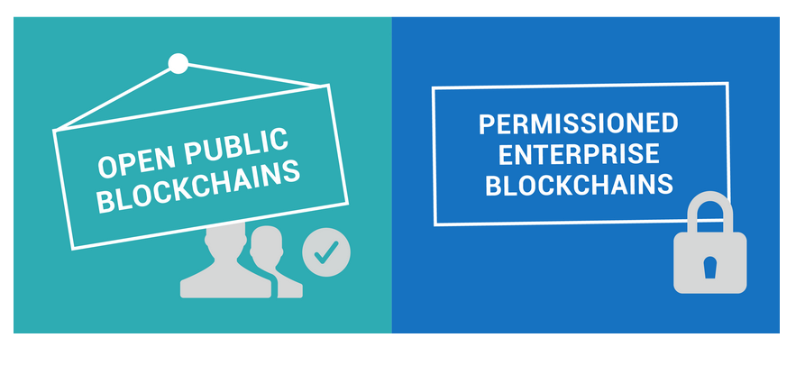
Blockchain types
Public Blockchains
  All participants are anonymous members
    Not suitable for business
  Competition (Proof of Works)
  Crypto currency & Reward
Private Blockchains (or Permissioned Blockchains)
  Permissioned DLT – Distributed Hyperledgers
  Identity module & Confidential transaction
  No Cryptocurrency & programmable (automate business logic)
  No competition (and incentive) since participants are identified
    Participants will be kicked out if they are cheating
Notes:
https://medium.com/coinmonks/ethereum-blockchain-hello-world-smart-contract-with-java-9b6ae2961ad1

Slide 17
Private Blockchains
Enterprise blockchains developer
Tools for full stack blockchains:
  Hyperledger composer
    Focus on business network:
      participants, identity, assets, transaction
    Blockchain applications (DApp)
  Hyperledger fabric
    Focus on peers, chaincode, consensus
    Backend blockchains

Slide 18
Hyperledger Composer
Hyperledger Composer is an extensive, open development toolset and framework to make developing blockchain applications easier.
It simplifies application development on top of the Hyperledger Fabric blockchain infrastructure
  which allows components, such as consensus and membership services, to be plug-and-play.
Model a business network and integrate existing systems and data with the blockchain applications.
Notes:
https://www.outsystems.com/blog/posts/building-blockchain-enabled-app/

Slide 19
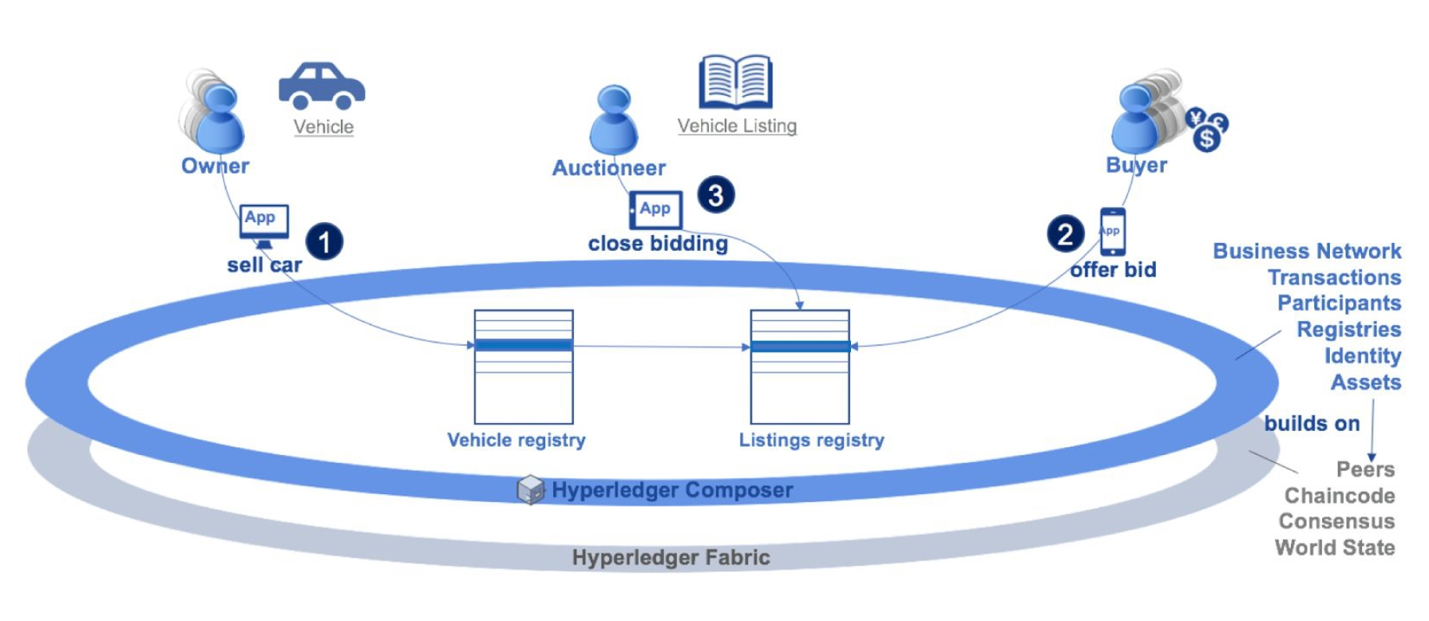
Hyperledger Composer & Fabric
Notes:
https://www.infoq.com/articles/blockchain-poc-hyperledger

Slide 20
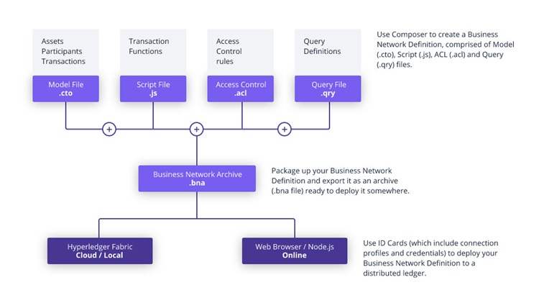
Hyperledger Composer
Composer abstracts the Blockchain complexities

Slide 21
Hyperledger composer experiment
Carauction

Slide 22
Business network: Car Auction
The model implements:
  3 member participants:
    Paul: Owner,
    Warodom and Kevin: Buyer (bidding)
  Two assets:
    A vehicle: a car with id (9999)
    A vehicle listing: declare for bidding offer (carListing)
  Two transactions:
    Making an offer (bid) on a car and closing a bid on an auction.

Slide 23
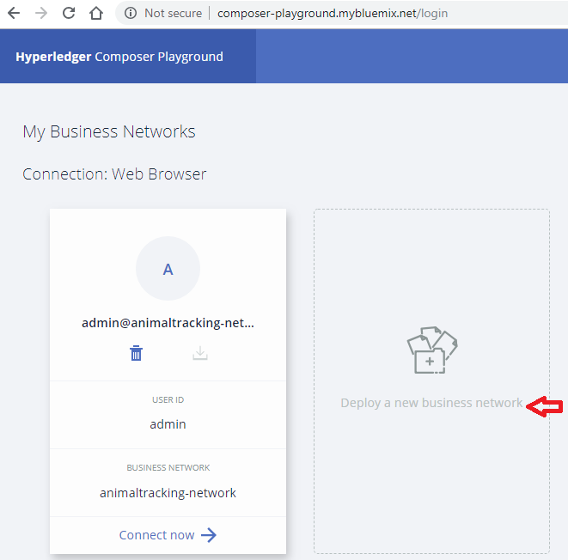
Experiment
http://composer-playground.mybluemix.net/
Select deploy a new business network

Slide 24
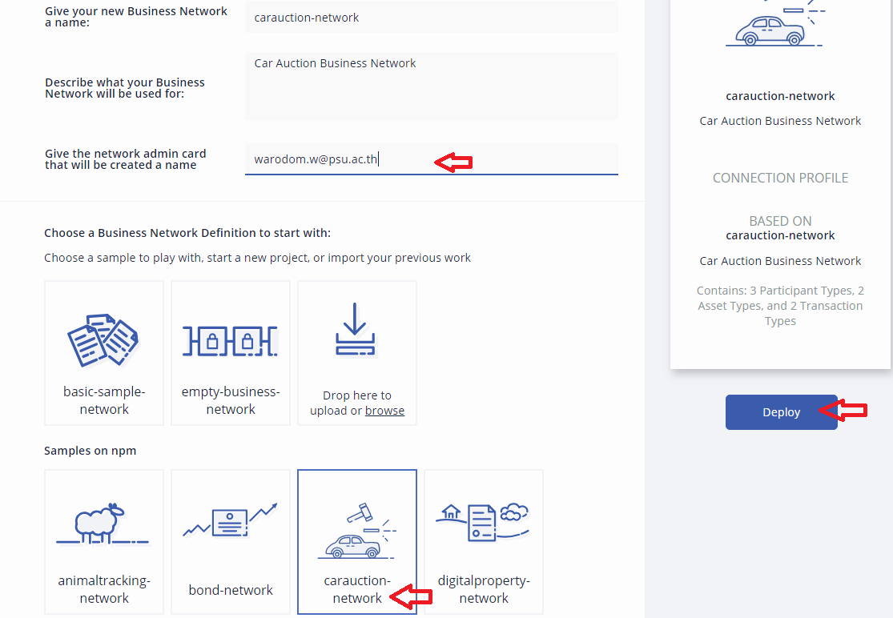
Experiment
2
3
Select
carauction-network
Enter an email
Deploy
1

Slide 25
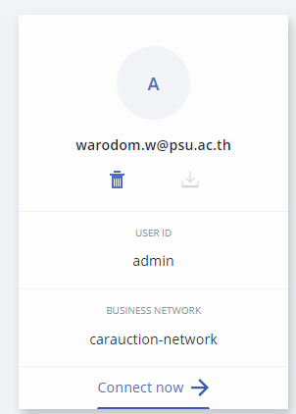
Connect to carauction
Hyperledger fabric for blockchain network is provided by the web site.
We focus on Business network (caracution) as DApp only.
Scenario:
  1 member who wants to sale a car
  2 members who wants to buy a car from this auction system
Connect now

Slide 26
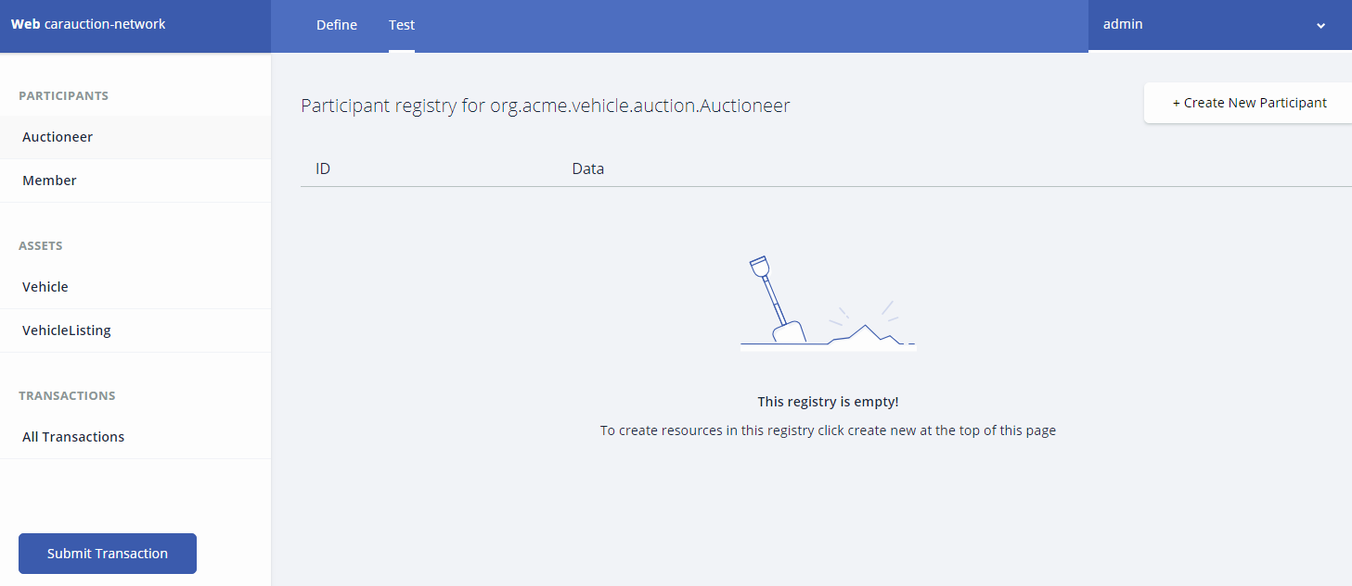
Test carauction network
Ready to implement business network

Slide 27

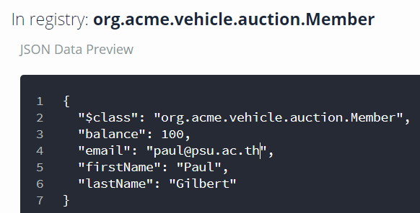
Create participants
3 member participants
  Paul Gilbert as a car owner
  Warodom Werapun as a buyer
  Kevin Durant as another buyer
No Auctioneer on this experiment

Slide 28
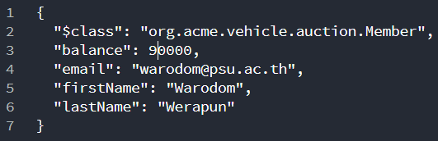
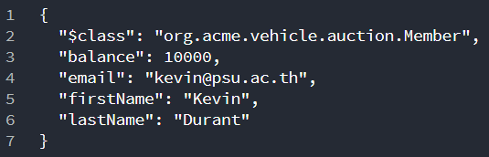
Create 2 more participants

Slide 29
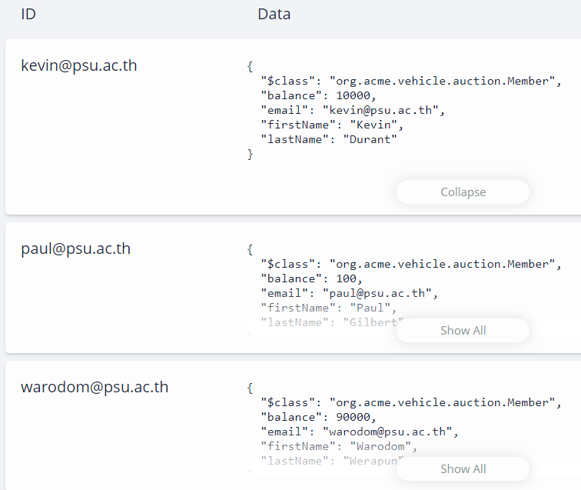
All member participants

Slide 30
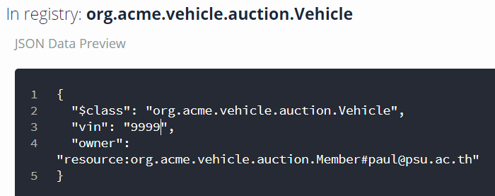
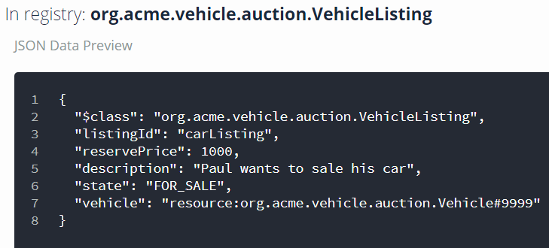
Create asset and asset listing
Create vehical and vehicalListing
Asset id ( car id)
Car owner

Slide 31
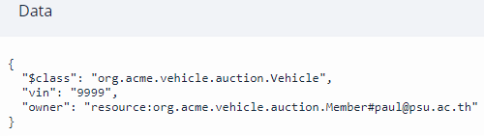
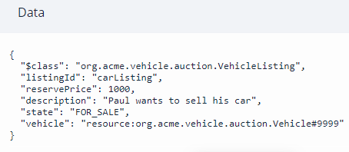
Asset and asset listing
car
carListing

Slide 32
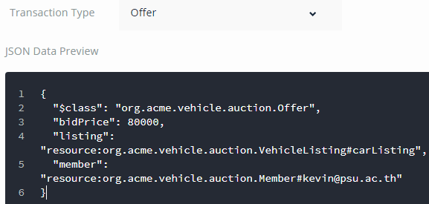
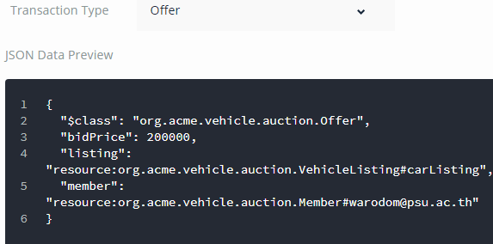
Submit transaction
Bidding Offer
Kevin places ‘Bidding offer’ at 80,000 baht
Warodom offer at 200,000 baht
Paul will close bidding and let see the winner

Slide 33
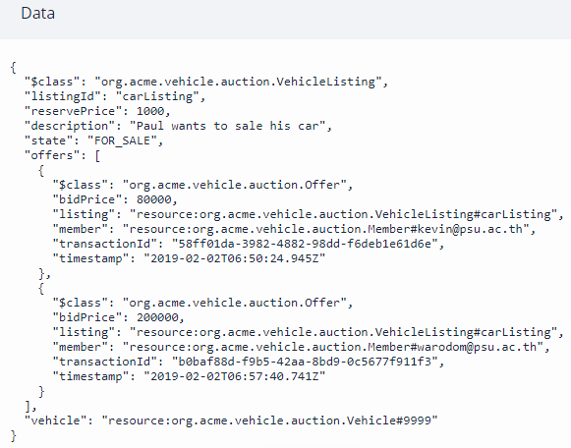
After place bidding offer

Slide 34
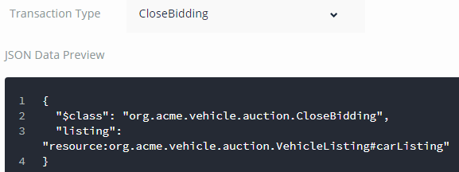
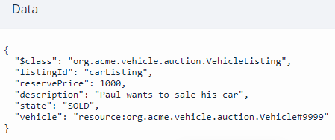
Submit transaction
State is changed

Slide 35
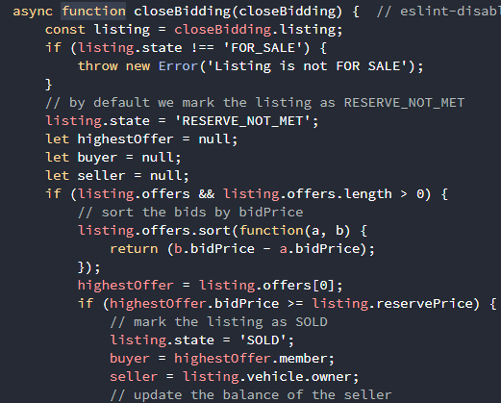
Place close bidding
Smart contract in lib/logic.js is called:
async function closeBidding(closeBidding)

Slide 36
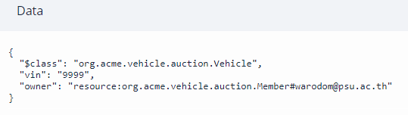
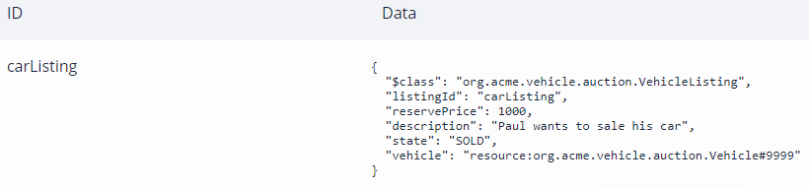
Asset owner is changed
carListing is automatically updated asset state to be “SOLD”.

Slide 37
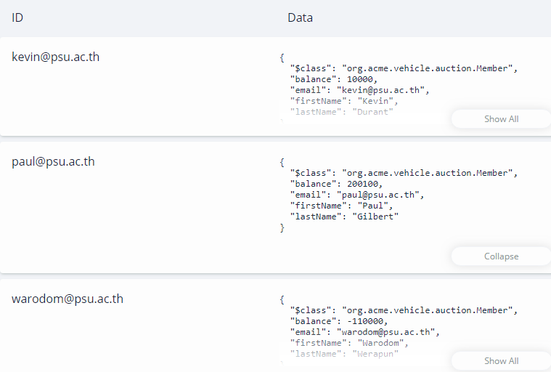
Money is transferred
Update

Slide 38
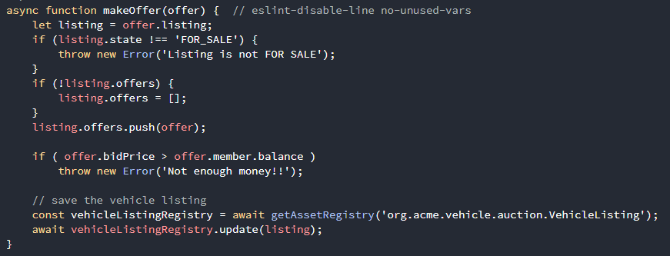
Check a buyer wallet
Edit lib/logic.js to check bidPrice with member balance

Slide 39
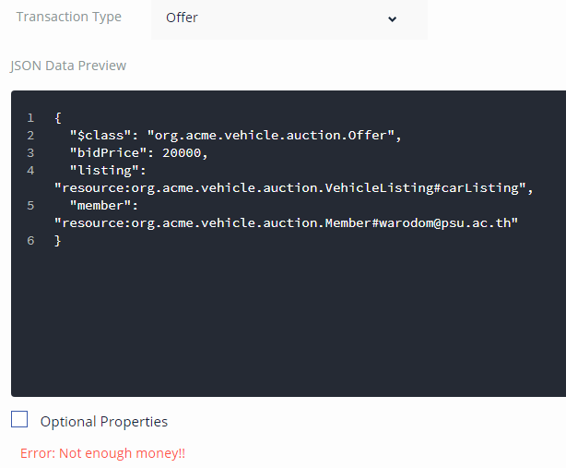
Not allow to place bidding

Slide 40
References
https://www.c-sharpcorner.com/article/basics-of-blockchain/
https://en.wikipedia.org/wiki/Blockchain
https://medium.com/swlh/how-does-bitcoin-blockchain-mining-work-36db1c5cb55d
https://anders.com/blockchain
https://hyperledger.github.io/composer/latest/tutorials/playground-tutorial.html

